Slide 1

Fáilte go Naíscoil agus Bunscoil Bheanna Boirche!
Dé Máirt 10ú Meitheamh 2025
Tuesday 10th June 2025

Slide 2

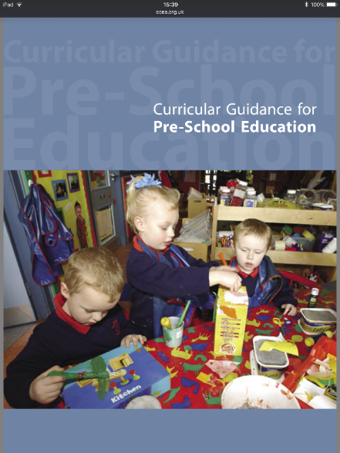
Curaclam Curriculum
Our pupils will be following the Northern Ireland Pre-School Curriculum as set out by the Department of Education.
This includes Personal, Social and Emotional Development, Physical Development, Language Development, Early Numeracy, The Arts and The World Around Us.

Slide 3
Curaclam (ar lean…) Curriculum (continued…)
At Naíscoil / Nursery level, the whole curriculum is delivered through play-based learning. Children learn to problem-solve, take turns, share, explain their methods and extend their vocabulary and communication skills through language-rich, adult supervised/led play experiences. They will cover real-life topics such as ‘Animals’, ‘The Body’ and ‘Clothes’, ‘People’, ‘The House’, ‘Travel’, etc. as well as covering seasons, festivals, celebrations, etc..

Slide 4
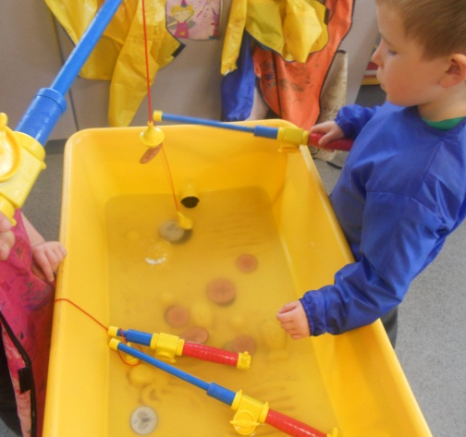
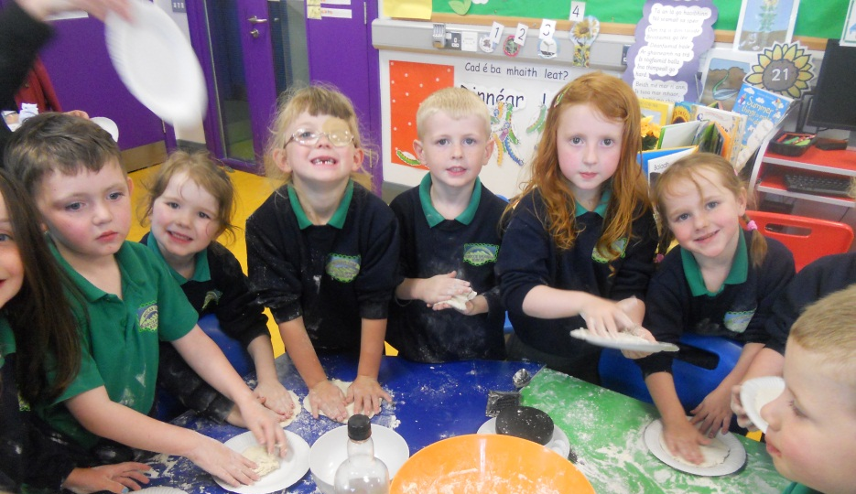
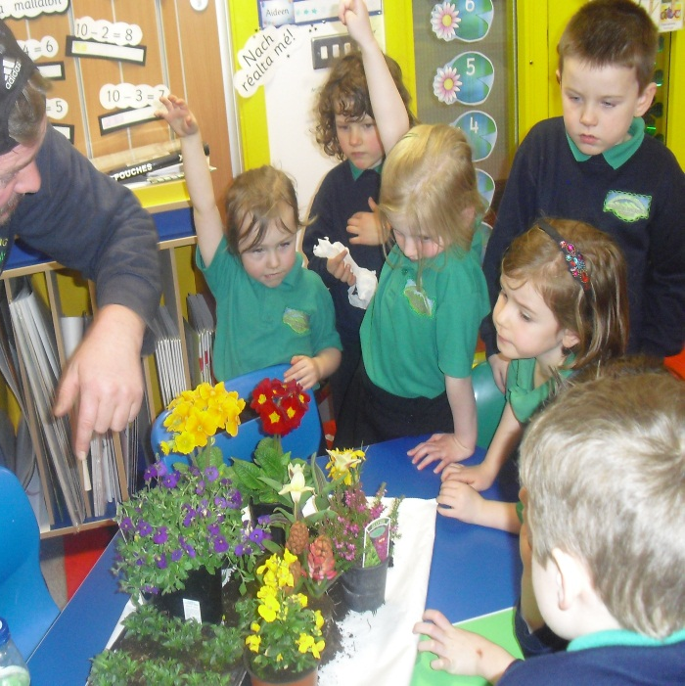
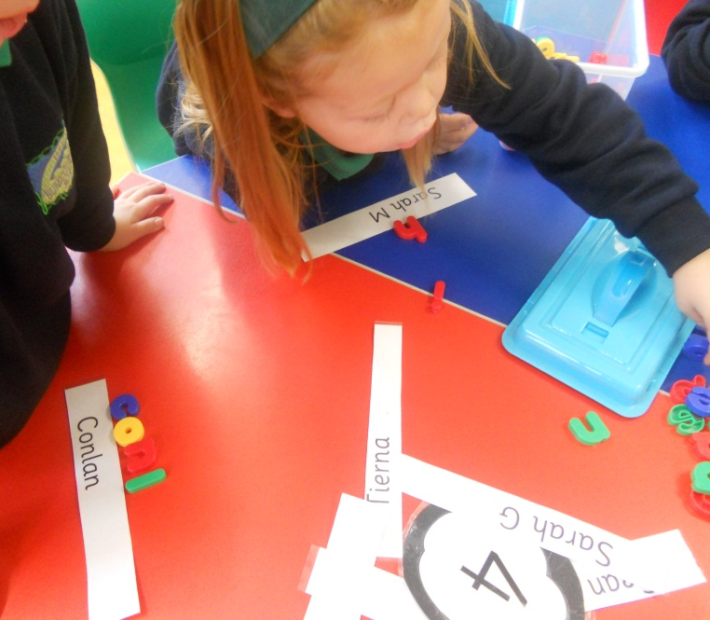
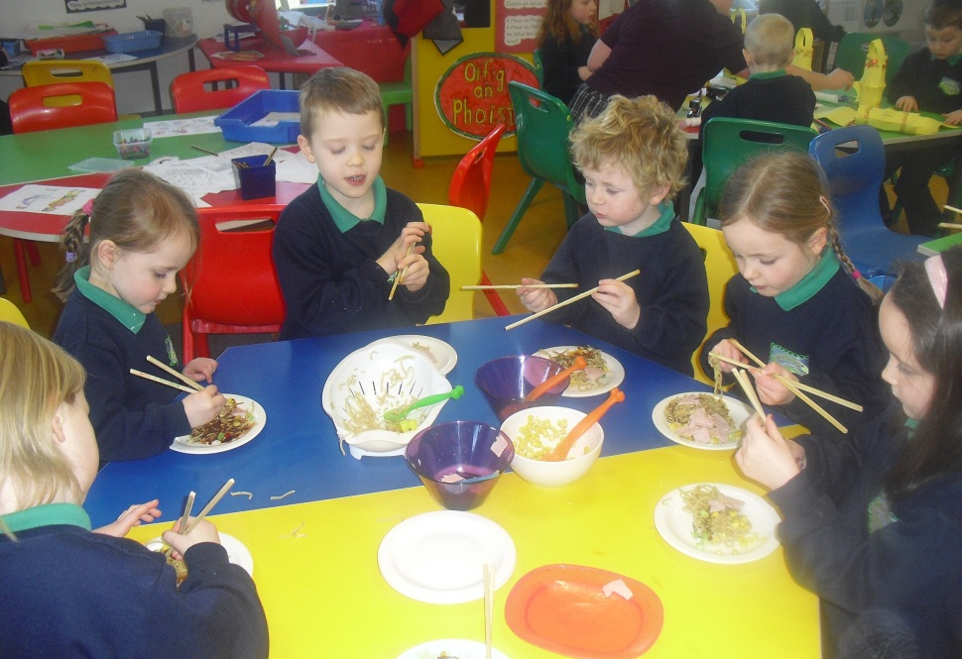

Slide 5
An Lá Scoile The School Day
Naíscoil begins at 9 am.
The children in the Naíscoil will eat a healthy snack each day of toast / bread, ham, cheese, yoghurt, fresh fruit, milk or water. We also include a special sos where children can try out different textures of food and explore foods they may not normally get to try to see what they think. This snack is provided at a cost of £15 per term.
Each Naíscoil day consists of free play, stories, song/poems, outdoor play, conversation and includes all elements of the curriculum as previously mentioned.
Naíscoil finishes at 12.00 noon.

Slide 6
Poncúlacht agus Tinreamh
Punctuality and Attendance
Session begins at 9am. If parents arrive before 9am, please wait with your child until we open the door. On wet mornings, parents are welcome to wait in the hall.
Pupils arriving after 9.20am are marked as late for the session.
If your child is absent, if he or she will be late or need to leave early, please inform us via private message on Seesaw or at the door.
Good punctuality and attendance are very important at this young age to set good habits of routine, as well as giving the children every opportunity for language-acquisition, developing play and social skills, and developing confidence and self-esteem.

Slide 7
Éide Scoile School Uniform
Our uniform consists of:
Navy sweatshirt embroidered with the school logo and motto (available from McKenny’s Clothes Shop in Castlewellan);
Tracksuit bottoms, skirt or shorts;
Green polo shirt embroidered with the school logo and motto;
Navy school coat (optional);
Black shoes;
Girls may wear knee socks, navy tights or white ankle socks;
Girls may wear navy or green gingham dresses in the summer time;
Outdoor play clothes:
Outdoor play is a key tenet of the Nursery curriculum
Suitable waterproof coat / jacket
Appropriate trainers / boots / wellies for the weather
Naíscoil pupils are strongly recommended to wear velcro shoes / trainers to enable them to change as independently as possible into wellies / outdoor boots

Slide 8
Tuismitheoirí Parents
Our caring, family ethos at Naíscoil agus Bunscoil Bheanna Boirche means that we strongly value the importance of parental input in their child’s education, and we enjoy a wonderful level of parental participation and involvement in our school community here at Naíscoil agus Bunscoil Bheanna Boirche.
We strive to involve parents in the life of the school. Parents help with our school garden, with our outdoor play areas, after-school activities and assist on school trips and events. Several parents are employed in the school in various roles.
We believe that happy children are more effective learners. Parents are always encouraged to discuss any concerns they may have either with the class teacher or with the principal. Our door is always open, and we pride ourselves here at Naíscoil agus Bunscoil Bheanna Boirche on our open and friendly relationships between teachers and parents.
While having Irish in the home is not a prerequisite to attend Naíscoil agus Bunscoil Bheanna Boirche, parents are strongly encouraged to avail of the many great Irish Language classes that are available in the area in order to be able to support their child’s learning.

Slide 9
Cairde Our Parent Support Group
We have a very active and dedicated Parent Support Group called ‘Cairde’ who regularly arrange activities such as fundraiser events and family fun days.
Their fundraising goes towards supporting school development and assists with purchasing of resources, class reading books, developing our outdoor play area, and equipment and materials used to aid and further your child's learning.
They are an integral part of Naíscoil agus Bunscoil Bheanna Boirche and are always keen for new members to join in and help in whatever small way they can. Search “Cairde Naíscoil agus Bunscoil Bheanna Boirche” on Facebook.

Slide 10

Ag ullmhú don Naíscoil
Preparing for Naíscoil
Putting on own shoes, jumper, coat (Velcro shoes)
Communicating needs (toilet, drink, etc)
All clothes labelled
How to use schoolbags, lunchboxes, tupperware etc…
Sharing toys, taking turns, etc.
Knowing when they need to use the toilet
Limit screen time – outdoor play, puzzles, imaginative play, etc…

Slide 11
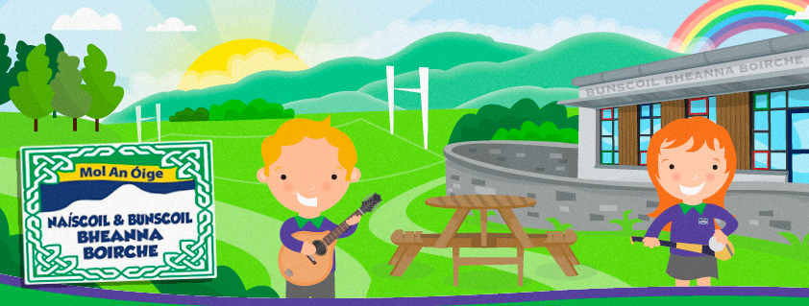
Polasaithe Scoile School Policies
Included in your information pack is a summary document of our Child Protection Policy and our Intimate Care Procedures.
All of our other school policies are available to view on the school website www.bunscoilbb.com or from the school office by appointment with the principal
Data collection, permission & information forms to be returned to the Naíscoil by next Friday 20th June at the latest please.

Slide 12

Sláinte do pháiste
Your child’s health and hygiene
Please inform staff of any health and medical needs your child has including any food allergies, asthma etc…that we’re not already aware of.
If your child becomes ill while in school, we will contact the number you have provided on your data collection form. Please make sure this is always up to date and inform us of any changes throughout the year.
In the case of wetting accidents, we encourage pupils to change independently using the change of clothes in their bags/in the cloakroom. In the rare case of a soiling incident, as per our ‘Intimate Care’ policy, pupils will be encouraged to clean themselves independently, made comfortable, and parents will be called.
Please be aware that staff cannot administer medicine. If your child needs medication, feel free to come to the school to give it when needed.
Please inform staff of anything that may affect your child’s behaviour such as bereavement, sudden shock, separation, etc. All information will be treated as strictly confidential, and will help us to care for and support your child as best we can.

Slide 13
Sláinte do pháiste
Your child’s health and hygiene
If your child is ill, please keep them at home until they have fully recovered to help prevent the spread of infection. NHS guidance on incubation periods for common illnesses is available online via the following link:
https://www.publichealth.hscni.net/sites/default/files/Guidance_on_infection_control_in%20schools_poster.pdf
If you are in any doubt, please also just contact the school office for clarification.

Slide 14
Benefits of Immersion Education
Research shows that children in Irish-medium schools may find it easier to learn further languages
Research consistently finds that the immersion experience actually enhances English language development (Cloud, Genesee & Hamayan 2000).
Research indicates that “children in early immersion education programmes tend to perform better than children in regular programmes on several aspects of English achievement” (Baker & Hornberger 2001).
Studies show children who are bilingual learn to read more rapidly than their monolingual peers (Bialystok et al. 2005).

Slide 15
Benefits of Immersion Education
Better performance academically (Gallagher & Hanna, 2002).
An understanding and openness to other cultures (Gallagher & Hanna, 2002).
Improvement in cognitive functioning in creativity and communication (Bialystok et al. 2005).
Higher scores in English and Maths (Education Research Centre, 2011)
Enhanced awareness of identity, culture and sense of community (Baker, 2003)
Increased Self Esteem (Baker, 2003)
Bilingual Education enriches academic productivity, creative talents and self-esteem in students (NMABE, 2006; Cummins, 2000)
Improved communication and social skills (Cummins, 2000)

Slide 16

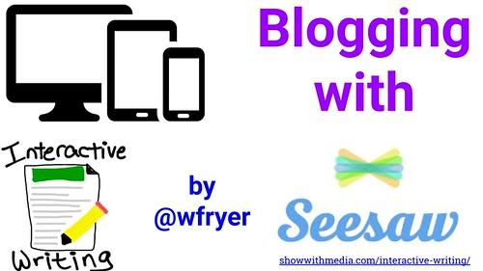


Aip Scoile
School App
As we are an award winning Eco School with multiple awards for ICT also, we aim to use as little paper as possible. Therefore, we send out important messages and information via Seesaw and our Schools NI app.
Parents are asked to ensure they download the school app prior to their child beginning Naíscoil. Please ensure that notifications are enabled, select Bunscoil Bheanna Boirche as your default school, and check the app regularly to ensure that you receive all whole-school general messages.
Simply search for ‘Schools NI’ wherever you download your apps.
We also ask parents to visit our website regularly to access school holiday lists, latest photos, and to keep up to date with what is happening in our school.

Slide 17
Ceist ar bith?
Any questions?

