Slide 1
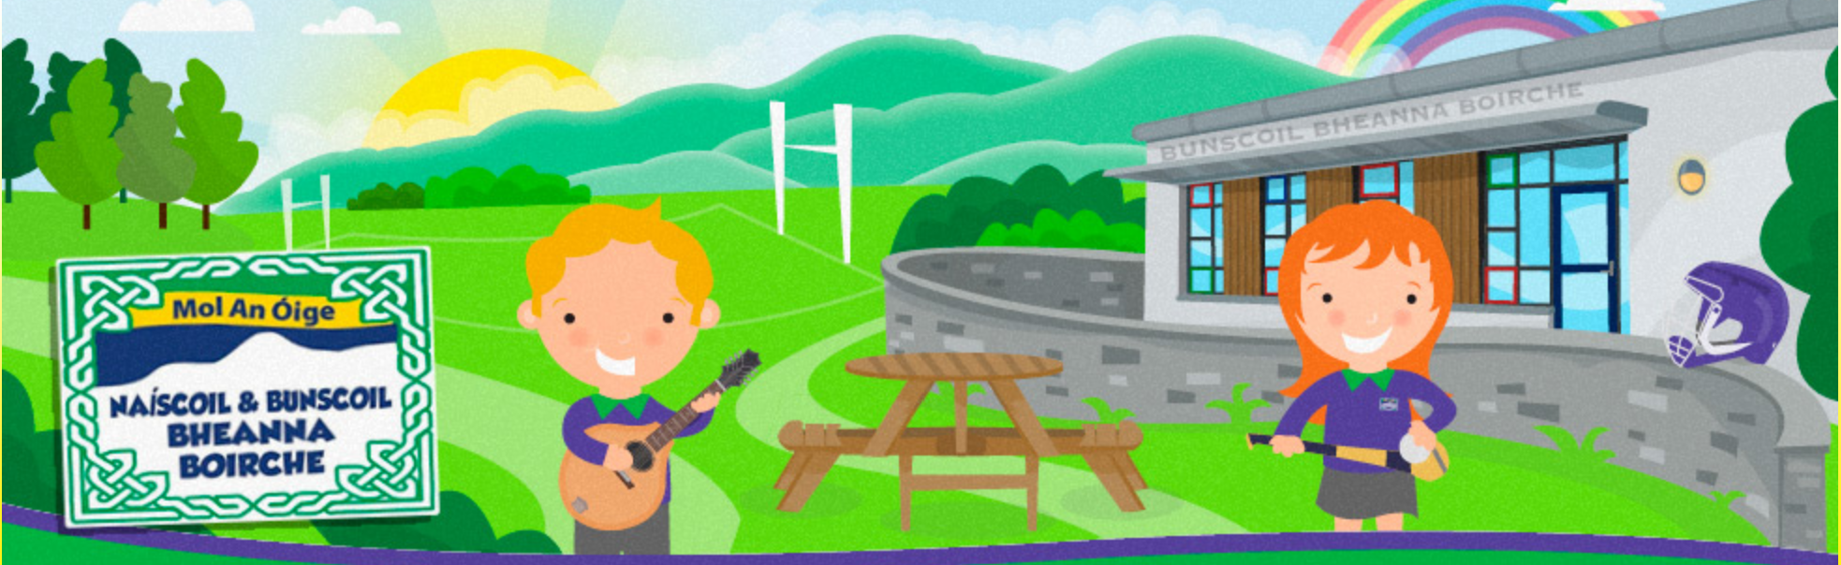
Cruinniú Curaclaim
Curriculum Meeting
Deireadh Fómhar 2025
Curriculum Meeting
Deireadh Fómhair 2025
Rang 2
Bunscoil Bheanna Boirche
Brenda Nic Cumascaigh

Slide 2
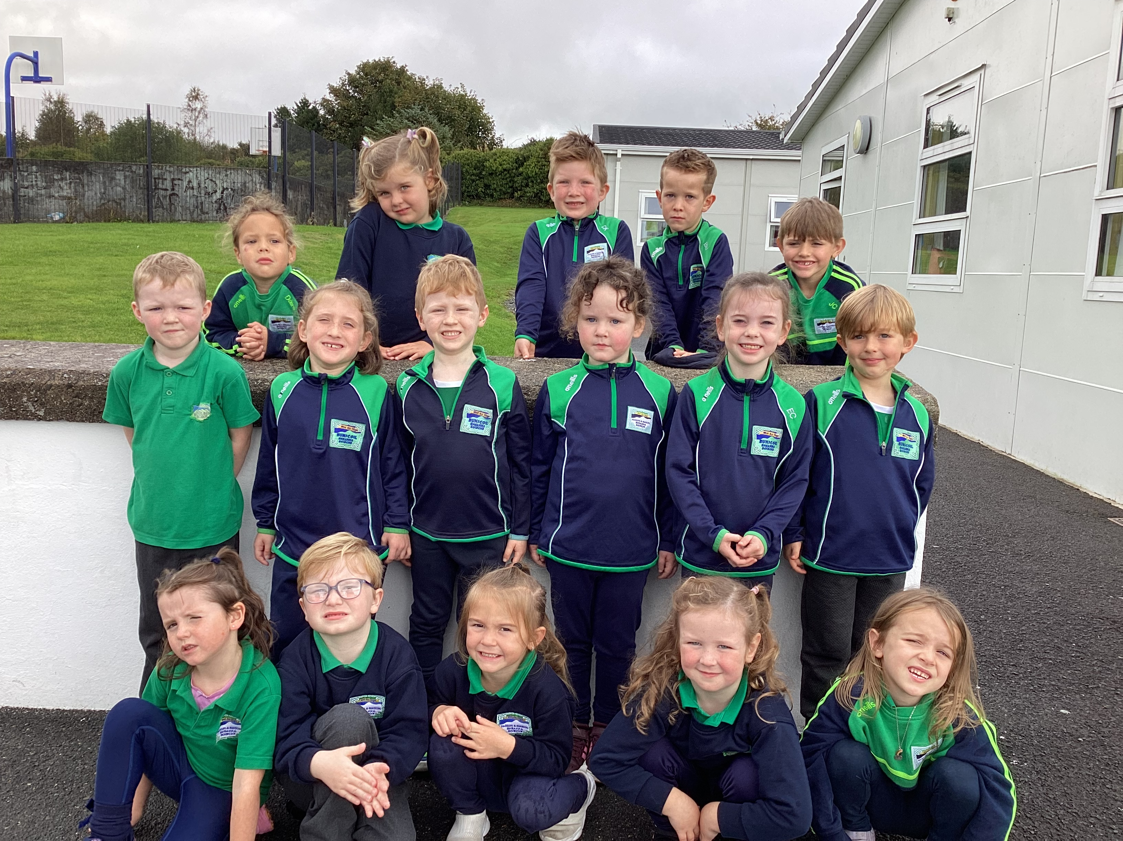

Slide 3
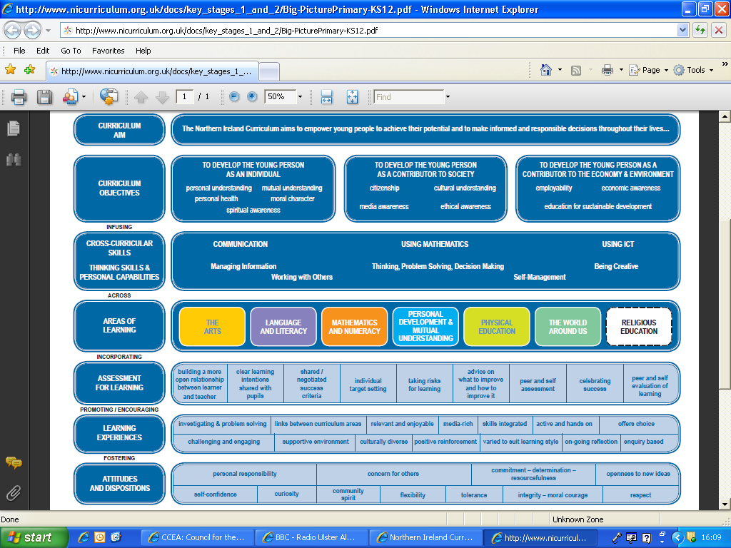

Slide 4
Talking and Listening
Talking for different audiences | Listening and responding | Group discussion and interaction | Drama
Children will: Use spoken and written language in their play and other learning experiences Speak clearly and audibly with confidence to a range of audiences Demonstrate an understanding of the syntax of the Irish language Convey simple information showing awareness of what the listener needs to know Interpret a text by reading aloud with some variety in pace and emphasis Recite poems and rhymes with some variety in pace, emphasis and intonation Recite and join in playground chants, action verses and rhymes Articulate preferences and discuss reasons | Children will: Listen with enjoyment and respond to stories, rhymes, poems and songs, plays, assembly, other children’s work Listen to tapes or moving image texts and identify points of interest Listen to and evaluate a range of texts including media texts Listen with sustained concentration to other children and adults Listen to and follow instructions accurately Retell stories in sequence, using some formal features of story language Summarise in own words, e.g. the main idea, instructions given | Children will: Take turns and make relevant contributions to paired and group discussions Listen and build on others’ suggestions Ask and answer different types of questions Explain their views to others Consider alternative viewpoints Co-operate to reach agreement Begin to plan by talking about what they are going to do | Children will: speak and behave in an appropriate manner, e.g. doctor in hospital, taking a message, using a message use improvisation and work in role to explore characters, situations and familiar themes act out own and well-known stories to deepen understanding of character, motive and story use different voices for characters when reading aloud use a range of props, e.g. story sacks or story boxes to create or retell stories use a range of non-verbal skills e.g. gesture, facial expressions to convey feelings and moods present dramatisations to a range of audiences give a personal response to a performance

Slide 5
Language and Literacy/Reading
Learning Outcomes | Activities
Know to select books to read for enjoyment and to find out information Read a wide range of various types of texts, both fiction and non-fiction Awareness of various styles and types of text Develop a personal preference and give opinions about what they have read, different characters, favourite page etc. Know how to make predictions showing an understanding of ideas, events and characters Talk about different happenings in class books and relate them to their own experiences Show awareness of punctuation and structure Improve fluency and confidence in reading Use various strategies to read unfamiliar words and make sense of what they have read | Guided reading groups Reading familiar rhymes, stories and poems independently Quiet reading books Listening to children’s favourite story Independent reading Experiment with ideas through writing in a variety of play- writing lists in the shop, taking orders in café, writing labels, cards, birthdays invitations etc. Role-play corner, story sacks, dolls/puppets to act out elements of stories Just2Easy/Green Screen apps to retell stories in their own words using moving image apps Using simple picture books Using ICT to make simple labels Linguistic phonics / Fónaic na Gaeilge Spelling strategies / games

Slide 6
Literacy and Language/Writing
Learning Outcomes | Activities
Awareness of various features of differing texts, i.e. headings, bullet points, etc. Increased awareness and understanding of structure Use phonological and sight vocabulary when writing during shared, guided and independent work Experiment with writing ideas and use a wide range of vocabulary in their writing Create simple texts using R2 fónaic words, word walls and high frequency word lists and use learned strategies to help spell unfamiliar words Create texts on paper and on screen, choose independently what to write about, plan and follow it through Grammar and Punctuation Write with spaces between words Recognise full stops and capital letters when writing and use them correctly - beginning sentences, names, places with a capital letter and finish with a full stop. Supporting writing at home https://send.eani.org.uk/sites/default/files/2023-07/Literacy%20Guidance%20-%20Supporting%20writing.pdf | Write captions for their own work, e.g. for displays, in class books etc. Write and draw labels for a purpose- everyday use/purposes e.g. in role-play area, toys, equipment use a wide range of reading experiences in the construction of a variety of written texts, e.g. using personal experience, making simple picture books, creating rhymes Various writing and topical activities Analysis of various types of writing Focused grammar and punctuation lessons Focus on different writing genres each half term- instructional, explanation, persuasive, diary entry, poetry

Slide 7
Numeracy/Number
Learning Outcomes | Activities
Counting, understanding number and number recognition Recognise, count, sequence and write numbers to 10, 20, progressing to 50,100 as appropriate Count forwards / backwards from different points Know the number before, after, between to 30 Count in 2s to 20, Count in 5s to 50, Count in 10s to 100 Explore ordinal numbers- first, second, third etc. Begin to recognise odd and even numbers Addition- add two numbers to 10, progressing to 20 Explore addition facts for 6, 7, 8, 9, 10 Know doubles to 20 Subtract within 15, progressing to 20 by end of Rang 2 | Mental maths games Practical math tasks Explore numbers relevant to everyday life i.e. phone numbers, number plates, door numbers etc. Making variety of sets, comparing sets by looking, matching objects, sorting and counting during play-based learning Practical reinforcing during games- first, second, third etc. Further reinforcement on IPad with maths apps- Top marks, Eggs to order etc. Sequencing number Paired and group work / games Investigating number and pattern Questioning and identifying steps / strategy Word problems

Slide 8
Numeracy/Measures, and Shape and Space
Learning Outcomes | Activities
Ability to estimate Understand and use language relating to length, width, volume, etc. Suggest suitable standard and non-standard units Begin to understand the concept of scale Develop competence in dealing with time Investigate and talk about the properties of shapes, e.g. those that roll/ do not roll, those with straight edges/ curved edges Recognise and name common 2-D shapes- square, triangle, circle, rectangle Describe and name common 3-D shapes – cube, cuboid, sphere, cylinder and cone | Mental maths games Practical maths tasks Opportunities during water/sand play to fill, measure, compare and encouraged to use language of comparison i.e. longer, shorter, heavy, light, holds more/less/nearly full and so on Outdoor play- providing building blocks, larger wooden items to balance, lift and weigh, order, compare etc. Make pictures and patterns with 2-D shapes during play based learning Build and make constructions with 2D and 3-D shapes

Slide 9
Numeracy/Time & Sorting
Learning Outcomes | Activities
Time Understand and use the vocabulary related to time · Know the days of the week · Recognise and read o’clock times on an analogue clock · Recognise and read half past times on an analogue clock Sorting Be able to use mapping diagrams to show relationships Sort using Carroll diagrams Be able to display and interpret data using simple bar graphs and pictograms | Mental maths activities Collins Maths worksheets Practical maths lessons using large and smaller clocks Daily class picture timetable/ days of the week Talk about significant times on the clock- class discussions of things that happen daily/weekly i.e. roll call, break lunch, P.E. days, assemblies Practical activities to sequence times of the day and explore time patterns e.g. morning afternoon, evening, days Sorting and data activities using ICT – J2Easy and other programmes

Slide 10
World Around Us
DTO R2 topics
Back to school/Seasons
Celebrations/Birthdays
People who help us
Houses and homes Minibeasts
Four main strands-
Interdependence | Place | Movement and energy | Change over time
Ourselves Interaction Survival | Local and global habitat How the world has changed Environment Cultural / heritage links | Emigration – why? When? Weather and its affects Raiders and settlers | Past, present, future Our influence Seasons Pollution / global warming

Slide 11
ICT
The 5 E’s | Activities
Explore | Researching – finding and using information Using digital tools to investigate and solve problems.
Express | Creativity – use of various ICT features to express work
Exchange | Online collaboration and communication
Evaluate | Reflection – process and outcome. Improvements and revisions
Exhibit | Organising and presentation of work
G Suite – Google Classroom - Google Drive – Google Docs – Google Slides
Collaborative learning and working (real-time)

Slide 12
PDMU
Personal Development | Mutual Understanding
Self-esteem, self-confidence and development of personal attributes Management of emotions and responses to others’ emotions Health and well-being | Relationships – friends and family Rights and responsibilities Valuing cultural diversity Learning to live as a member of society
Wonderful Me
How do I Feel?
Keeping Healthy and Staying Safe
Getting Along with Others
I am Learning to…
Healthy Relationships
My Body
Keeping Safe
Maireachtáil. Foghlaim. Le Chéile.
NSPCC – Keeping Safe Nurture in 5/CAN and High 5 lessons
https://www.nspcc.org.uk/services-and-resources/working-with-schools/keeping-safe/

Slide 13
Physical Education
Skills | Activities
Fundamental Movement P.E programme and UK Athletics Co-ordination Balance Self-control Body awareness Handling equipment Spatial awareness Co-operation Instructions Direction Speed / pacing Accuracy | Warm-up games Running, jumping, hopping, skipping, etc. Team games Competitive games Throwing, catching, kicking, etc. Running Invasion games Hurling

Slide 14
Assessment
Whilst there is no formal assessment in Rang 1 and Rang 2, children are observed daily by both the class teacher and classroom assistants. The information gained from these observations is used to plan future lessons.
‘During Years 1 and 2 ongoing assessment will be based mainly on teacher observation which will inform the learning programme for each child. Observations are a natural and essential part of good practice for teachers and classroom assistants. Well-planned, regular and skilful observations help teachers gain information about children's progress over time which ensures that all children's needs are being met.’
http://ccea.org.uk/curriculum/foundation_stage/assessment
Numeracy
We follow the Collins Numeracy Scheme- children will be assessed in the form of numeracy half termly tests. Parents will be informed of the results of these and advised of any areas to be developed/worked on at home with children.

Slide 15

Litriú i Rang 2/Spellings
In P2, our spelling programme is closely linked to our phonics lessons. We focus on teaching children to listen for the sounds in words and then write the letters that represent those sounds. Each week, we will focus on: Phonics Words: A set of words based on the sound or spelling pattern we are learning that week
High Frequency Words: Words that don't follow the usual phonics rules and need to be learned by sight, we cover 3-5 HFW per week in class. Your child's weekly words will be sent home on a Monday. We will practise them in class throughout the week, with an informal check-in on Friday.
Fun & Effective Spelling Activities to Do at Home The key is to make practice short, fun, and frequent. Just 5-10 minutes each day is far more effective than a long session once a week. Try a different activity each night to keep it interesting! 1. Look, Say, Cover, Write, Check LOOK: Look carefully at the word. SAY: Say the word aloud, sounding it out. COVER: Cover the word with a hand or piece of paper. WRITE: Write the word from memory. CHECK: Uncover the original word and check your spelling. Correct any mistakes.

Slide 16
Litriú …continued
2. Rainbow Writing Write the spelling words out once. Then, trace over them two or three times using different coloured pencils or crayons. This is great for muscle memory. 3. Magnetic Letters or Letter Tiles Use letters on the fridge or letter tiles from a game (like Scrabble) to build the words. This hands-on approach helps children focus on each letter in the word. 4. Sensory Writing Get creative with different textures! Shaving Foam: Spray a layer of shaving foam onto a tray and let your child write their words with their finger. Sand or Salt: Pour a thin layer of sand or salt into a baking tray for tracing. 5. Word Hunt Give your child one of their spelling words and ask them to find it in a book, magazine, or newspaper at home. This helps them see the word in context. 6. Outdoor Chalking On a dry day, take some chalk outside and write the words in big letters on the pavement or a wall. 7. Typing Let your child type their words on a computer, tablet or old keyboard. This is a great way to practise and helps develop keyboard skills. Tips for Success Praise Effort, Not Perfection: Celebrate their hard work and progress. If they make a mistake, gently point it out and help them fix it. Keep it Positive: If your child is tired or frustrated, it’s okay to stop and try again later. Talk About Words: Point out interesting words when you are out and about. Talk about the sounds you can hear in them. Read, Read, Read: The more your child reads, the more they will see words spelled correctly, which helps them become a better speller. We hope this guide is helpful. By working together, we can help your child develop the skills and confidence they need to become a successful speller.

Slide 17



Aip Scoile School App
As we are an award-winning Eco School, we aim to use as little paper as possible. Therefore, we send out important messages and information via our Schools NI app.
Parents are asked to download it ASAP, if you haven’t done so already. Please select Bunscoil Bheanna Boirche as your favourite school, and ensure that notifications are enabled and that you check the app regularly. We also ask parents to visit our website to keep up to date with what is happening in our school, for the school dinner menu etc...
Our app is available on both Android and Apple devices. Simply visit our school website where you will be prompted to download the app for free. www.bunscoilbb.com

Slide 18

We strongly recommend every family downloads the Safer Schools NI App, an online platform funded by DENI to support parents ensure internet use at home is safe.
Keeps you up to date with the current online trends, threats, and risks to your child. This information is sent directly to your device!
Delivers the information you need to know on social media and gaming platforms, helping you understand the latest buzzwords and how to set privacy and parental settings on platforms like Among Us, Minecraft and TikTok.
Offers expert guidance to help you navigate important issues such as bullying, mental health and healthy relationships. Giving you practical tips on how to approach these conversations with your children.
The Online Safety section will signpost you to help and support where you need it when you need it – it's in your pocket!

Slide 19
Class rules, rewards and sanctions
We adhere to our school’s positive behaviour policy- please refer to the school website for perusal.
Our class contract is clearly displayed in the class, and we refer to it regularly during the school day.
Class rules | Class rewards | Class sanctions
Speak in Irish Show respect and kindness to each other and school staff Respect all class and school equipment Put hands up to speak in class Always try your hardest and do your best work | Class dojo/reward system Extra play time Note home to say… Praise/certificates at weekly assembly Special praise form principal Fun afternoon/play park | May result in a loss of dojos Time taken away from Golden Time Additional work assigned Note sent home to parents Sent to principal Meeting with parents if behaviours are repeated

Slide 20
An Lá Scoile/The School Day
School day begins at 9 am. Children are supervised in the clós (yard) from 8.45 am
Children who are late will be marked late on the register.
If your child is absent, you should contact the school via the office on the first day of the absence, then send a completed absence slip into school with your child on his/her return. If this does not happen, the absence goes down as “unexplained absence”.
If you are collecting your child early, you must contact the office before coming to the classroom.
Break time is from 10.30-11.00am
Lunchtime is from 12-1.00pm
Home time is 2pm and 1.50pm on a Friday to ease traffic congestion
At Bunscoil Bheanna Boirche, we pride ourselves on our healthy eating policy. Our school dinners cost £2.60 daily and come from St. Malachy’s Primary School in Castlewellan and are of a high standard. We advise that you refer to the weekly dinner menu and advise your child of choices so they know what they will have when dinner roll is taken, daily. It is recommended that pupils eat fruit, a yoghurt or a small sandwich at break time. Water is always available, and pupils are welcome to bring bottled water to school. Sugary/fizzy drinks, crisps, chocolates and sweets are not allowed at break time as these can impact on the children’s behaviour. We do not have any children with a nut allergy at present but we discourage bringing nuts to school and ask that treats/buns are not sent in for birthdays or other times in the year.
Breakfast club is available Monday - Friday, £3 daily
After school club is available Monday - Thursday £3 daily.
No pre-booking is required for Breakfast Club or After-school Club.

Slide 21
Class timetable
 | 9.00-9.30am | 9.30-10.30am | 10.30-11am | 11-12pm | 1-1.45pm | 1.50-2pm
Monday | Nurture in 5 | Literacy tasks Fónaic na Gaeilge Reading & writing | Break & yard play | Numeracy Mental Maths Collins Maths activities/work- sheets | Play based learning (outdoor play) | Quiet time and getting ready to go home
Tuesday | Nurture in 5 | Literacy tasks Fónaic na Gaeilge Reading & writing | Break & yard play | Numeracy Mental Maths P.E | Play based learning | Quiet time and getting ready to go home
Wednesday | Nurture in 5 | Literacy tasks Fónaic na Gaeilge Reading & writing | Break & yard play | Numeracy Mental Maths Collins Maths activities/work- sheets | Play based learning (outdoor play) | Quiet time and getting ready to go home
Thursday | Nurture in 5 | Literacy tasks Fónaic na Gaeilge WAU | Break & yard play | CAN/NSPCC or Beo go Deo lesson P.E | Play based learning | Quiet time and getting ready to go home
Friday |  | Assembly Class dictation Art | Break & yard play | Numeracy Mental Maths Collins Maths activities/work- sheets | Play based learning | School finishes at 1.50pm

Slide 22
Homework
Increased emphasis on more learning/practical based homework with fewer written pieces of work per week. There will be more emphasis on more interactive and language immersive homework, these homework tasks will vary weekly, and it is therefore essential that all parents are logged onto and follow homework instructions on Google Classroom.
N.B Please note on days when NSPCC homeworks are assigned we ask that these worksheets are not completed until Thursday evenings as these lessons are always taught on Thursday mornings.
Homework folders go home every Monday and are to be returned every Friday morning to allow us time to get homework folders/books etc. organised in time for the following week. Please return any written completed homework every Friday in the blue homework folder. Children may take a page in their red homework books to practise their weekly spellings, if they wish. Spellings are to be learnt during the week in preparation for our weekly class dictation on a Friday morning. Learning tasks such as songs/poems will be inserted into these books also and pupils will be prompted to learn them as per instruction on Google Classroom.
Léitheoireacht-Reading as follows:
Dé Luain/Monday- previously read book
Dé Máirt/Tuesday- class reading book
Dé Céadaoin/Wednesday- we encourage children to listen to English reading/start reading easy starter books/texts

Slide 23
Ag tacú le do pháiste/supporting your child Whilst having Irish in the home is not a prerequisite to attend Naíscoil agus Bunscoil Bheanna Boirche, parents are strongly encouraged to avail of the many great Irish Language classes and intensive courses that are available in the area in order to be able to support their child’s learning. Follow Glór Uachtar Tíre on Facebook, Instagram, or visit their website for information on upcoming lessons and events. In addition, homeworks are always supplemented with support materials for parents to use to help with pronunciation and meaning. Remember, homework is a REVISION of work/topics covered in class, so pupils will be able to tell you what they are meant to do, and will take great joy in doing so! The overview sheets and verbal instructions on Google Classroom will also be of help to you. There are also some fantastic websites to assist parents with Irish and support their child, such as: www.abair.ie www.tearma.ie www.foclóir.ie www.bbc.co.uk/northernireland/irish/blas www.irishforparents.ie www.cúla4.com www.foghlaim.tg4.ie We also recommend using the following apps if you have a tablet device at home: Cód na Gaeilge, Cúla 4, Fuaim Ú

Slide 24
Uniform
Our school uniform:
Navy sweatshirt embroidered with the school logo and motto (available from McKenny’s Castlewellan, Co. Down);
Grey trousers, skirt or shorts;
Green polo shirt embroidered with the school logo and motto;
Navy school coat (optional);
Black shoes;
Girls may wear navy knee socks, navy tights or white ankle socks;
Girls may wear navy or green gingham dresses in the summer time;
P.E. uniform consists of:
Grey/ navy track bottoms, or grey/navy shorts;
Suitable trainers
Green polo shirt embroidered with school logo and motto
School football jersey and quarter zips are optional and available to order on the O’Neills website
No football jerseys or branded hoodies
**PLEASE ENSURE ALL ITEMS OF CLOTHING ARE LABELLED CLEARLY!**

Slide 25
Summary
Punctuality and attendance
Visiting or early collection via office
Messages can be sent to class teacher on Google Classroom and will be answered from 8.30am-4.30pm
Homework –details posted on Google Classroom
Reading – Monday - Wednesday, spellings - each night
Name on clothing
School uniform
Healthy break and please let your child know if they are eating lunch/dinner daily and if attending after school clubs and activities
PE clothes on PE days Tuesday and Thursdays – plain t-shirt and shorts / track bottoms or school jersey
Please let school know of any illnesses or infections in the home
School website and app
Safer Schools App
www.bunscoilbb.com

Slide 26
Illness/sickness at school and in the home Please inform staff if your child has any food allergies, asthma etc… that we are not already aware of. If your child becomes ill while at school, we will contact the number you have provided on your data collection form. Please make sure to let us know of any changes to contact information throughout the year. As we have previously communicated, we have children in the school who are immunocompromised, one of whom is in our class. To help protect these vulnerable children, we kindly ask that you notify us immediately if your child is ill or if there is sickness in the home, as immunocompromised children may need to receive preventative treatment within a short timeframe after exposure. The health and well-being of our immunocompromised pupils depends on the cooperation of all parents. Your support is greatly appreciated in helping us keep every child safe. We have been teaching the R2 class good hand hygiene and reinforcing the cover your coughs message and will be sanitising and washing hands on a much more regular basis. Please take the opportunity to reinforce these messages at home. Go raibh maith agaibh.

Slide 27
Continued…
Please see the NHS guidance on safe incubation periods for common illnesses.
https://www.publichealth.hscni.net/sites/default/files/Guidance_on_infection_control_in%20schools_poster.pdf
All school policies are available for your perusal on the school website www.bunscoilbb.com or from the school office by appointment with the principal.
Please do not hesitate to contact me via Google Classroom/or the school office to make an appointment to speak to me about any concerns you may have.
Go raibh maith agaibh

Slide 28
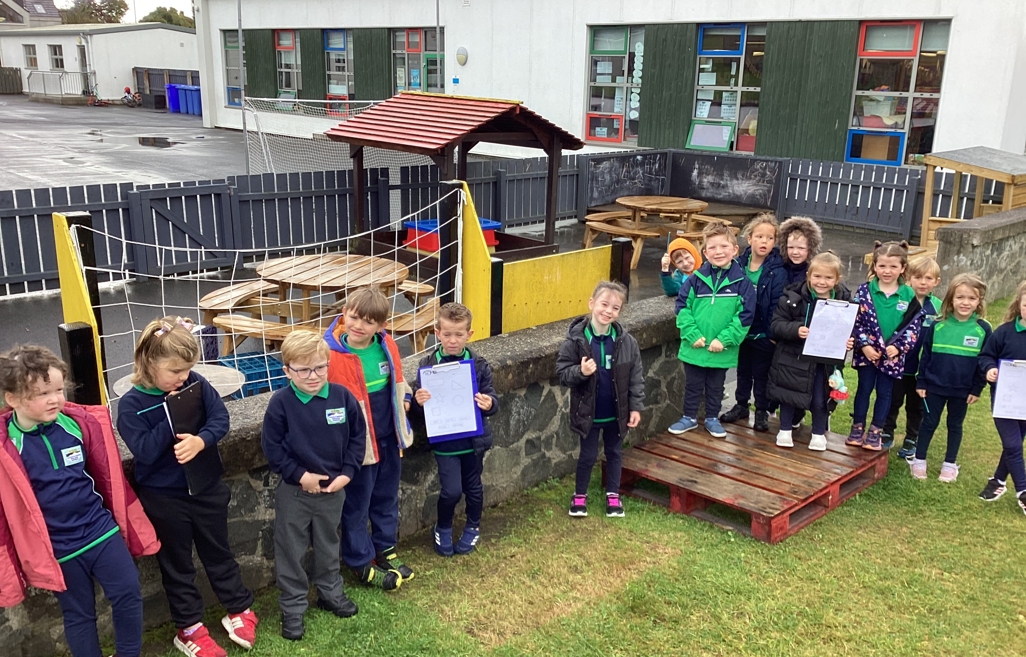
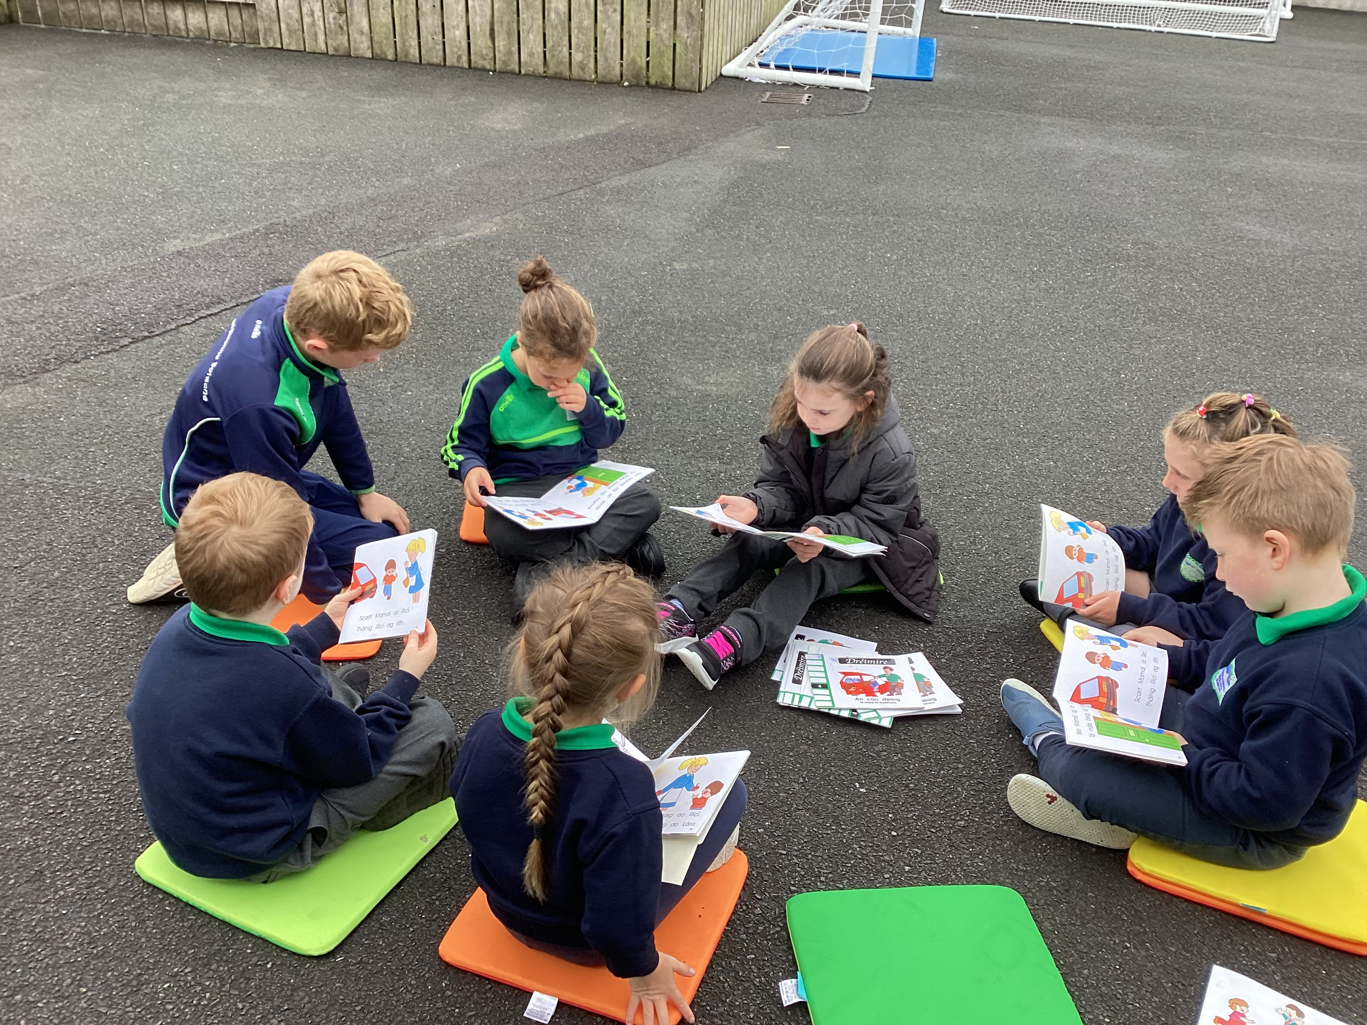
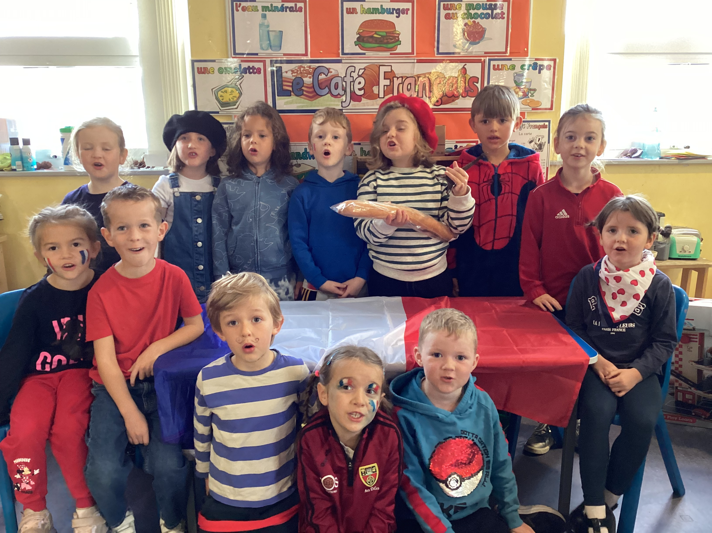
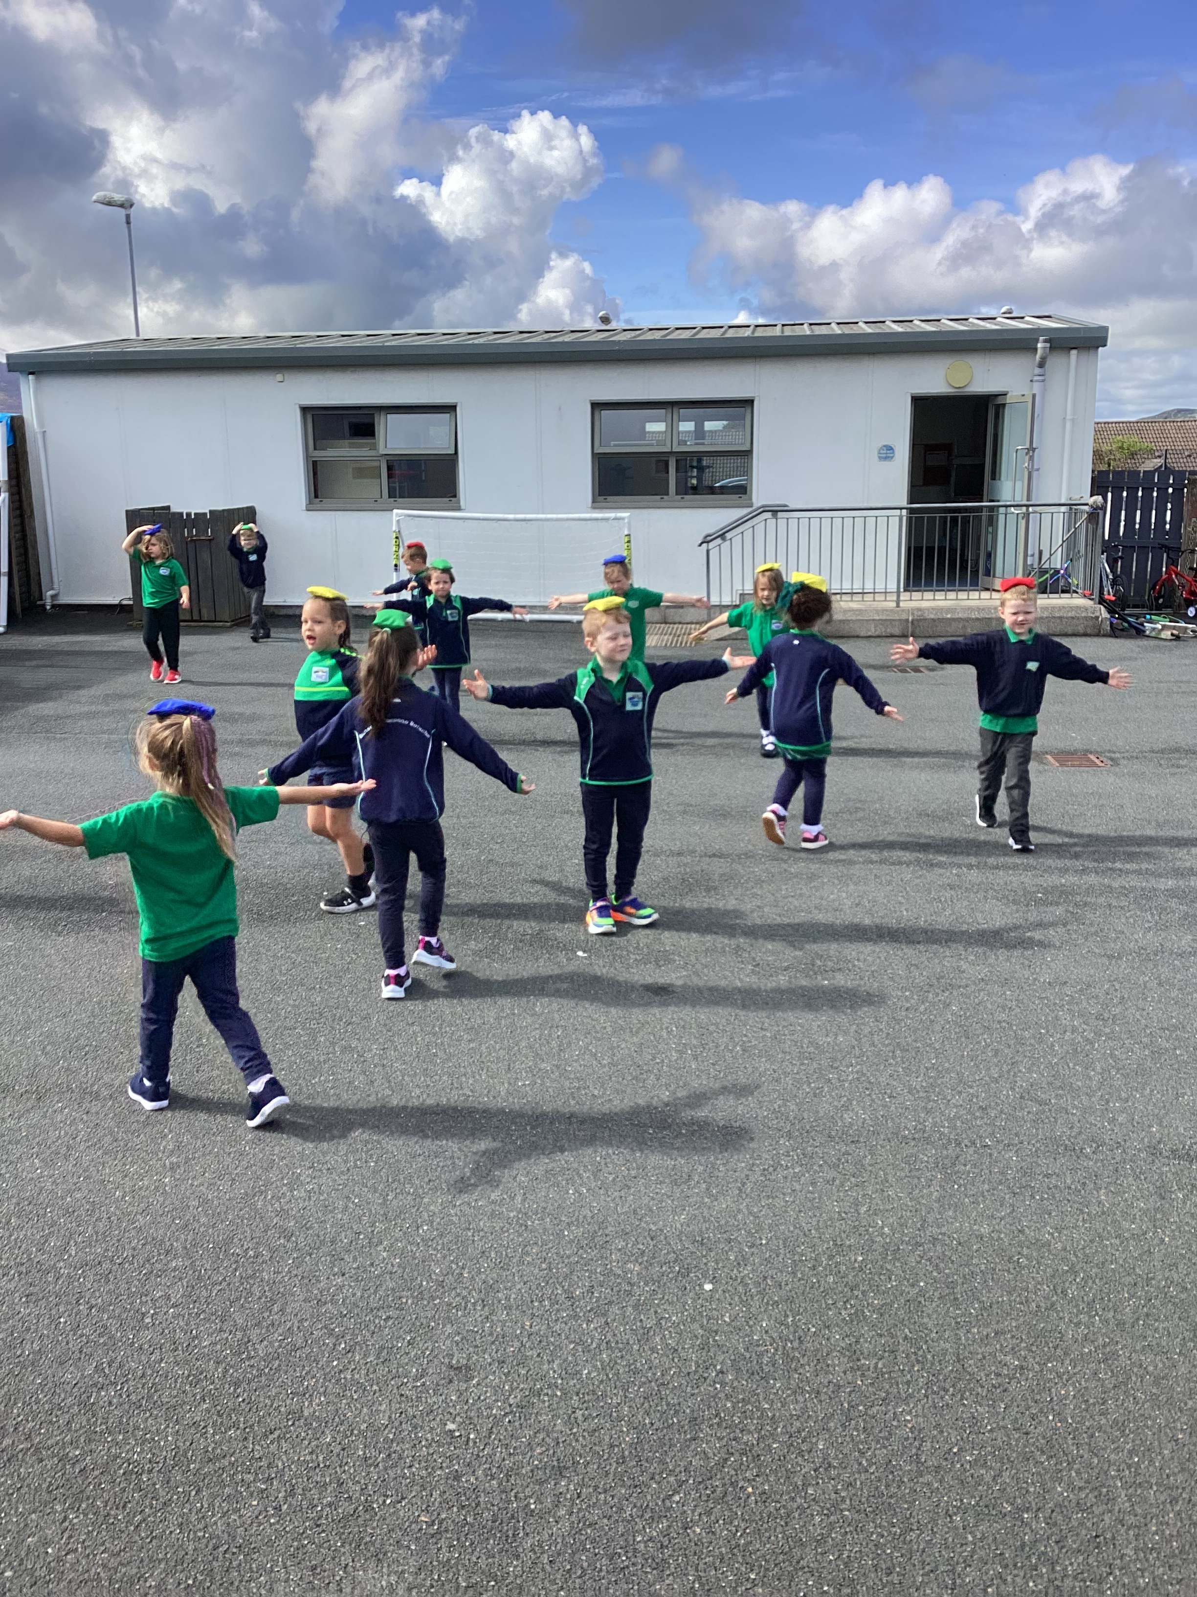
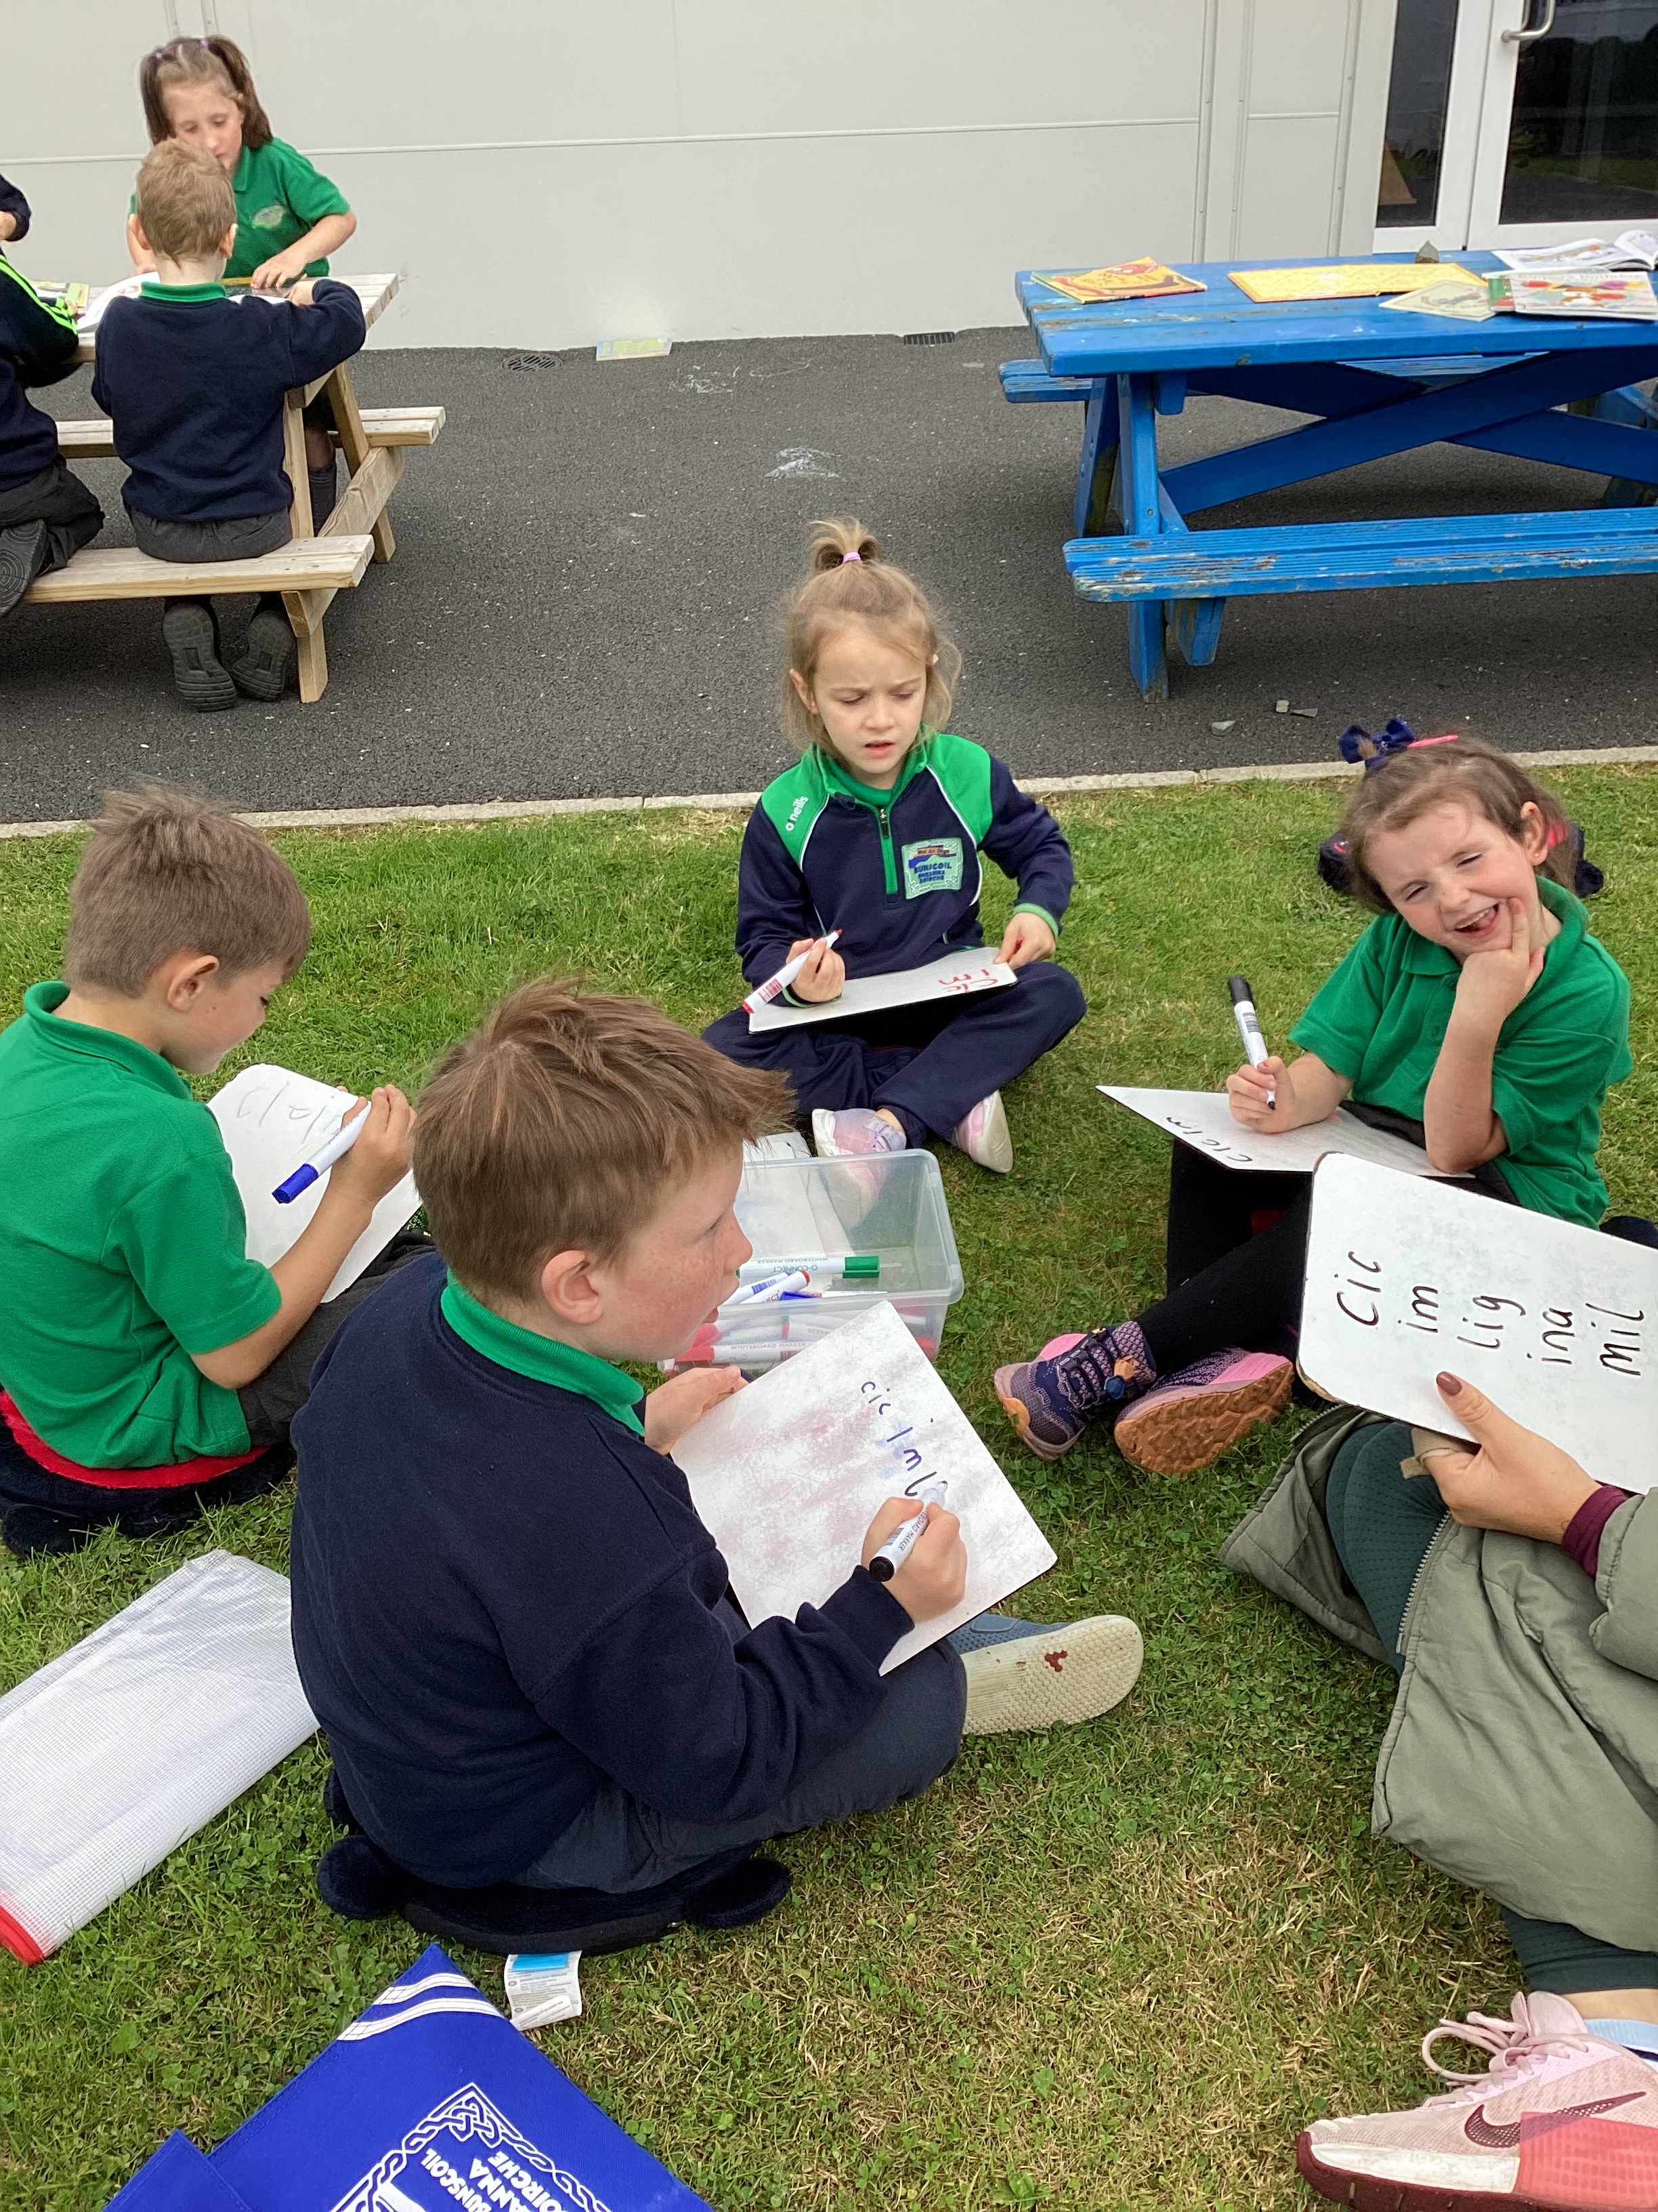

Slide 29


