Slide 1
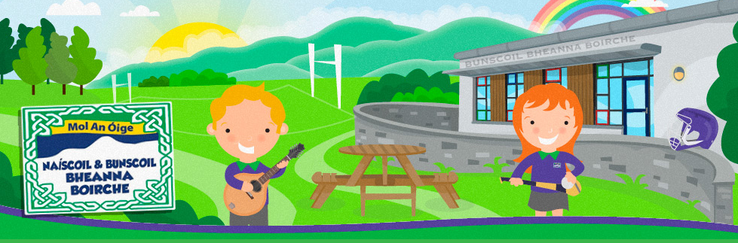
CRUINNIÚ CURACLAIM
Rang a Cúig
Múinteoir Caoimhe

Slide 2
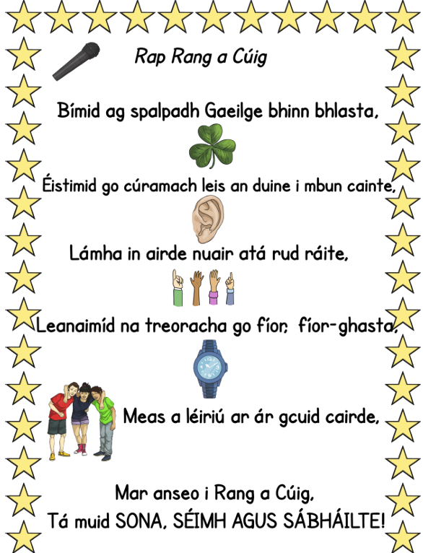
Conradh Ranga –
Our Class Contract
At the beginning of the year, the children worked together with the adults in the classroom to co-construct a class contract.
We recite these rules every Monday morning after circle time to ensure that the children know what is expected of them.
The rules translate as follows:
We speak Irish.
We listen carefully to whomever is speaking.
We raise our hands to speak.
We follow instructions promptly.
We respect our friends…
Because in Rang a Cúig, we are happy, calm and safe.

Slide 3
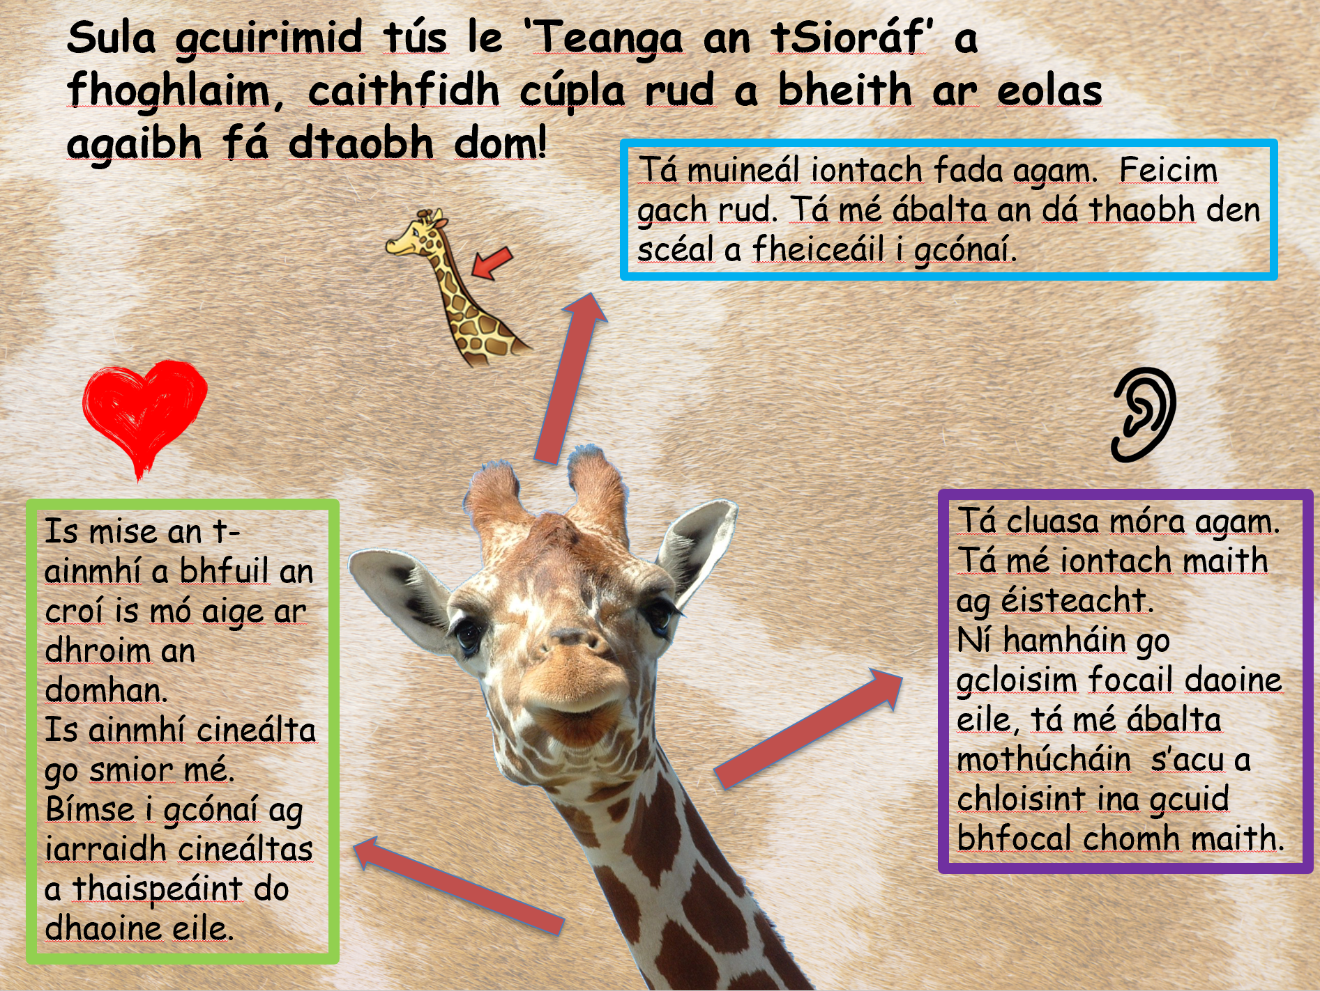
Teanga an tSioraif –
Giraffe language
In Rang a Cúig, the children are using to learn ‘Giraffe language’, which is helping us to interact with each other with kindness and empathy. They have learnt that giraffes have long necks (which help them see both sides of a story). They have learnt that giraffes are great at listening not only to the words of others, but also to the emotions behind their words and that the giraffe is the creature with the biggest heart in the world, which help them treat everyone with kindness.
We often refer to this in our daily interactions. You could ask your child to teach you more about this at home!

Slide 4
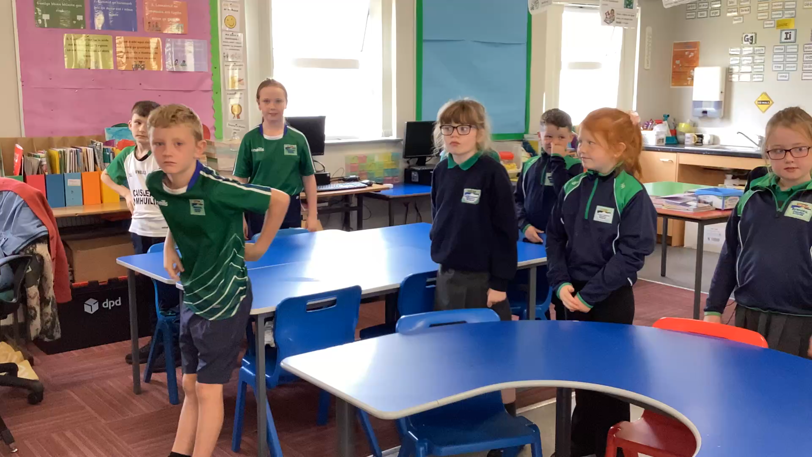
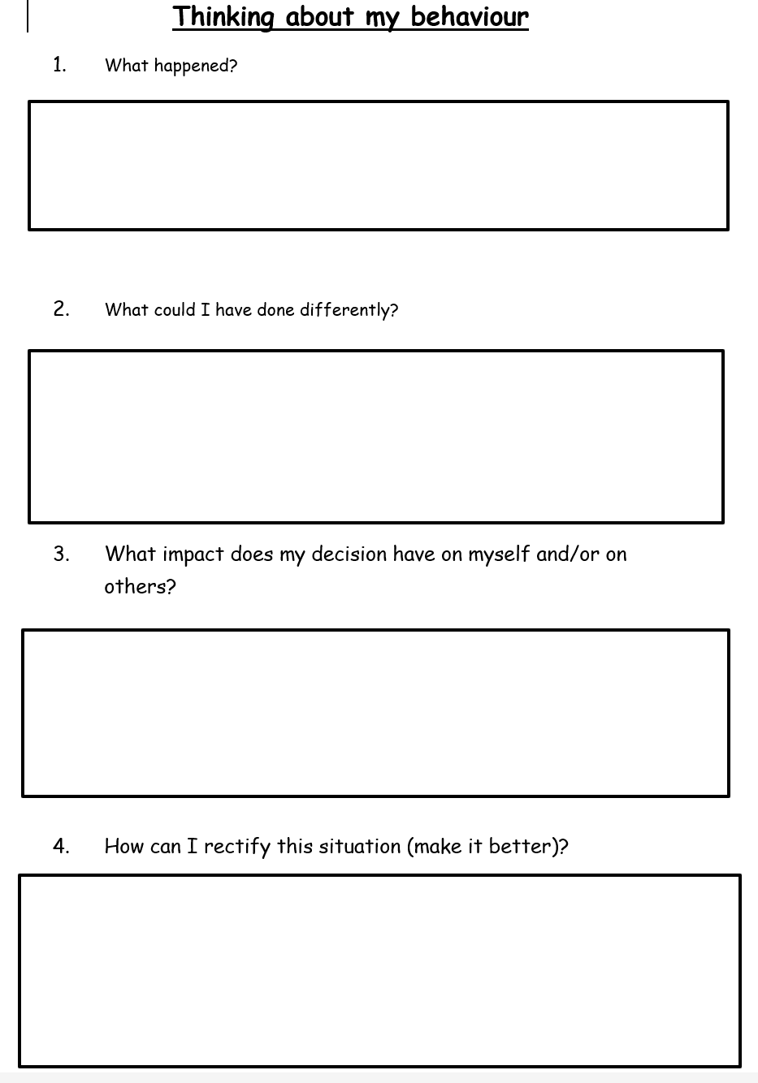
Iarmhairtí– Consequences
The children in Rang a Cúig understand that they have the RIGHT to feel ‘sona, séimh agus sábháilte (happy, calm and safe) at school, but they also understand that this comes with the RESPONSIBILITY to make sure that others feel the same.
We adopt a restorative approach when managing behaviour in the classroom.
The children are firstly given a quiet warning. If they continue to make a bad choice at this point, they will spend time with an adult filling in the following sheet ‘Ag smaoineamh ar mo chuid iompar/ Thinking about my behaviour’. They will have the responsibility to repair the relationship with others if trust has been broken.

Slide 5

Clár ama an lae – Daily Timetable
9.00.9.10am - Registration
9.10-9.30am - Tasc na maidine/Morning Task
9.30-9.50am – English phonics or Fónaic na Gaeilge
9.50-10.30am - Gaeilge – Grammar/Comprehension/Writing genre
10.30-11.00am - Breaktime
11.00-11.20am - Mental maths activities
11.20-12.00pm - Numeracy
12.00-1.00pm - Lunch
1.00-1.20pm - Accelerated Reading novels & quizzes
1. 20 -2.00pm – English - Grammar & Punctuation/ Comprehension / Writing Genre/ Writing based on WAU topic/ Reading Groups
2.00- 2.40pm - W.A.U (topic work)/ Art/ Mindfulness/ Personal Development
2.40-3.00pm - Ceol/ Music
3.00 Hometime
Here is a sample timetable outlining what a typical day in R5 looks like.
R5 have Corpoideachas (PE) on Thursday and Friday and pupils come to school dressed in their PE kits on these days.

Slide 6
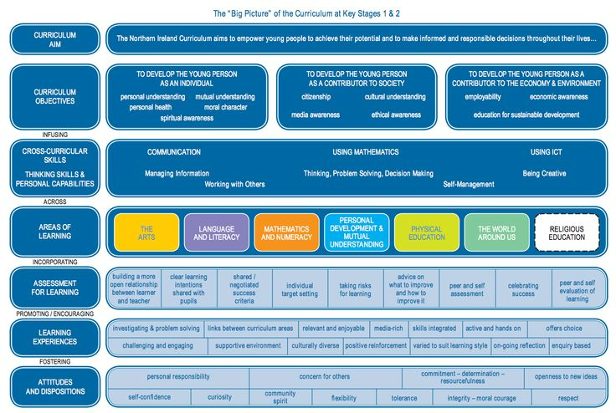
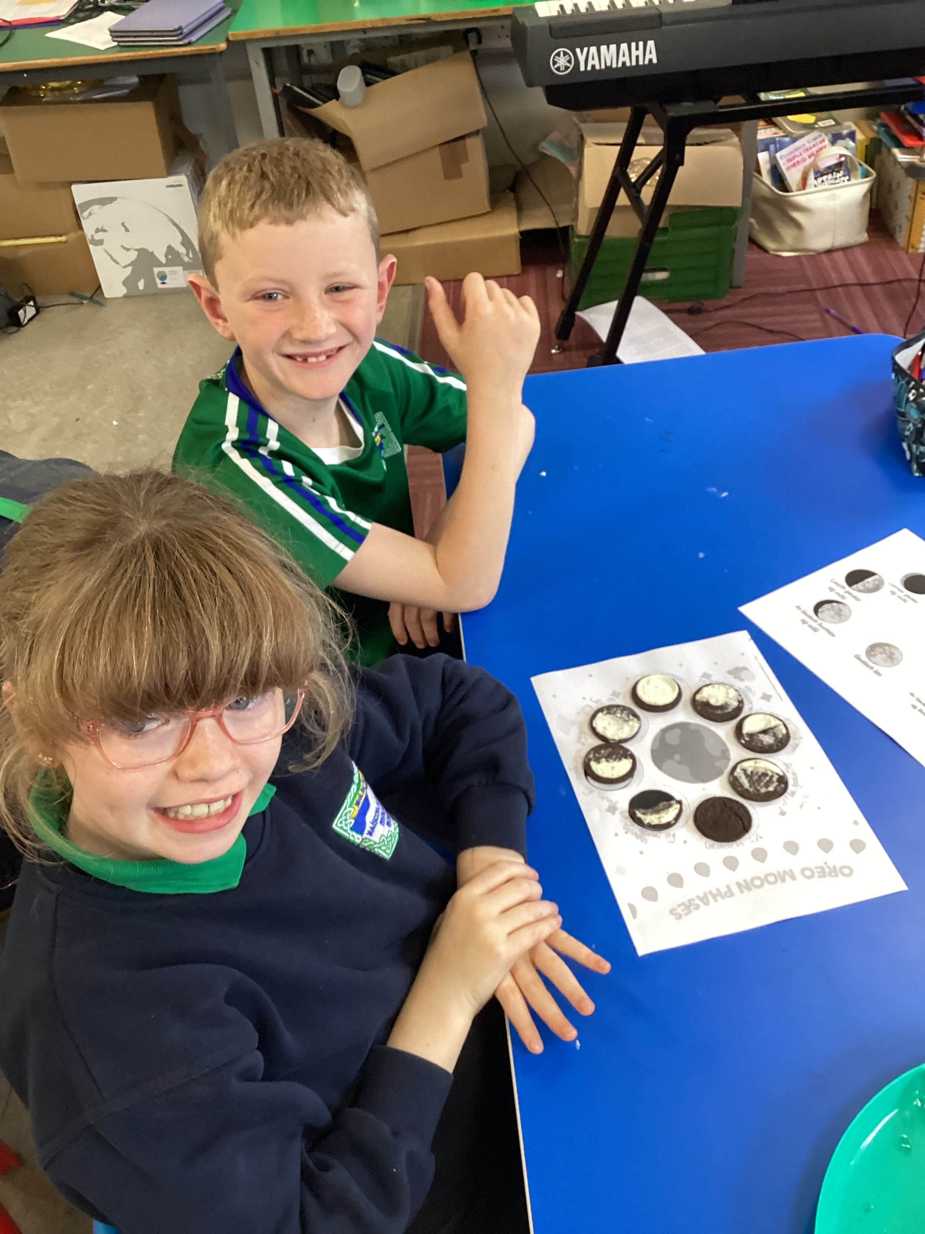
Curriculum
We follow the Northern Ireland Curriculum: Literacy, Numeracy, The World Around us, The Arts (Art and Design, Music and Drama), P.E., Personal Development and Mutual Understanding, ICT and RE.
A significant proportion of the Curriculum in Rang 5 is delivered through Topic-based learning. Children learn to problem solve, investigate ideas, create projects, cooperate with others, explain their findings and extend their vocabulary and communication skills through a variety of Topics.
We are currently working on and enjoying our topic ‘An Grianchóras’ (The Solar System). Ask us about this at home!

Slide 7


Obair bhaile - Homework
We are continuing to adopt the approach implemented last year, in which the children are given one piece of written homework a week, with 3 other small practical or online tasks.
This allows families to spend more time on reading and spelling, two vital skills.
Homework will be glued into the children’s homework book on Monday. They will return completed homework on Fridays.
As we are trying to foster independence as the children move into KS2, they are given the responsibility to place their homework book and old reading books in the right tray each Friday morning.
We will continue to use Google Classroom this year in R5. Links to homework games will be posted on our ‘Seomra Ranga Google’. Children will sometimes be set a homework task on Google Classroom. They can post their work underneath the ‘Assessment’ tab.
Voice recordings of Irish spellings can also be found on Google Classroom each week.
Children are reminded to bring their ‘comhad scoile’ to school each day.

Slide 8


Litearthacht - Literacy
Literacy is taught through both the mediums of Irish and English.
Reading:
Reading is viewed as both a vital life skill and a form of enjoyment in R5. We enjoy listening to stories at break time as we eat. At this age, we are beginning to move away from the ‘learning to read’ stage and are beginning to ‘read to learn’. We have lots of access to non-fiction books and are learning to use these independently to learn more about our topics. As well as reading their ‘home reader’ each night, R5 children should be encouraged to read for pleasure each night too.
We use the Accelerated Reading scheme in Rang a Cúig. The children are encouraged to read their Accelerated Reader book at home. If you would like recommendations for suitable books for your child, please visit Children’s Book Ireland, who publish updated book lists regularly.
https://childrensbooksireland.ie/our-recommendations
Please note that our local library in Castlewellan has an excellent stock of Irish language books on the ground floor! Bígí ag léamh i nGaeilge chomh maith!
Writing:
The children will be introduced to a new genre of writing each half term (eg, recount, instructional, narrative etc.). We are currently focusing on writing our own creative recounts based on our topic ‘An Grianchorás’.
In Rang a Cúig, we will place a particular focus on producing high quality pieces of writing. We will focus on the 5 stages of the writing process (collating ideas, planning, drafting, redrafting and editing and publishing) and the children will have plenty of opportunities to share their writing with suitable audiences.
Talking and Listening:
In R5 we place a significant emphasis on talking and listening, especially in Irish, as this helps us acquire our second language.
We complete circle time every Monday morning, where the children use provided sentence starters to share news with their class. We also engage in lots of drama-based activities as part of our Literacy lessons, before beginning the writing process.

Slide 9
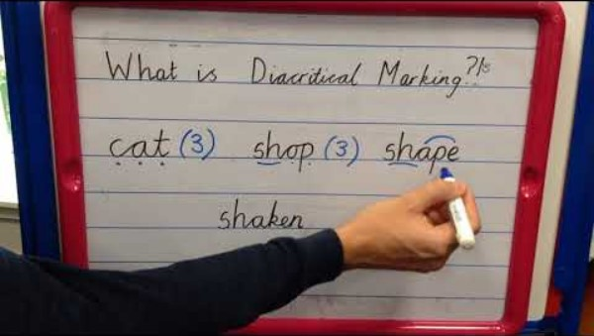
Litriú - Spelling
R5’s approach to Phonics –
Monday: Children work in groups to generate words that contain the target sound.
Tuesday: Sound buttoning of spelling words.
Wednesday: Practical spelling stations / Decodable comprehension containing target sound
Thursday:
Sentence dictation
Friday:
Spelling test
We are working hard to improve our spelling in Rang a Cúig.
We have been focussing on the long vowel sounds in English this half term in R5. We have learnt the terms ‘digraph’ and ‘split digraph’ and can explain these terms very well.
We have been learning how to use sound buttons and engage in sound buttoning activities at least 3 times a week.
You can watch the following video to help support us with this at home.
In Rang a Cúig, we are always encouraged to attempt to spell a word in our ‘Have a Go’ pad, before asking an adult for a spelling.
When spelling at home, encourage your child to attempt the word first.
Spelling mistakes can be very insightful, as it helps adults understand which phonemes we know and which phonemes we do not yet know!
Give us the opportunity to engage in small, but purposeful spelling activities at home.
Could an adult dictate a shopping list for us to write?
Could we write a letter or a post card to a relative who lives far away?

Slide 10


Litriú sa bhaile – Spelling at home
Here are some practical ways that the children can practise their weekly target sound at home.
An assessment will be set on Sumdog spelling based on both that week and previous weeks’ target sounds. The children are encouraged to complete these weekly.
Set a timer and listen to speech for 1-2 minutes. This could be a conversation, the tv, radio, an adult reading a story etc.
Listen carefully for our weekly target sound and attempt to spell the words that you have heard containing that sound.
Can you encourage your child to practise their spellings using a multisensory approach.
Use a stick to write in mud.
Chalk writing on tarmac.
Write with your finger in salt/shaving foam.
The children can use the following blending board at home to create their spelling words digitally:
https://research.dwi.ufl.edu/op.n/file/gc8nkxns914enc7d/?embed&fbclid=IwAR1OiYiB6fERCg-3wSWOPc0QZh4cmzyZ7wdO7f__fU2c4trzyanvj1xebko
This a very useful resource, which we use frequently in class!

Slide 11

Uimhearthacht - Numeracy
A strong foundation in mental maths will benefit the children greatly as they begin to face more complicated concepts as they move into KS2. We will spend 20 minutes each day engaging in mental maths games and exercises to consolidate the children’s understanding of the four operations: addition, subtraction, multiplication and division.
Throughout Rang a Cúig the children will develop their understanding of Number, Shape and Space and Data Handling.
Number - Increase competence in dealing with whole numbers and deepen knowledge of place value, recognise pattern and relationships in number, multiplication tables, develop ability in using four main operations and show understanding of maths in real-life problems.
Shape and Space - 2D/ 3D shapes- Construct, describe and analyse shapes and awareness of angle, symmetry and co-ordinates.
Data Handling- Measurement- Length, Weight, Capacity, Volume and Time- Ability to convert metric units of measurement and understand the concept of scale. Develop competence in dealing with time, ability to read and understand data stored in a variety of ways, collection and classification, presentation, interpreting of data and probability.

Slide 12
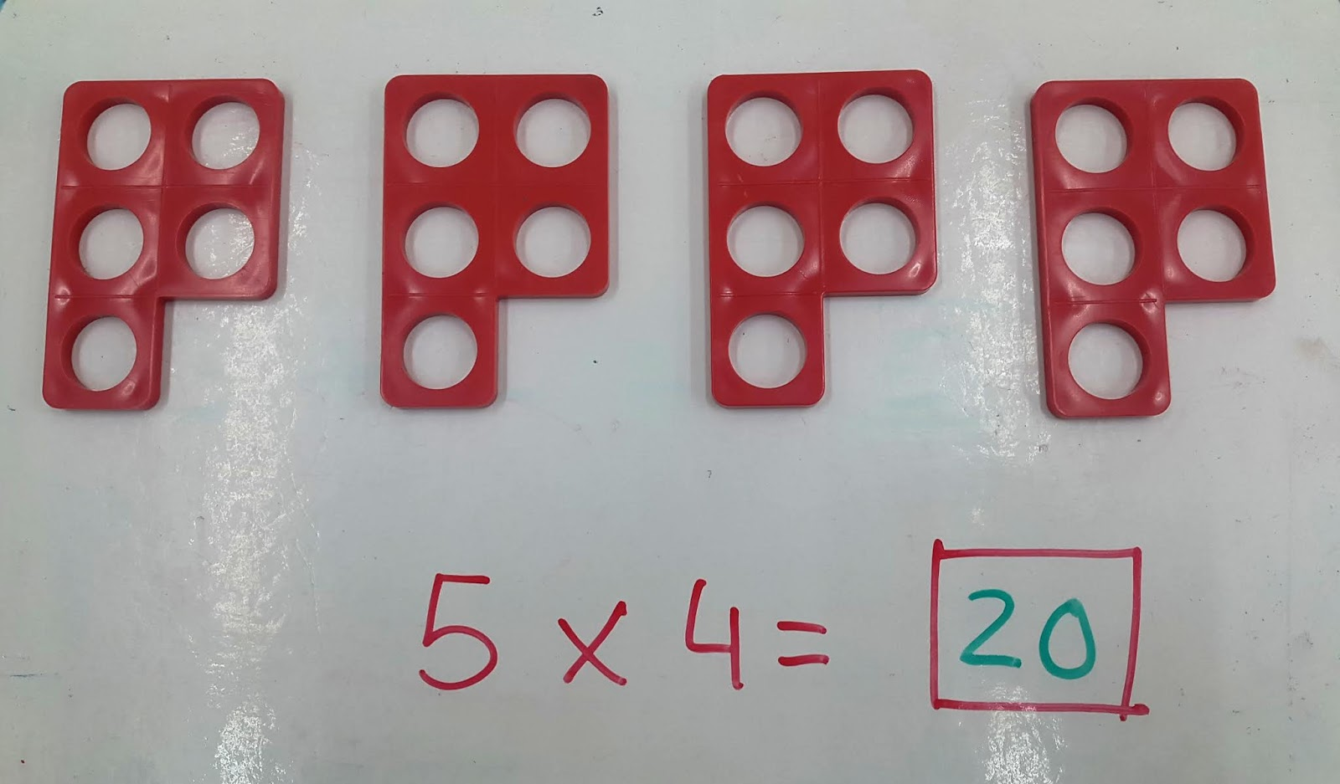
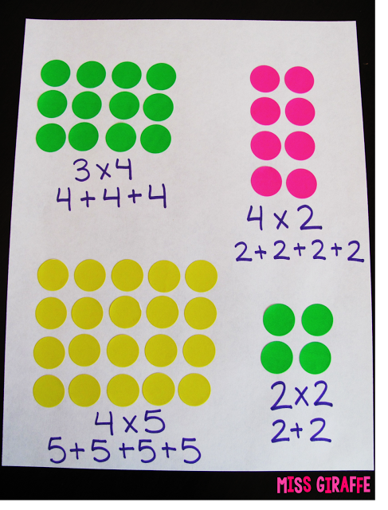
Times tables - Numeracy
In R5, we place a significant emphasis on the learning of multiplication and division facts. It is crucial that the children achieve rapid recall of these facts, as fluency is needed when they meet harder, more abstract topics, such as fractions, percentages and decimals in R6&7. They must first develop a very strong conceptual understanding of multiplication and division. After the Halloween break, we will spend time exploring multiplication and division conceptually, by creating and sharing between equal groups, building array and representing repeated addition with Numicon. The children will build a variety of strategies that they can use to determine answer of facts throughout the year. Here is a list of the strategies that the children will be taught and encouraged to use:
2 Times Tables – Doubles
10 Times Tables – Skip counting
5 Times Tables -- Multiply by 10 and divide by 2
4 Times Tables – Double and double again
8 Times Tables – Double, double and double again
3 Times Tables – Double and add a group
6 Times Tables – Multiply by 5 and add a group/ Multiply by 3 and double
9 Times Tables – Multiply by 10 and subtract a group
7 Times Tables – Multiply by 5, multiply by 2 and add

Slide 13


An Domhan Thart Orainn/ World Around Us
In Rang a Cúig, we will be focusing on five main topics during ‘An Domhan Thart Orainn’ lessons. Cross-curricular learning will take place during these lessons, allowing the children to develop their language skills and mathematical skills in a fun and engaging manner.
We will be exploring the following topics throughout the year:
Term 1a) - The Solar System
Term 1 b) - Native Animals of Ireland
Term 2 a) - Natural Disasters
Term 2b) - Our Culture (The history of the Irish Language, the history of our music, sporting and dancing traditions in Ireland etc.)
Term 3 - The Egyptians

Slide 14
Measúnú - Assessment
Bunscoil Bheanna Boirche assesses pupils in the same ways as pupils are assessed in any other primary school in Northern Ireland- Irish or English Medium.
In accordance with the NI Curriculum, in Years 1-7, teachers must assess your child’s learning.
Continuous assessment is done regularly in the classroom, through assessing your child’s written work, participation in class discussions and tests on a Friday. However in Rang 5 pupils undergo standardised tests in the summer term in English, Irish and Maths which give a more formal indication of progress. These scores are then analysed by the teachers, and used to plan the future teaching and learning of our pupils.
Parent-teacher meetings in February will help update you on your child’s progress and will give you the opportunity to learn about how you can help your child in the home environment.
At the end of each school year, you will receive a written report from your child’s teacher. This will describe your child’s progress in every aspect of the curriculum.

Slide 15

Imeachtaí Seach–Churaclaim Extra-Curricular activities
Club Bricfeasta- Breakfast club from 8-8.45am
Club iarscoile- The ‘After-School Club’ takes place on a Monday- Thursday after school - 3pm-4pm.
The club will offer a range of different activities for the children ie. gardening, crafts, games etc. The cost for both clubs is £3.

Slide 16

Tuismitheoirí - Parents
Our caring, family ethos at Bunscoil Bheanna Boirche means that we strongly value the importance of parental input in their child’s education.
We believe that happy children are more effective learners. Parents are always encouraged to discuss any concerns they may have either with the class teacher or with the principal. Our door is always open, and we pride ourselves here at Bunscoil Bheanna Boirche in our open and friendly relationships between teachers and parents.

Slide 17
Go raibh míle maith agaibh!

