Slide 1
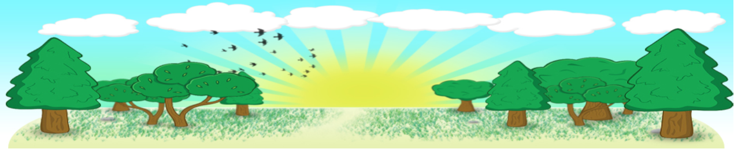
Fáilte go
Bunscoil
Bheanna Boirche
Rang a 3

Slide 2
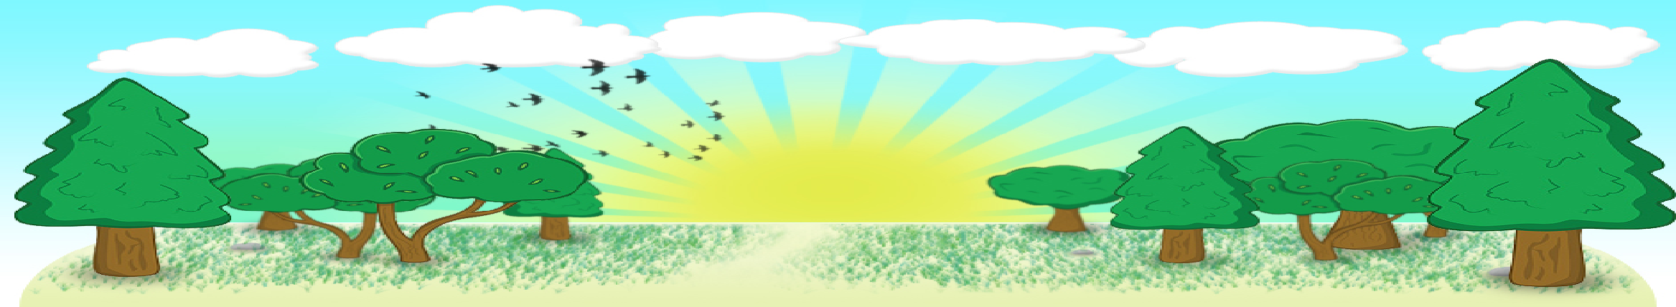
Curaclam - Curriculum
There are three stages in Primary School:
Foundation Stage (Rang 1 and 2)
Key Stage 1 (Rang 3 and 4)
Key Stage 2 (Rang 5, 6 and 7)
We follow the Northern Ireland Curriculum. The next slide is sometimes called the Big Picture. It shows in detail what the Northern Ireland Curriculum involves.

Slide 3
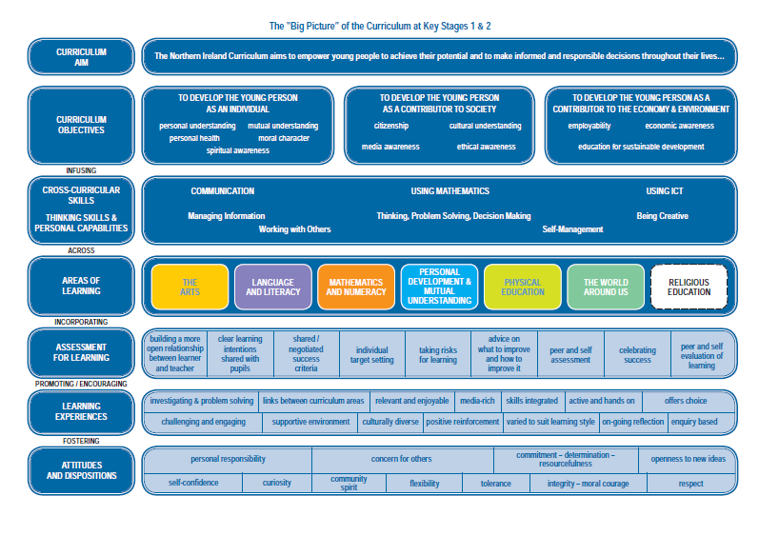

Slide 4
Curaclam Thuaisceart Éireann
(Northern Ireland Curriculum)
Your child is currently in:
Key Stage 1
Areas of Learning
Literacy
Numeracy
The World Around Us
The Arts (Art & Design, Music and Drama)
P.E.
Personal Development and Mutual Understanding (PDMU)
ICT
Religious Education
Skills & Capabilities
-Thinking Skills and Personal Capabilities
- Cross-curricular Skills
Communication
Using Mathematics
Using ICT
A significant proportion of the curriculum in Rang 3 is delivered through activity-based learning. Children learn to problem solve, take turns, share, explain their methods and extend their vocabulary and communication skills through language rich, adult supervised/led play experiences.

Slide 5
Curaclam (ar lean…)
Curriculum (continued…)
We are very well resourced with ICT equipment, with a PC, laptop, surface pro, interactive whiteboard and a set of ipads in each classroom. ICT is planned carefully to enhance and progress our children’s learning.
We pride ourselves in innovative and pupil-friendly use of technology, sharing voice notes, MP3 links, and links to Irish language resources for you to use at home to help support your child in their learning in an immersion setting.
We are nondenominational school, and we follow ‘Living Learning Together’, a pastoral care programme which encourages personal development and mutual understanding of the world and the wider community. We prepare children for the Catholic sacraments if their parents so wish, following the Veritas ‘Beo Go Deo’ Catholic Education Series.
We also cater for children who do not wish to participate in R.E. Please let me know if you do not wish your child to do R.E. and/or First Confession
First Confession will take place in St Malachy’s church (Date will be confirmed). There will be one homework per week for a number of weeks before First Confession to let you know what your child has been learning in class.

Slide 6
Class timetable
 | Mon | Tue | Wed | Thur | Fri
9-9.15 | Reading for Pleasure/fun | Reading for Pleasure/fun | Reading for Pleasure/fun | Reading for Pleasure/fun | Reading for Pleasure/fun
9.15- 9.25 | Roll call and dinner roll | Roll call and dinner roll | Roll call and dinner roll | Roll call and dinner roll | Roll call and dinner roll
9.30-9.50 | Fónaic na Gaeilge/Spelling | Fónaic na Gaeilge/Spelling | Fónaic na Gaeilge/Spelling | Fónaic na Gaeilge/Spelling | Tionol /Assembly 9.30-10.00
9.45-10.30 | Literacy- Reading/Writing | Literacy- Reading/Writing | The World Around Us | Literacy- Reading/Writing | Nurture Spelling- address common class difficulties with sound of week
10.30-10.45 | Eat break | Eat break | Eat break | Eat break | Eat break
10.45-11.00 | Outdoor break | Outdoor break | Outdoor break | Outdoor break | Outdoor break
11 - 11.15 | Mental Maths | Mental Maths | Mental Maths Maths Tasks and Activities | PDMU/PERSONAL DEVELOPMENT Mental Maths | Mental Maths
11.15-12.00 | Maths Tasks and Activities | Maths Tasks and Activities |  | Maths Tasks and Activities | Maths Tasks and Activities
12.00- 1.00 | Eat lunch | Eat lunch | Eat lunch | Eat lunch | Eat lunch
 | Lunchtime Outside break | Lunchtime Outside break | Lunchtime Outside break | Lunchtime Outside break | Lunchtime Outside break
1.00-1.45 | Language Activities | PE | PE | Structured Play | Structured Play
1.50-2.00 | Preparations for hometime | Preparations for hometime | Preparations for hometime | Preparations for hometime | Preparations for hometime

Slide 7
Language and Literacy
In Irish Medium Education,
Key Stage 1 children are enabled to learn fundamental language and literacy skills in both
English and Irish.
The next few slides go into more detail on these 3 core elements to Language and Literacy (English and Irish):
Listening, Understanding and Talking,
Reading
Writing

Slide 8
Language and Literacy
Listening, Understanding and Talking
Participate in listening, understanding and talking in all the areas of learning outlined in the Big Picture
Listen to, respond to and explore stories, poems, songs, drama and media texts through use of traditional and digital resources
Listen to and respond to guidance and instruction
Listen to, understand and take part in group and paired activities
Describe and talk about real experiences and imaginary situations and about people, places, events and artefacts (for example, talk about a dream they had)

Slide 9
Language and Literacy
Reading
Participate in shared reading experiences - for example; reading online books using the Interactive Whiteboard.
Participate in smaller group reading experiences. This encourages the children to answer out well and get engaged in discussions based on texts.
Focused learning, specific tasks based on the reading material.
Fónaic na Gaeilge, learning about sounds (fuaimeanna). Encouraging children to sound out words.
Children start English in class in the 2nd term and will have English Reading and Spelling for homework early in the 2nd term.

Slide 10
Language and Literacy
We are very well resourced with Reading materials. We use the following schemes to teach reading
Fónaic na Gaeilge and Linguistic Phonics
Word investigations – sounds / syllables
Collins Primary Literacy
Séidean Sí
CLEITE
Rigby Star
Big Cat
Bug Club
Céim ar Chéim

Slide 11
Language and Literacy
Writing
Participate in lessons to improve writing in sentences, ordering a sentence, filling in blanks in sentences etc.
experiment with rhymes, rhythms, verse structure and all kinds of word play.
use a variety of strategies to spell words correctly.
develop increasing competence in the use of grammar and punctuation to create clarity of meaning, for example use of full stops.
Writing lists, greeting cards, letters, observations and descriptions based on events or activities from stories, poems, pictures or class lessons.
develop a swift and legible style of writing by working on letter formation, spacing, writing on lines etc.

Slide 12
Matamaitic agus Uimhearthacht
Processes in Mathematics
making decisions in Maths
communicating mathematically and mathematical reasoning (children explaining how they got their answer to the class )
Number
Activities with the 100 square, counting to 100, recognition of numbers to 100 (We start with revision of writing the numbers 1-20, then work with numbers to 30, then to 50, and then move on to 100)
Number patterns (3+5, 13+5, 23+5) etc.
Relationships and Sequences in number, working with tens and units etc.
Money – recognition of coins, counting money, giving the correct amount of money, different ways to put out certain amounts of money, giving change from 5p 10p.
Addition and Subtraction: add one to a number; add 2 to a number; subtract 1 from a number; subtract 2 from a number; add 10 to a number; add 9 to a number, doubles (1+1 2+2…….. 10+10)
Practical preparation for multiplication and division
Fractions – understanding one half, one quarter and the symbols

Slide 13
Matamaitic agus Uimhearthacht
Measures
Length, height, weight, capacity and volume using non-standard measures; comparing measures for example using a metre stick to compare the length/height of other items
Time – naming days of week in order, seasons in order, recognising half past, quarter past, quarter to
Shape and Space
Recognising basic three dimensional shapes; investigating the relationship between two dimensional shapes and three dimensional shapes
Handling Data
Graphs – understanding how to read pictographs, bar graphs and block graphs

Slide 14
Matamaitic agus Uimhearthacht
We are very well resourced with Maths materials. We use the following to teach Maths
Collins Primary Maths
Activity based learning resources
Dice
Dienes equipment
Counters
Unifix. Multilink, numicon
Basic number games (Snap, making pairs, dominoes etc)
Activities / Games online
Interactive resources / Apps

Slide 15
Other areas of Learning
The World Around Us: Science & Technology, History and Geography
We start the year with a series of mini-topics Roald Dahl, Spain, Autumn, Halloween, Winter
Then we continue with
Christmas around the world
The Weather
Celebrations
Minibeasts
The Arts
Music -We do lots of singing, learn the names of instruments, work on rhythm etc.
Drama – This is usually linked to reading, poetry, Christmas play etc.
Art and Design – This is usually linked to the seasons/time of year, class topics, competitions or other whole school events

Slide 16
Personal Development and Mutual Understanding (PDMU)
We follow the NSPCC Keeping Safe Programme
Class theme and homework each term
Term 1 Healthy Relationships
Term 2 My Body
Term 3 Keeping Safe
If you want to find out more check NSPCC website
www.nspcc.org.uk
We follow the Living Learning Together Programme
Unit 1- Getting to know me
Unit 2- Feeling good and feeling sad
Unit 3- Taking care Be safe
Unit 4- Getting along with others
Unit 5- Why should I ?
Unit 6- I belong

Slide 17
Obair Bhaile
Google Classroom will be used for sending homework tasks and the class stream on Classroom will be used for sending messages. Worksheets for the week will be sent home on the 1st day of the week in your child’s homework folder.
An easy–read will be sent home with your child each week (which they will have read in class the week before). Pupils should spend at least 10 minutes each night reading both this easy-read, their new reading book and their own supplementary reading material. Parents can keep a record of what their child has read in the reading record if you wish but please only write regarding reading in this Reading Record book and remember I will only be checking it on the days when I need to write in it.
It is also very important to continue to read as often as possible to your child in Rang 3. Rang 3 children particularly enjoy picture books where they can listen as they enjoy following the story through the pictures.
Homework will consist of one written piece of work (Literacy, Numeracy, a topic-based homework or Personal Development), Spellings, Reading and practical learning tasks.
This written homework is to be returned digitally using Classroom by Thursday evening. Feedback will be given digitally on Friday morning.
Homework folders with your child’s reading book and Reading Record book inside must be returned to school each morning as we use these throughout the day and on a Friday, we also need to prepare the Homework folders for the following week.

Slide 18
Litriú / Spellings
Spellings activity and list will be given at the beginning of week- it is a good idea to put the sounds in an envelope and repeat the activity on Mon, Tue and Wed so your child knows the spellings really well each week.
Your child will be assessed every week with a dictation based on the words we’ve been working on during the week, at school and at home. In class we will also go over any difficulties that the spelling dictation has flagged up. Your child’s spelling dictation will be sent home in the blue homework folder on Mondays and parents need to sign each week and send the spelling book back in your child’s blue folder the next day.
In Rang 3 our spelling programme is closely linked to our phonics lessons. We focus on teaching children to listen for the sounds in words and then write the letters that represent those sounds.
Each week, we will focus on:
Phonics Words: A set of words based on the sound or spelling pattern we are learning that week. We will practise them in class throughout the week.
High Frequency Words: We also focus on words that don't follow the usual phonics rules and need to be learned by sight
Fun & Effective Spelling Activities to Do at Home
The key is to make practice short, fun, and frequent. Just 5-10 minutes each day is far more effective than a long session once a week. Here are some extra ideas once the main spelling homework activity has been completed.
1. Look, Say, Cover, Write, Check
LOOK: Look carefully at the word.
SAY: Say the word aloud, sounding it out.
COVER: Cover the word with a hand or piece of paper.
WRITE: Write the word from memory.
CHECK: Uncover the original word and check your spelling. Correct any mistakes.

Slide 19
Litriú/Spellings (cont)
2. Rainbow Writing Write the spelling words out once. Then, trace over them two or three times using different coloured pencils or crayons. This is great for muscle memory.
3. Magnetic Letters or Letter Tiles Use letters on the fridge or letter tiles from a game (like Scrabble) to build the words. This hands-on approach helps children focus on each letter in the word.
4. Sensory Writing Get creative with different textures!
Shaving Foam: Spray a layer of shaving foam onto a tray and let your child write their words with their finger.
Sand or Salt: Pour a thin layer of sand or salt into a baking tray for tracing.
5. Word Hunt Give your child one of their spelling words and ask them to find it in a book, magazine, or newspaper at home. This helps them see the word in context.
6. Outdoor Chalking On a dry day, take some chalk outside and write the words in big letters on the pavement or a wall.
7. Typing Let your child type their words on a computer, tablet or old keyboard. This is a great way to practise and helps develop keyboard skills.
Tips for Success
Praise Effort, Not Perfection: Celebrate their hard work and progress. If they make a mistake, gently point it out and help them fix it.
Keep it Positive: If your child is tired or frustrated, it’s okay to stop and try again later.
Talk About Words: Point out interesting words when you are out and about. Talk about the sounds you can hear in them.
Read, Read, Read: The more your child reads, the more they will see words spelled correctly, which helps them become a better speller.
By working together, we can help your child develop the skills and confidence they need to become a successful speller.

Slide 20
Assessment
A key question parents often ask is ‘how will my child be assessed?’
Bunscoil Bheanna Boirche assesses pupils in the same ways as pupils are assessed in any other primary school in Northern Ireland – Irish or English medium.
In accordance with the NI Curriculum, in Years 1 – 7, teachers must assess your child’s learning.
In Rang 1, 2 & 3, this predominantly takes the form of ongoing individual classroom observations. In Rang 3, pupils are also assessed on a weekly basis on their key literacy and numeracy skills/targets, albeit in a very informal style, such as structured games and 1:1 activities.
In Rang 3 - 7, pupils undergo standardised tests in the summer term in English, Irish and Maths, which give a more formal indication of progress. These scores are then analysed by the teachers and used to plan the future teaching and learning of our pupils.
At the beginning of the 2nd term, 1:1 parent-teacher meetings help to update you on your child’s progress and to suggest areas to help support your child at home.
At the end of each school year, you will receive a written report from your child’s teacher. This will describe your child’s progress in every aspect of the curriculum.

Slide 21
Spóirt
At Bunscoil Bheanna Boirche, pupils experience a wide range of sporting activities.
Where possible a coach from the Ulster Council or Down GAA visits for hurling/camogie and Gaelic football
Key Stage 2 pupils play Gaelic football, hurling and soccer for the school in local inter-school competitions, travel to Down Leisure Centre in Downpatrick every spring for swimming lessons, and participate in Cycling Proficiency Programme.
Structured weekly PE lessons are also taught, in which teachers follow a movement and athletics scheme which ensures continuity and progression of core skills and competences and Fundamental Skills, for example ball skills (throwing, kicking) bat skills (hitting) etc.
There will be 2 PE lessons per week. In Rang a 3 these will be on Tuesday and Wednesday.

Slide 22
Imeachtaí Seach-churaclaim
Extra-curricular activities
Club Bricfeasta – breakfast club from 8 – 8.45 am
Afterschool Club 2-4pm daily Monday - Thursday
Gaelic Football and Hurling training and participation in inter-schools competitions
School Council and Eco-School committee (R4-7)
Summer Scheme - having fun and speaking Irish in July
Regular school trips, walks and outings

Slide 23
An Lá Scoile
The School Day
Class begins at 9.00am. Children are supervised in the clós (playground) from 8.45am, and parents can avail of our ‘Club Bricfeasta’ which will be available each morning from 8 – 8.45 am.
Breaktime is from 10.30-11.00am.
Lunchtime is from 12.00-1.00pm.
At Bunscoil Bheanna Boirche, we pride ourselves on our healthy eating policy. Our school dinners come from St. Malachy’s Primary School in Castlewellan and are of a high standard. It is recommended that pupils eat fruit, a yoghurt or a small sandwich at breaktime. Children are encouraged to bring a bottle of water to school. Sugary/fizzy drinks are not allowed. Crisps, chocolates etc. are not allowed for break, and we discourage unhealthy snacks for lunch. We do not have any children with a nut allergy in the class at present, but we discourage bringing nuts to school. Pupils are not allowed to share their lunch with others.
Rang 1 and Rang 2 go home at 2.00pm.
Rang 4 – 7 go home at 3.00pm **EXCEPT FRIDAYS**
Rang 3 go home at 2.00pm until Christmas Mon to Thur and 1.55pm on Fridays. From January onwards, Rang 3 go home at 3.00pm **EXCEPT FRIDAYS WHEN THEY GO HOME AT 1.55pm
Our after-school club runs from 2 – 4pm Monday to Thursday in the school bialann.

Slide 24
Éide Scoile
School Uniform
Our uniform consists of:
Navy sweatshirt embroidered with the school logo and motto; (available from McKenny’s Clothes Shop in Castlewellan.)
Grey trousers, skirt or shorts;
Green polo shirt embroidered with the school logo and motto;
Navy school coat (optional);
Black shoes;
Girls may wear navy knee socks, navy tights or white ankle socks;
Girls may wear navy or green gingham dresses in the summer-time;
P.E. uniform consists of:
Grey/ navy track bottoms, or grey/navy shorts (without brands/logos)
Suitable trainers
Green polo shirt embroidered with the school logo and motto (or school jersey which is optional)
The school jersey can be worn for P.E. and on sporting occasions such as Sports Day.
NO JERSEYS OR BRANDED HOODIES
N.B. PLEASE ENSURE ALL ITEMS OF CLOTHING ARE LABELLED CLEARLY

Slide 25
Poncúlacht - Punctuality
Punctuality is extremely important here at Bunscoil Bheanna Boirche. School begins at 9.00am. Register is taken first thing, and anyone who arrives after 9.15am is marked in as late. Anyone who arrives after 9.30am is marked absent for the morning (unless attending an appointment, in which case the teacher should be informed). If attendance falls below 85% the Education Welfare Officer from the Education Authority will investigate absences.

Slide 26
Ailléirgí - Allergies
We have pupils in the school with allergies. It is important that your child knows he/she cannot share his/her lunch with friends in class.

Slide 27
Tuismitheoirí - Parents
Our caring, family ethos at Bunscoil Bheanna Boirche means that we strongly value the importance of parental input in their child’s education, and we enjoy a wonderful level of parental participation and involvement in our school community here at Bunscoil Bheanna Boirche.
We strive to involve parents in the life of the school. Parents help with breakfast club, after-school activities and assist on school trips and events. Parents are employed in the school as lunchtime supervisors and classroom assistants. Parents are also involved in school fundraising, and we have a very active and vibrant Parents’ Support Group who regularly organise fundraising events and activities to help subsidise school trips and equipment.
We believe that happy children are more effective learners. Parents are always encouraged to discuss any concerns they may have either with the class teacher or with the principal. Our door is always open, and we pride ourselves here at Bunscoil Bheanna Boirche on our open and friendly relationships between teachers and parents.

Slide 28
Tuismitheoirí - Parents
Our school website also has a free app which parents need to download, as you will receive instant notifications and updates to the school calendar/day-to-day changes etc.
In addition, Cairde BBB has a private Facebook Group which regularly posts photos and reminders of what’s been happening at school. Make sure to join!

Slide 29
Cairde
Our Parent Support Group
We have a very active and dedicated Parent Support Group called ‘Cairde’ who regularly arrange activities such as fundraiser events and family fun days.
Their fundraising goes towards subsidising buses for school trips to reduce the cost for parents, purchasing class iPads, class reading books, developing our outdoor play area etc.
They are an integral part of Bunscoil Bheanna Boirche and are always keen for new members to join in and help in whatever small way they can. Keep up to date on the Facebook Group or speak to one of the parent members if you think you could spare a few hours a month or have any great ideas to share.

Slide 30
Polasaithe Scoile
School Policies
Child Protection Summary Policy given out to all pupils on beginning Naíscoil and Rang 1.
All of our other school policies are available to view on the school website www.bunscoilbb.com or from the school office by appointment with the principal.

Slide 31
Ag cuidiú le do pháiste
Supporting your child
Whilst having Irish in the home is not a prerequisite to attend Bunscoil Bheanna Boirche, parents are strongly encouraged to avail of the many great Irish Language classes that are available in the area in order to be able to support their child’s learning.
In addition, homework are supplemented with support materials for parents to use to help with pronunciation and meaning.
Remember, homework is a REVISION of work/topics covered in class, so pupils will be able to tell YOU what they are meant to do, and will take great joy in doing so!
There are some fantastic websites to assist parents with Irish and support their child, such as: www.abair.ie www.tearma.ie
www.irishforparents.ie
We also recommend using the following apps if you have a tablet device at home:
Cód na Gaeilge, Mathletics, Sumdog, Cúla 4, Fuaim Ú, iMovie, Beebot, Scratch Jr, Book Creator
and we welcome any recommendations for good apps you may come across at home! Please send them in!

Slide 32
Ag cuidiú le do pháiste
Supporting your child
It is important that your child’s school bag, homework folder with your child’s reading book and reading record book inside is sent into school each day.
Ensure your child knows if they are taking lunch or dinner that day and if it is dinner that he/she knows which dinner preference he/she would like.
We have a class contract which has been worked on and agreed by Rang a 3. Rang a 3 have agreed that being kind to their class peers is very important and that they need to follow all class rules that ensure their safety and enhance their learning. These class rules are displayed in the classroom and are discussed regularly with Rang a 3 in class. It is important that you remind your child of the importance of keeping these rules and do this on a regular basis as well.
Please let us know if you will be taking your child out of school early for an appointment.
After your child has been off school for example with an illness it is important you return an absence slip giving the reason for the absence. These slips have been given out by the office at the beginning of the year.
Sending in money- while this can be sent in a marked envelope, child’s name, amount and what it is for, it is much easier if you use the ParentPay online payment system.

Slide 33

Go raibh maith agaibh

