Slide 1
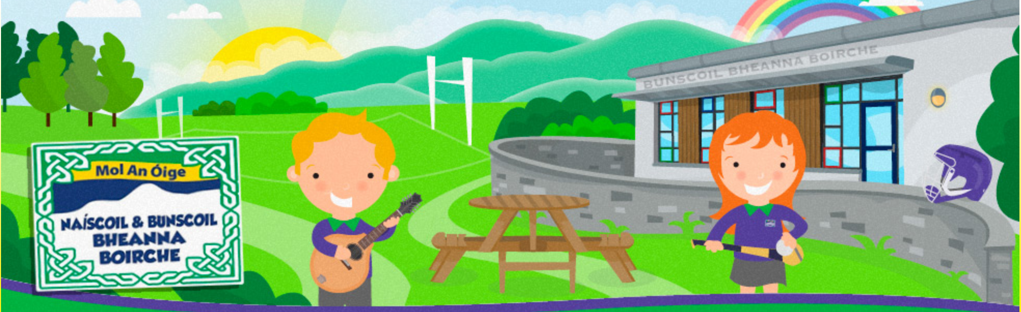
Cruinniú Curaclaim
Curriculum Meeting 2025
Rang 6/7
Naíscoil agus Bunscoil Bheanna Boirche
Múinteoir: Rachel Nic Róibín
Cúntóirí Ranga: Lorna, Stephen agus Dearbhail
Notes:
1

Slide 2

Dialann an lae Daily Routine
9.00.9.10- Registration
9.10-9.30- Morning Task
9.30-9.45- Phonics
9.45-10.15- Gaeilge – Grammar/Novel/Comprehension/Writing
10.15-11.00- Breaktime (Maoir Shúgartha are outside assisting R1/2 and
everyone else will doing practical activities between 10.45-11am)
11.00-11.20- Mental maths activities
11.20-12.00- Maths work
12.00-1.00- Lunch
1.00-1.20- Quiet Reading/ Accelerated Reader novels & quizzes
1.20- 1.40- Homework - allocated homework and correcting previous homework (Monday and Thursday)
1.40-2.20 English- grammar/punctuation/novel/comprehension/writing and WAU topic
2.20- 2.40- W.A.U (topic work)/ Art/ Personal Development/ Practical tasks
2.40-3.00- Class novel
3.00 Hometime

Slide 3
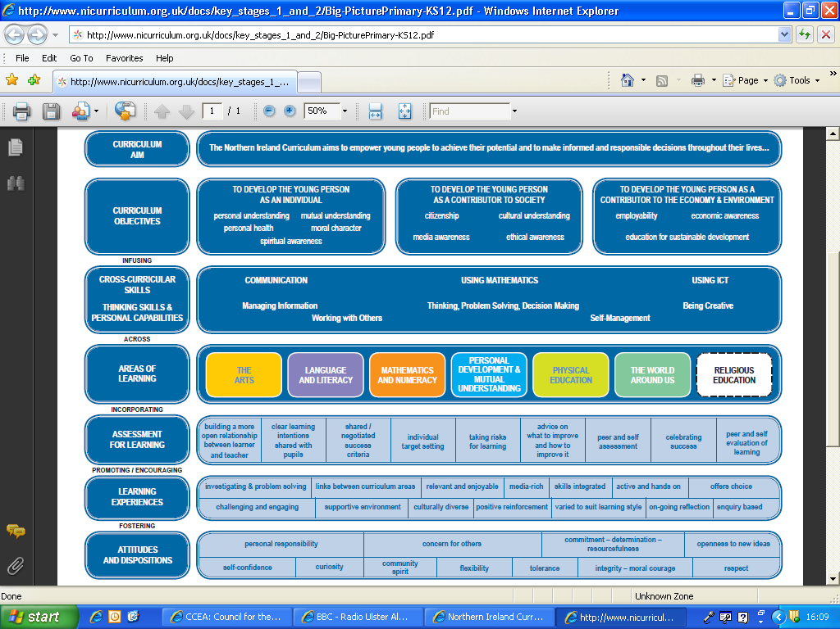
Notes:
3

Slide 4
Literacy and Language This will be taught through both English and Irish.
Reading
Learning Outcomes | Activities
Reading for enjoyment and for information Read a wide range of various types of texts Develop a personal preference Show ability to interpret and evaluate texts Show awareness of punctuation and structure Awareness of various styles and types of text Improve fluency and confidence in reading Use various strategies to read unfamiliar words | Reading groups Independent reading Linguistic phonics / Fónaic na Gaeilge Research tasks News activities Use of various styles of text Class and group discussion Spelling strategies / games
Notes:
4

Slide 5
Literacy and Language
Writing
Learning Outcomes | Activities
Increased awareness and understanding of structure Awareness of various features of differing texts, i.e. headings, bullet points, etc. Understand importance of planning Develop a personal style of writing Ability to revise and edit Use various types of writing to create atmosphere and effect Develop competence in composing digitally Increased competence in grammar and punctuation Use learned strategies to help spell unfamiliar words | Various reading activities Planning for writing Analysis of various types of writing Topic-based writing activities Focused grammar and punctuation lessons Opportunities to revise work (2**, 1 wish) Write for various audiences Diary entries, writing letters, creative writing, narrative, explanation, news articles, poetry, lists, alphabetical order, argumentative and persuasive writing, word-play, book reviews, etc. Different writing genre focus each half term
Notes:
5

Slide 6
Literacy and Language
Talking and Listening
Learning Outcomes | Activities
Ability to tell and recall stories Ability to participate in class discussions Show understanding of conventions of group discussion Share, listen to and evaluate ideas Respond to evidence and formulate opinions Ability to ask appropriate and useful questions Show understanding of audience, using appropriate language, speech, etc Recognise differences in dialect, accent and colloquial speech, as well as formal and informal speech | Shared and guided reading activities Sharing news / stories Circle time Class discussions Debates Creating and presenting presentations PDMU topics
Notes:
6

Slide 7
Numeracy
Processes
Learning Outcomes | Activities
Ability to plan and organise Selection of appropriate equipment / resources Develop competence in use of mathematical language Analyse, revise and edit Present work and findings clearly | Mental maths games Questioning – open-ended and closed questions Self-evaluation and justification Izak9 Problem solving tasks
Notes:
7

Slide 8
Numeracy
Number
Learning Outcomes | Activities
Increase competence in dealing with whole numbers and deepen knowledge of place value Develop knowledge of fractions and percentages Understanding of negative numbers Recognise pattern and relationships in number Multiplication tables / Division facts Develop ability in using four main operations Show understanding of maths in real-life problems | Mental maths games Practical maths tasks Practising times-tables Sequencing number Paired and group work / games Investigating number and pattern Questioning and identifying steps / strategy Word problems
Notes:
8

Slide 9
Numeracy
Measures, and Shape and Space
Learning Outcomes | Activities
Ability to estimate Knowledge of length, width, volume, etc. Ability to convert metric units of measurement Understand the concept of scale Develop competence in dealing with time Construct, describe and analyse 2-D shapes Identify and describe common 3-D shapes Awareness of angle, symmetry and co-ordinates | Mental maths games Practical maths tasks Investigating shapes (2-D and 3-D) Map and atlas work Drawing and constructing shapes Using appropriate equipment
Notes:
9

Slide 10
Numeracy
Handling Data
Learning Outcomes | Activities
Ability to read and understand data stored in a variety of ways Collection and classification Presentation Ability to design data collection sheets Interpret data Probability | Reading various sources of data – tables etc. Analysing digitally stored tables Classifying data using criteria (grouping) Compiling data banks in various ways Presenting information and discussing implications / meanings Undertaking surveys and collecting data
Notes:
10

Slide 11
World Around Us
September – October: Europe
November- December: Christmas all over the world
January- February: Arctic and Antarctic
March- April: The Vikings
May- June: Mythology and Tales
Combination of Geography, History and Science and Technology
Four main strands-
Interdependence | Place | Movement and energy | Change over time
Ourselves Interaction Survival | Local and global habitat How the world has changed Environment Cultural / heritage links | Emigration – why? When? Weather and its affects Raiders and settlers | Past, present, future Our influence Seasons Pollution / global warming
Notes:
11

Slide 12
ICT
The 5 E’s | Activities
Explore | Researching – finding and using information Using digital tools to investigate and solve problems.
Express | Creativity – use of various ICT features to express work
Exchange | Online collaboration and communication
Evaluate | Reflection – process and outcome. Improvements and revisions
Exhibit | Organising and presentation of work
G Suite – Google Classroom - Google Drive – Google Docs – Google Slides
Collaborative learning and working (real-time)
Notes:
12

Slide 13
The Arts
Drama | Music | Art
Role-play Topic-based drama activities Christmas play Use / designing of props | Ceol Gaelach Topic-based songs Songs from other countries | Line, shape, colour, pattern, etc Drawing, sketching, painting, cutting, designing, etc Studying famous artists and their work
Notes:
13

Slide 14
PDMU
Personal Development | Mutual Understanding
Self-esteem, self-confidence and development of personal attributes Management of emotions and responses to others’ emotions Health and well-being | Relationships – friends and family Rights and responsibilities Valuing cultural diversity Learning to live as a member of society
What makes me feel?
Thinking and feeling
Moving on
Fit for the future
Says who?
Healthy Relationships
My Body
Keeping Safe
Maireachtáil. Foghlaim. Le Chéile.
NSPCC – Keeping Safe
https://www.nspcc.org.uk/services-and-resources/working-with-schools/keeping-safe/
Notes:
14

Slide 15
Physical Education
Skills | Activities
Co-ordination Balance Self control Body awareness Handling equipment Spatial awareness Co-operation Instructions Direction Speed / pacing Accuracy | Warm-up games Running, jumping, hopping, skipping, etc Team games Competitive games Throwing, catching, kicking, etc Gaelic football Running Rounders Invasion games Hurling Swimming Walking
Notes:
15

Slide 16
Punctuality and Attendance
School begins at 9 am
Children who are late will be marked late on the register.
If your child is absent, you should phone the school office on the first day of the absence. Alternatively, you can send a message on Classdojo. On their return to school, pupils should have a completed absence slip to give their teacher. If absences are not explained by parents, they are reported as “unexplained absence”.
If you are collecting your child early, you must contact the office before coming to the classroom.

Slide 17
Homework
We have an increased focus on learning tasks such as spelling and reading.
Please sign dictation book and your child’s reading record book every week.
Learning homework is extremely important. Please ensure your child is completing their learning homework – tables, spellings, maths facts
Presentation – please ensure written homework is presented neatly and carefully (title, date, handwriting)
All homework will be sent home on Monday. This will include voice recordings from our weekly spelling test which will be added to our Google Classroom.
Homework will consist of one written piece of work (Literacy/Numeracy/World Around Us or Personal Development), Spellings, Reading and Practical learning tasks.
All homework from the week must be completed by Thursday morning.
Our dictation will take place on a Friday.

Slide 18
Reading
A lot of the R6/7 children are becoming “independent readers” – and may not want to read with mum or dad
Talk to them about what they are reading (characters, plot, new vocabulary etc)
Children should read over what we have read at school – they are not to read on. They should supplement their school reading books with their own reading for pleasure
Accelerated Reader- Children are more than welcome to bring these books home but they must bring them to school every day for quiet reading

Slide 19
Uniform
Full school uniform should always be worn. Names on all clothing is very important as items always go missing
PE gear – Plain tracksuit bottoms or shorts. Trainers – children cannot take part in PE without trainers.
We will have PE on Monday and a Friday this year.
Gaelic Football training will take place on a Monday (those who do not wish to take part in the Gaelic football sessions will be doing other tasks such as Reading/Art/Sumdog/J2Easy etc.)
We remind you that pupils are not to wear branded Club / County or soccer gear for PE lessons. Pupils should wear plain shorts or track bottoms, as well as the school jersey or plain green t-shirt.

Slide 20
Assessment
A key question parents often ask is how my child be assessed?
Bunscoil Bheanna Boirche assesses pupils in the same ways as pupils are assessed in any other primary school in Northern Ireland- Irish or English Medium.
In accordance with the NI Curriculum, in Years 1-7, teachers must assess your child’s learning.
Continuous assessment is done regularly in the classroom, through assessing your child’s written work, participation in class discussions and tests on a Friday. However, Rang 3-7 pupils undergo standardised tests in the summer term in English, Irish and Maths which give a more formal indication of progress. These scores are then analysed by the teachers, and used to plan the future teaching and learning of our pupils.
Parent-teacher meetings help to update you on your child’s progress and to suggest areas to help support your child in the home environment.
At the end of each school year, you will receive a written report from your child’s teacher. This will describe your child’s progress in every aspect of the curriculum.

Slide 21
Imeachtaí Seach-Churaclaim- Extra Curricular activities
Club Bricfeasta- Breakfast club from 8-8.45am
Club iarscoile- After-schools club which takes place on a Monday- Thursday after school - 3pm-4pm.
The club will offer a range of different activities for the children ie. gardening, Art, use of ICT and games.
The cost for the both clubs is £3 per day.

Slide 22
Tréadchúram/ Pastoral Care
Your child’s emotional well-being is as important to us as their academic development. We in the Rang 6/7 classroom of Naíscoil agus Bunscoil Bheanna Boirche will be partaking in many activities/events to cover this area e.g.
· Reward/Merit system - Dojos (linked to class rules)
-Whole class rewards
- Individual – Dalta & Gaeilgeoir na Seachtaine, Dalta agus Gaeilgeoir na Míosa, etc.
· Circle Time; discussions and role plays on friendships, emotions, bullying, sharing, empathy, etc
· “Maireachtáil foghlaim le chéile”, NSPCC “Keeping Safe”, Cothú i gCúig, Cúig in Airde, Connect and Nature lessons cover many areas of growing up, our families, relationships, respecting ourselves & others, etc.

Slide 23
Iompar agus Rialacha – Behaviour and Rules
‘In Naíscoil agus Bunscoil Bheanna Boirche we aim to promote positive behaviour by using a balance of rewards and actions. We recognise that all children are individuals and will have differing strengths, and that all children learn in different ways. The rewards reflect the overall positive ethos of the school and are aimed at promoting self-esteem and to encourage all pupils to positively recognise and take responsibility for their learning and behaviour.’
Conradh Ranga – Class contract/
As part of our circle time at the start of the year we made our class contract. The children chose these and agreed to them all. These include:
–Setting a good example
-Helping out when needed
-Speaking in Irish
-Working to the best of their ability
-Showing good behaviour
Showing respect to their peers, staff and school equipment.
- Sos sláintiúil (healthy break) – ensuring the children bring a healthy break and a bottle of water to school. No fizzy or sugary drinks permitted.
We use Dojo’s in Rang 6/7 to acknowledge the great progress made by the children. If for any reason that the children haven’t been following our class contract, they may have some of their Dojo’s removed.
We also follow a traffic light system in our class. Every child starts with 25 minutes of golden time at the start of the week. Every child in Rang 6/7 starts on the colour ‘Green’ at the start of the day and if the child hasn’t been following our class contract they will then be moved to ‘Orange’. If the behaviour doesn’t improve, they will then be moved to ‘Red’. If the child has been doing something great that day i.e. good listening skills, focused on their work, good behaviour etc. they can move back down. The aim is to finish on ‘Green’ by the end of the day. If the child doesn’t get back to ‘Green’ by the end of the day, they will lose 5 minutes of Golden time on Friday afternoon.

Slide 24
Ag cuidiú le do pháiste- Supporting your child
A great way to help your child to encourage them to develop their own independence through taking responsibility for themselves.
Examples include;
-Ensuring that they are wearing the appropriate PE gear on the appropriate days (Mondays and Fridays)
-Looking after their coats, jumpers etc. (please label these)
-Remembering to take home and return their homework folders
-Take an interest in their work: ask them about their homework, reading books/novels or about what topics they are studying in school
-Encourage a healthy diet and lifestyle. (The school has a healthy break policy – only fruit, vegetables, milk or water are permitted.)
-Ensuring that they are aware of the dinner menu for that week.
The current dinner menu has already been sent out on the School App and is available to view on the school website. https://www.bunscoilbb.com/parent-area/biachlr-dhinnar/
There are some fantastic websites to assist parents with their child’s learning at home. These include;
www.tearma.ie
www.focloir.ie
www.topmarks.com
www.sumdog.com
Seomra Nuachta (through C2K)

Slide 25
Tuismitheoirí- Parents/Guardians
Our caring, family ethos at Naíscoil agus Bunscoil Bheanna Boirche means that we strongly value the importance of parental input in their child’s education.
We believe that happy children are more effective learners. Parents are always encouraged to discuss any concerns they may have either with the class teacher or with the principal. Our door is always open, and we pride ourselves here at Naíscoil agus Bunscoil Bheanna Boirche on our open and friendly relationships between teachers and parents.

Slide 26
Summary
Punctuality and attendance
Visiting or early collection via office
Homework – increased emphasis on learning work – dictation signed every week
Reading – Reading record signed
Name on clothing
Full School uniform worn
Healthy break
PE clothes on PE days – plain t-shirt and shorts / track bottoms
For updates and more information please visit our School website www.bunscoilbb.com and our school app - Schools NI - Bunscoil Bheanna Boirche.

Slide 27
Go raibh maith agaibh

