Slide 1
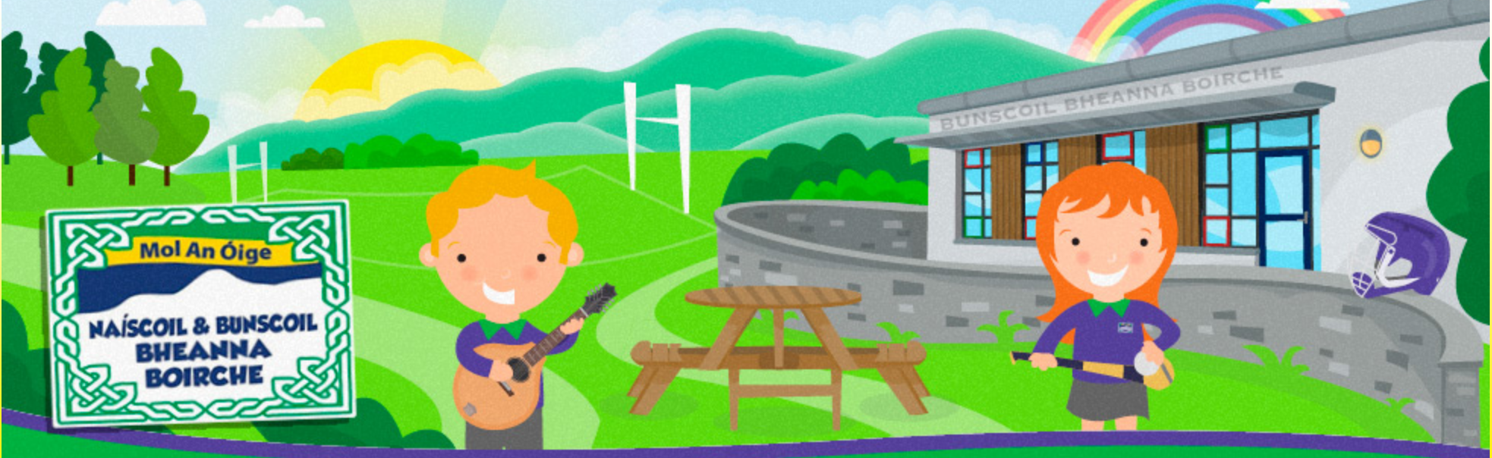
Eolas Curaclaim
Curriculum Information
Deireadh Fómhar 2025
Máire Uí Bhuadáin
Rang 1
Naíscoil agus Bunscoil Bheanna Boirche

Slide 2
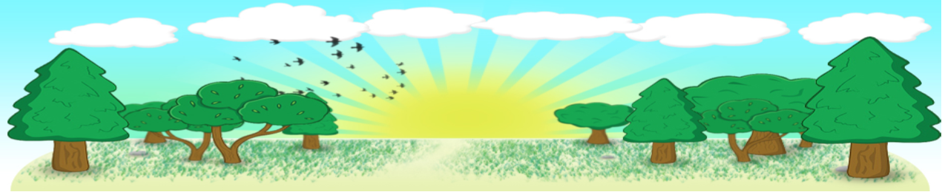
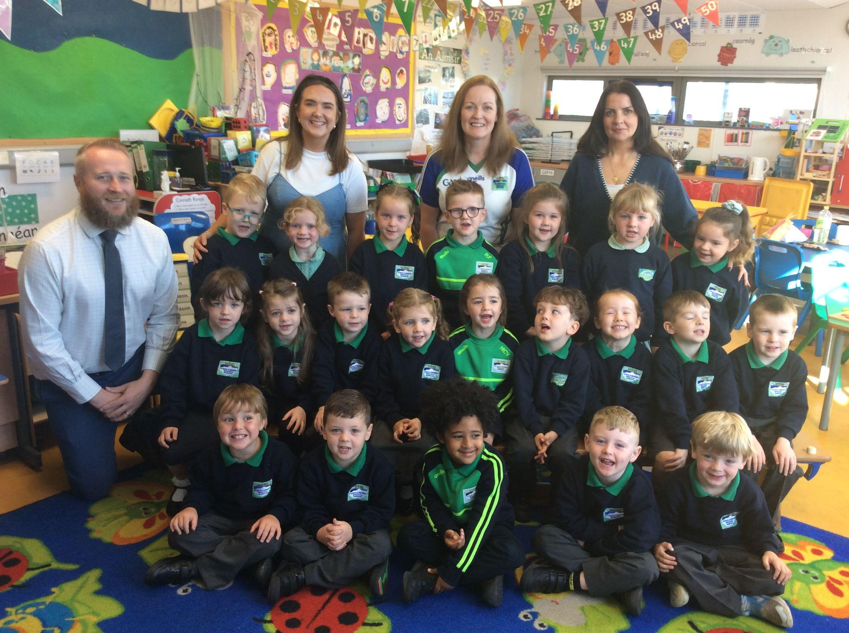
Fáilte go Rang 1!

Slide 3
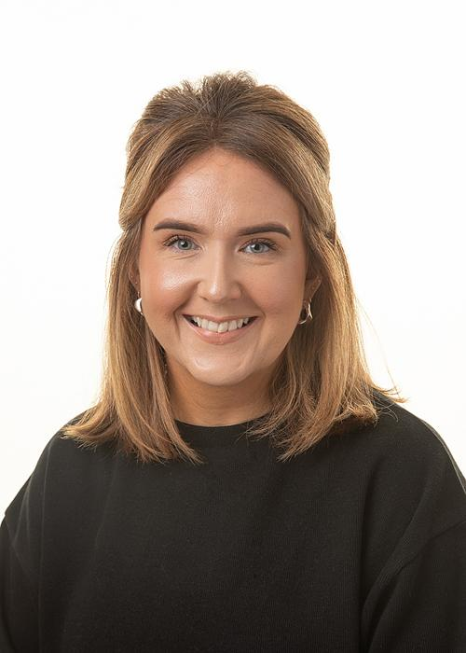
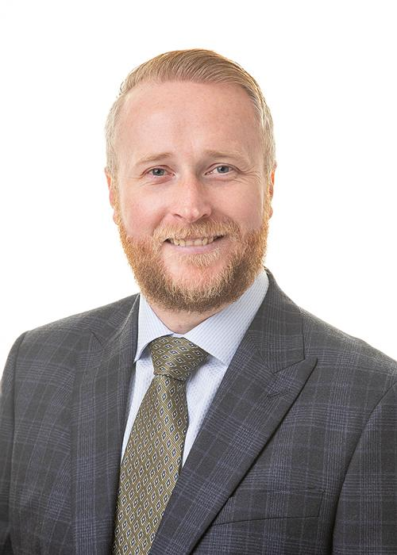
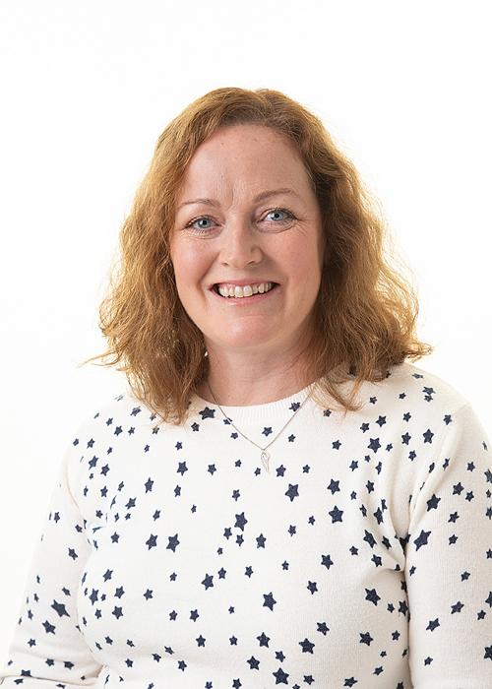
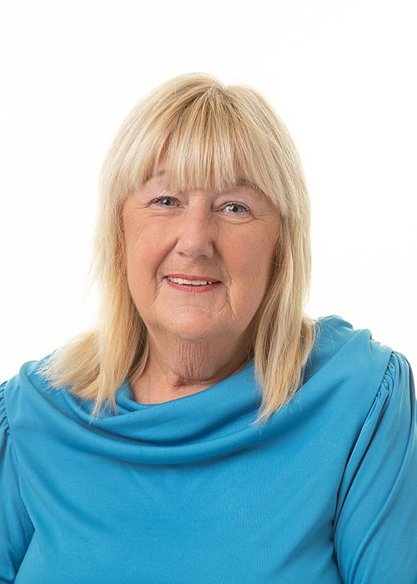
Foireann na Scoile
School Staff
Múinteoir Rang 1 - P1 Teacher Máire Boden
Príomhoide na Scoile - School Principal Ciarán Mac an tSionnaigh
Cúntóirí Ranga - Classroom Assistants
Martina Lenaghan and Beth Lawlor

Slide 4
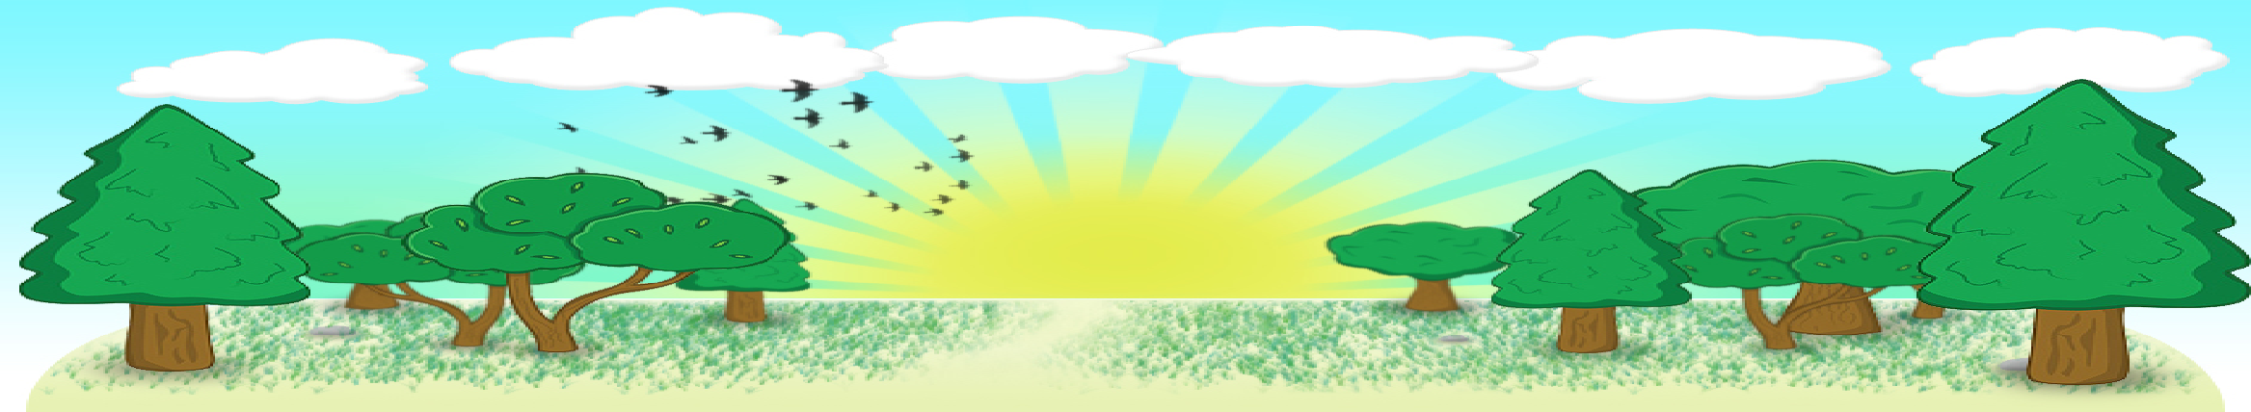
Curaclam
Curriculum
There are three key stages in Primary School:
Foundation Stage (Rang 1 and 2)
Key Stage 1 (Rang 3 and 4)
Key Stage 2 (Rang 5, 6 and 7)
We follow the same Northern Ireland Curriculum as any other primary school in NI: Literacy, Numeracy, The World Around Us, The Arts (Art & Design, Music and Drama), P.E., Personal Development and Mutual Understanding (PDMU), Religious Education and ICT.

Slide 5
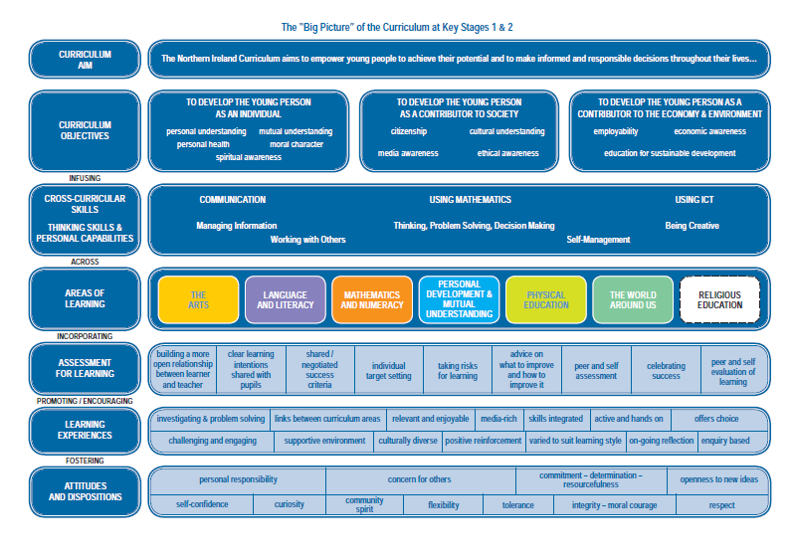

Slide 6
Curaclam (ar lean…)
Curriculum (continued…)
A significant proportion of the curriculum in Rang 1 is delivered through play-based learning. Children learn to problem solve, take turns, share, explain their methods and extend their vocabulary and communication skills through language rich, adult supervised/led play experiences. We cover real-life topics such as ‘The Post Office’, ‘At The Vet’ and ‘The Beach Café’, as well as covering seasons, festivals and celebrations throughout the world.
We are a non-denominational school, and we follow ‘Living Learning Together’, a CCEA pastoral care programme which encourages personal development and mutual understanding of the world and the wider community, along with the NSPCC Keeping Safe and Women’s Aid’s ‘Helping Hands’ programmes. We also prepare children for the Catholic sacraments if their parents so wish.

Slide 7
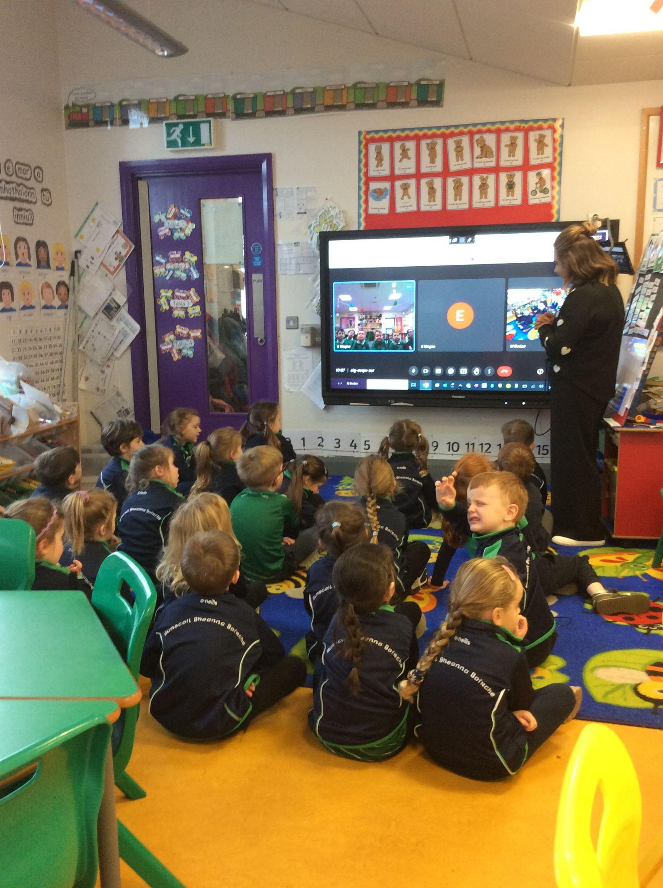
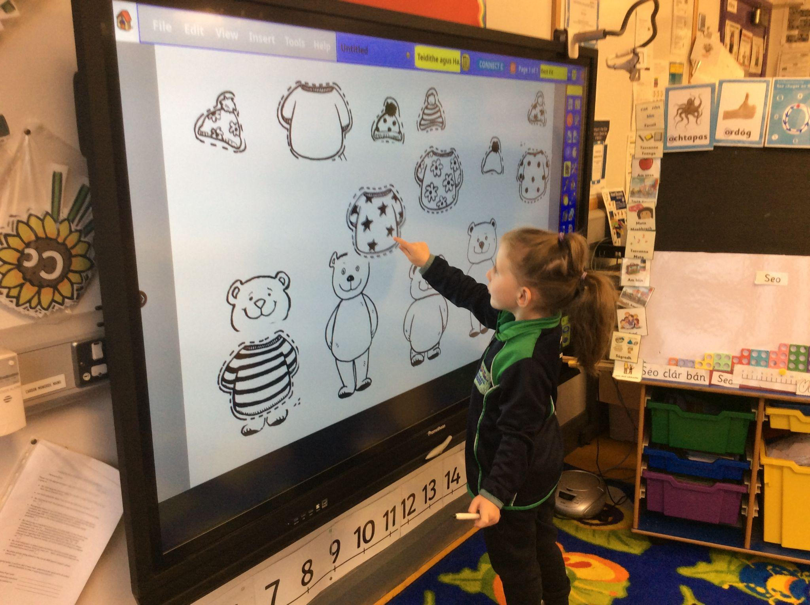
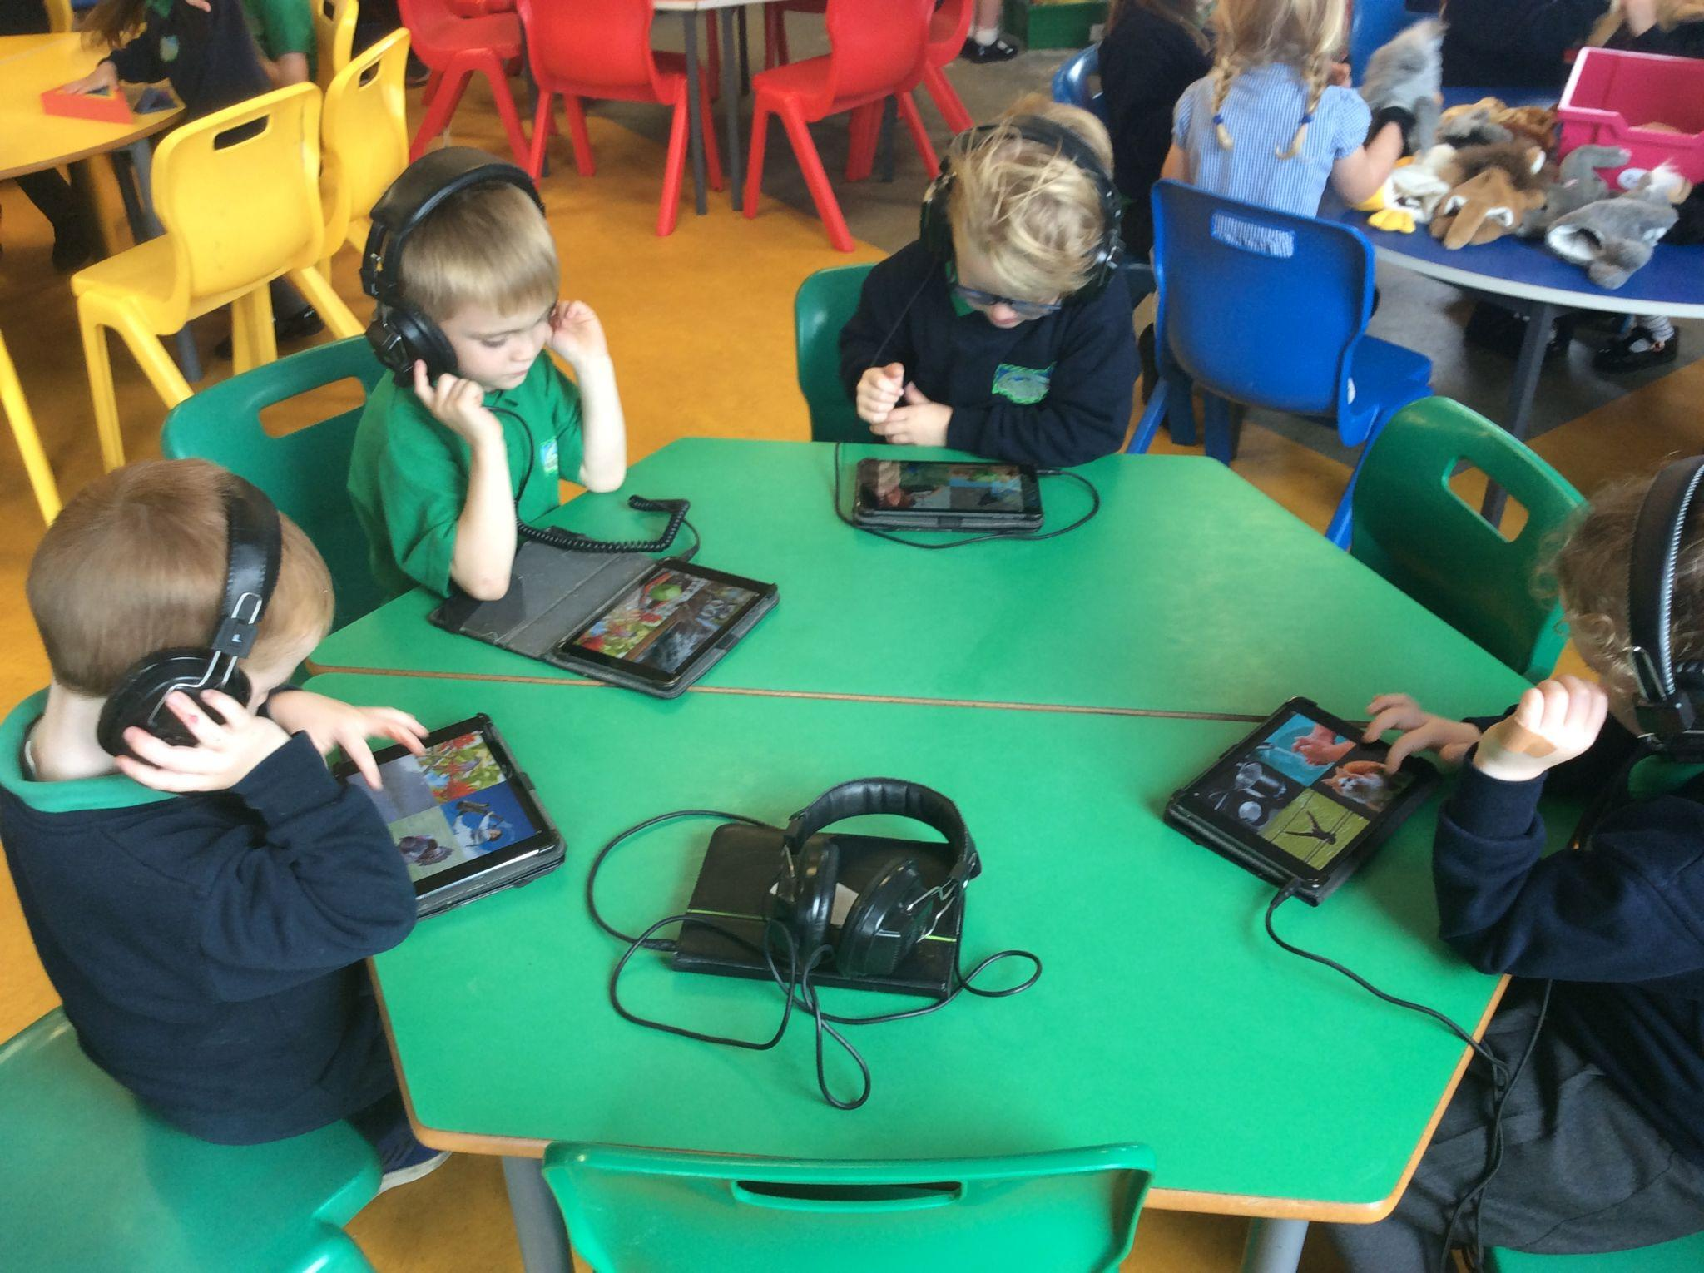
Curaclam (ar lean…)
Curriculum (continued…)
We are also very well resourced with ICT equipment, with PCs, laptops, Surface Pro devices, Chromebooks, an interactive board and a set of iPads in each classroom, but we also take pride in putting oral communication and interaction first, so children aren’t allocated digital devices on 1:1 basis, and ICT is planned carefully to enhance and progress our children’s learning.
We pride ourselves in innovative and pupil-friendly use of technology, sharing voice notes, MP3 links, and links to Irish language resources for you to use at home to help support your child in their learning in an immersion setting.
We were awarded ‘Digital-School’ status in June 2017, and we came first place in the Primary School section of the Northern Ireland C2K ICT Excellence Awards both in June 2019 and again last year in June 2024.

Slide 8
Litearthacht
Literacy
The biggest question parents have about our curriculum is about the teaching of Language and Literacy.
In Rang 1 we teach the same language concepts and literacy skills as taught in any other Primary 1 classroom in Northern Ireland , ie Talking & Listening, Reading, Writing and Phonological Awareness Skills such as Beginning Sounds, Rhyme, Syllables and Blending, we just happen to use Irish words as samples, rather than English, such as ‘madadh’ or ‘muc’ instead of ‘mouse’ or ‘monkey’ or ‘lón’ rhymes with ‘rón’, rather than ‘door’ rhymes with ‘floor’ etc…
We also teach phonics, looking at a new beginning sound a week, and we send home weekly high frequency keywords to help pupils with emergent reading
We also teach reading skills, just like our English-medium counterparts, suchas reading from left to right, and using beginning sounds, context and pictorial clues to help decode words and read stories
We teach writing skills, starting off with individual letters/sounds, building up to words and their own names, and progressing to sentence level work later in the year
Pupils are then taught English lessons from Rang 3 onwards, but have the foundation literacy skills from Rang 1 and 2 already, and so aren’t starting ‘from scratch’ at all.

Slide 9
Uimhearthacht
Numeracy
We follow the ‘Collins Primary Maths’ scheme for Mathematics and Numeracy instruction at Naíscoil Bheanna Boirche.
Over the course of our year, we teach Using Mathematics to our pupils, exploring the key areas of Uimhreas (Number), Tomhais (Measure), Cruth agus Spás (Shape and Space) and Láimhseáil Sonraí (Handling Data), revisiting them at regular intervals, building on their learning throughout the year.
Our maths curriculum is taught in a very practical and interactive way, encouraging the pupils to talk about their process and the learning.
We use a combination of practical equipment, worksheets and books and digital technology to teach Mathematics, and at a whole-school level we use the Sumdog app to help children build their mental maths skills. Your child has their own QR code to log in to their account, which will be stuck in to the inside of their homework jotter, which they will get after the Halloween break. We encourage children to make productive use of any time they spend on screens, and using Sumdog is a great way to do this.

Slide 10
Measúnú
Assessment
Whilst there is no formal assessment in Rang 1 and Rang 2, children are observed daily by both the class teacher and classroom assistants. The information gained from these observations is used to plan future lessons.
‘During Years 1 and 2 ongoing assessment will be based mainly on teacher observation which will inform the learning programme for each child. Observations are a natural and essential part of good practice for teachers and classroom assistants. Well-planned, regular and skilful observations help teachers gain information about children's progress over time which ensures that all children's needs are being met.’
http://ccea.org.uk/curriculum/foundation_stage/assessment
In addition, every 6 weeks, in-class activity based assessments take place to gauge learning each half-term in our letters/sounds, words, numbers and mathematical concepts covered so far.
We hold parent-teacher meetings every February, although any issues or difficulties will always be communicated as and when they are evident, which may be before this.
Annual progress reports are provided at the end of summer term.

Slide 11
Imeachtaí Seach-churaclaim
Extra-curricular activities
Club Bricfeasta – Breakfast Club open from 8 – 8.45 am which Rang 1 can attend once the phasing in process is complete in September.
Club Iarscoile - Afterschool Homework Club 2-4pm (2 – 3pm Rang 1 – 3, 3 – 4pm Rang 4 – 7) daily - as above, Rang 1 welcome to avail of the Club Iarscoile once settled in and staying until 2pm.
School Council
Eco-School committee
Summer Scheme every July
Regular school trips, walks and outings
Forest school activities in Bunkers Hill
Inter-school sports and quiz competitions
Scoildrámaíocht competitions
Poetry and conversation Feiseanna

Slide 12
An Lá Scoile
The School Day
Class begins at 9 am. Children are supervised in the clós (playground) from 8.45am.
Breaktime is from 10.30 - 11.00am. Lunchtime is from 12 - 1.00pm.
At Bunscoil Bheanna Boirche, we pride ourselves in our healthy eating policy. It is recommended that pupils eat fruit, a yogurt or a small sandwich at breaktime. Water is always available.
Our school dinners cost £2.60 per day, payable via ParentPay or with cash. ParentPay log-in details have been provided in early September, please get in touch with the office if you’re having any issues. The menu is put on our school website every term. We don’t allow sugary/fizzy drinks, crisps, chocolates and sweets. We do not have any children with a nut allergy at present but we discourage bringing nuts to school.

Slide 13
An Lá Scoile
The School Day
As a result of various dietary requirements and needs, we ask that parents don’t send in buns or treats on occasions such as birthdays etc. We also ask you to reiterate to your child about not sharing their food, as kind as they may think they’re being!
Please ensure your child knows what they are having each day - whether they will be having lunch or dinner - as sometimes pupils order themselves dinner, even though they are meant to be having lunch and vice versa, and this can be hard to keep track of.
Rang 1 and Rang 2 go home at 2.00pm Mon – Thurs and 1.50pm on Fridays to help ease traffic congestion
Please inform us of any changes in circumstances or if someone different/other than those identified in your data collection form will be collecting your child.

Slide 14

Poncúlacht agus Tinreamh
Punctuality and Attendance
School begins at 9 am, but pupils are welcome to be dropped off and supervised in the school yard from 8.45am.
On wet mornings, pupils come straight to the classroom from 8.45am.
It is very important for pupils to be in school on time, as they may miss registration, ordering their dinner (which is done first thing), discussing our plan for the day and the beginning of morning lessons. It can also lead to children being reluctant/shy to come into class, and it can be very disruptive to the whole class.
Children who are late will be marked late on the register.
If you are late arriving to school, please come in via the school office, as the back door is usually closed.
If your child is absent, you should contact the school office on the first day of absence, then send in a completed absence slip on your child’s return. If this does not happen, the absence goes down as “unexplained absence”.
If you are collecting your child early, you should contact the office before coming to the classroom, unless prearranged with Máire.

Slide 15
Iompar agus Rialacha
Behaviour and Rules
We have 3 simple school rules at Naíscoil agus Bunscoil Bheanna Boirche
1. Bíonn meas againn ar an Ghaeilge
(We have respect for the Irish Language)
2. Bíonn meas againn orainn féin agus ar a chéile
( We respect ourselves and others)
3. Bíonn meas againn ar an scoil agus ar threalamh na scoile
(We respect the school and the school equipment)
When we demonstrate good understanding of these rules, pupils are rewarded with stars, and when they gather 10 stars, they can pick a prize from the class box.
If pupils don’t follow the school rules, they are given a reminder of the rules, they may lose a star, they may be asked to sit out for some thinking time, they may have a note sent home, or they may be sent to see Ciarán.
Continued failure to respect or follow school rules may result in a meeting with parents.

Slide 16
Éide Scoile
School Uniform
Our uniform consists of:
Navy sweatshirt embroidered with the school logo and motto (available from John McKenny’s Clothes Shop in Castlewellan, Co. Down);
Grey trousers, skirt or shorts;
Green polo shirt embroidered with the school logo and motto;
Navy school coat (optional);
Black shoes (slip on/velcro ideally);
Navy or green gingham dresses in warmer weather;
P.E. uniform consists of:
Grey/ navy track bottoms, or grey/navy shorts;
Suitable trainers
Green polo shirt embroidered with the school logo and motto
We have a school jersey and quarter zip top which is OPTIONAL, which can be ordered from the O’Neills website. The quarter zip can be worn any day of the week too, not just PE days if you so wish.
Rang 1 pupils are strongly recommended to wear velcro trainers for PE to enable them to change as independently as possible

Slide 17
Éide Scoile
School Uniform
Please ensure that your child comes to school in a suitable waterproof coat, to allow us to be outdoors as much as possible. In Rang 1, coats with zips are preferable, as we need pupils to be able to put on and take off their coats as independently as possible. Similarly, slip on or velcro shoes are best, to help develop your child’s independence.
We also ask that you pack a change of underwear, socks and trousers/tracksuit bottoms in your child’s school bag daily (or it can be kept on their coat hanger in the cloakroom) in the case of a toileting accident or a fall in a puddle etc...
PLEASE ENSURE ALL JUMPERS AND COATS ARE CLEARLY LABELLED! Jumpers especially are frequently taken off, and are easily taken home by another pupil. If it is clearly labelled, it can be returned prompty, whereas without a name, it may become lost indefinitely.

Slide 18
Tuismitheoirí
Parents
We believe that happy children are more effective learners. Parents are always encouraged to discuss any concerns they may have either with the class teacher or with the principal. Our door is always open, and we pride ourselves here at Bunscoil Bheanna Boirche in our open and friendly relationships between teachers and parents.
If parents wish to speak to their child’s teacher privately, please ring the school office to arrange a telephone appointment, or send in a note to me.
I do not receive notifications of private messages sent in via Google Classroom, and therefore I may not see any messages until I go to check their submitted homework, which may be a number of days after messages have been sent.

Slide 19


Aip Scoile
School App
As we are an award-winning Eco School, we aim to use as little paper as possible. Therefore, we send out important messages and information via our Schools NI app.
Parents are asked to download it asap, if you haven’t done so already. Please select Bunscoil Bheanna Boirche as your favourite school, ensuring that notifications are enabled, and check the app regularly. We also ask parents to visit our website to keep up to date with what is happening in our school, for the school dinner menu etc...
Our app is available on both Android and Apple devices. Simply visit our school website where you will be prompted to download the app for free. www.bunscoilbb.com

Slide 20

Ag Tacú sa Bhaile
Home Support
Whilst we use our Schools NI app for whole-school, general messages, individual class level messages are sent primarily via each class ‘’Google Classroom’. Class teachers set homework tasks, provide helpful links, post messages and communicate at a class level using this app , as well as providing individual, personal feedback to pupil on their work/activities.
Log-in details and passwords have now been sent home, and we hope everyone is able to see the tasks and messages which have been sent so far. If anyone is having difficulties getting on to Google Classroom, please don’t hesitate to get in touch.
We also post information and news on our school website, www.bunscoilbb.com, where you’ll find updated dinner menus, important upcoming dates and so on.
And finally, we highly recommend parents follow Cairde Naíscoil agus Bunscoil Bheanna Boirche on Facebook for regular posts and suggestions regarding home-learning and Irish-language events and activities going on locally.

Slide 21
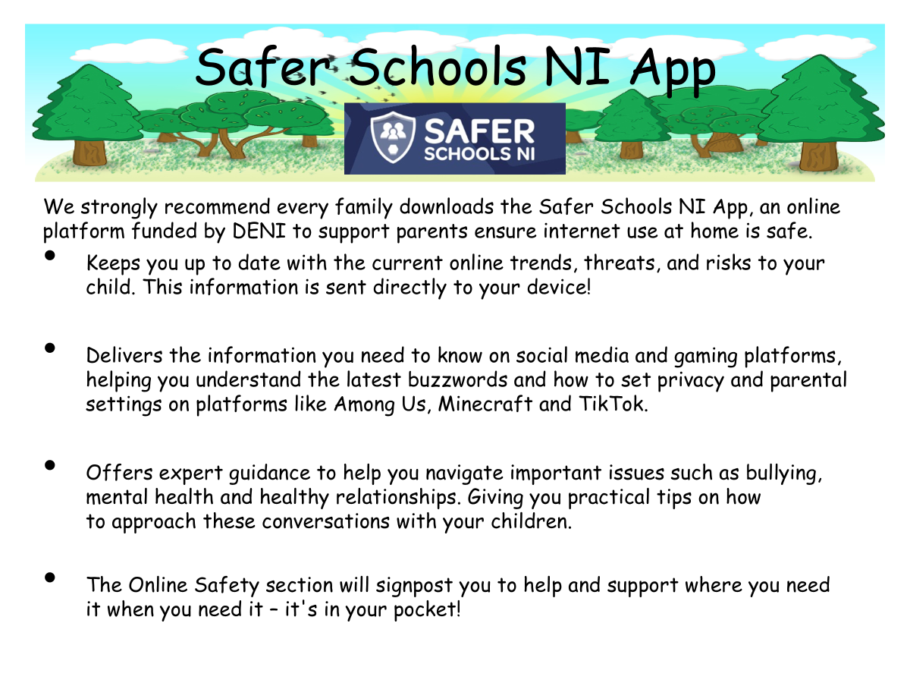

Slide 22

Obair bhaile
Homework
In Rang 1, we don’t send formal homework home until after the Halloween break, although we will continue to send home challenges and tasks such as finding and posting pictures of items, listening to a story/song or watching a short video and having a chat with you about it etc in the meantime. This is a great way for them to start using their Irish a bit more at home, but also to ensure everyone is comfortable and confident using Google Classroom.
Once written homework begins, we will send a blue BBB book folder home every Monday, which will contain any reading text books and worksheets needed for the week, along with a weekly overview of what to do, and how to help pronounce words etc. We will also send home a homework jotter for you to keep at home. As homeworks are completed, glue the worksheet into the jotter, take a photo of the piece of work/activity, and on Thursday evenings, attach all homework photos to the assignment on Google Classroom. We do not mind which night each task is completed, as long as all activities are completed and photos are posted to Google Classroom by Thursday evening, to allow us to assess the work and provide meaningful feedback in a timely manner.
Please return the blue homework folders to school every Friday, to allow us to prepare the folders again for the following Monday.

Slide 23
Obair bhaile
Homework
Due to both a decrease in levels of homework being completed over recent years, as well as an understanding of the importance of down-time and wider extra-curricular activities for children, at Naíscoil agus Bunscoil Bheanna Boirche we have reduced written homework tasks to one per week.
With the reduction in written tasks, it is hoped and expected that families will use this extra time to read with your children, both the school text books sent home and for fun with favourite storybooks or books borrowed from the library.
In addition, rather than nightly written activities, I will frequently set oral literacy homework tasks such as ‘Put the story in order’ or ‘Roll the dice and make a sentence with that word’ etc… Please make sure you spend time with your child completing these tasks, and taking a photo of them busy at work, to post to Google Classroom every Thursday.
Please don’t disregard the importance of reading, of the little sentence building tasks with your child’s high frequency word cards, or the impact of talking and listening activities. Children’s expressive language skills have seen a drastic decline over the last 10 years with the popularity of tablets and iPads in the home, and these tasks are designed to improve your child’s speech and language skills, to help their overall learning.

Slide 24
Obair bhaile
Homework
Please make sure to listen along to homework feedback sent by Máire on Google Classroom, so that your child can hear that their homework has been seen and enjoyed, and to take on board any suggestions for improvement etc…
Reminder! I do not receive notifications of any messages you send in via Google Classroom, and will only see them when I go in to correct work on Fridays. If you have any urgent questions or messages for me, please ensure to send in a written note, call the office, or say to me at drop off/collection, rather than leaving a Google Classroom comment.

Slide 25
Ag cuidiú le do pháiste
Supporting your child
Whilst having Irish in the home is not a prerequisite to attend Bunscoil Bheanna Boirche, parents are strongly encouraged to avail of the many great Irish Language classes and intensive courses that are available in the area in order to be able to support their child’s learning. Follow Glór Uachtar Tíre on Facebook, Instagram, or visit their website for information on upcoming lessons and events.
In addition, homeworks are always supplemented with support materials for parents to use to help with pronunciation and meaning. Remember, homework is a REVISION of work/topics covered in class, so pupils will be able to tell YOU what they are meant to do, and will take great joy in doing so! The overview sheets and verbal instructions on Google Classroom will also be of help to you.
There are also some fantastic websites to assist parents with Irish and support their child, such as:
www.abair.ie www.tearma.ie www.foclóir.ie
www.bbc.co.uk/northernireland/irish/blas www.irishforparents.ie
www.cúla4.com www.foghlaim.tg4.ie
And while nothing replaces good quality fine motor skill activities such as colouring in and doing jigsaws, the following apps are recommended to use with your child, if you have a tablet device at home:
Cód na Gaeilge, Cúla 4, Fuaim Ú, Sumdog

Slide 26
Ag cuidiú le do pháiste
Helping your child
Taking off and putting on own shoes, jumper, coat
Closing own coat/zip
Velcro shoes
All clothes labelled
How to open and close own schoolbags, lunchboxes, tupperware etc…
Colouring in, dot-to-dot activities and drawing pictures
Scissor skills
RECOGNISE own name in writing/print
Don’t practise letter/name-writing yet! This often leads to wrong letter formation habits which can be extremely difficult to undo. Leave that to us!

Slide 27
Ag cuidiú le do pháiste
Helping your child
Playing ‘I Spy’, changing to something beginning with the sound ‘mmmmm’ or ‘aaaaaa’ etc…
Turn-taking and waiting for their turn with games such as Snakes and Ladders
Problem solving skills through jigsaw puzzles
Talking about their day with you, and the 3 best things about their day, all to help develop basic conversation skills
Singing nursery rhymes together
Read bedtime stories together and encourage an interest in books and reading

Slide 28
Ag cuidiú le do pháiste
Helping your child
REDUCE SCREEN TIME
Numerous studies, including a recent research project conducted by Unicef, all agree that too much screen time for young children has many negative impacts, ranging from shorter attention spans, slower speech development and a lack of empathy
Expressive language skills, levels of focus, ability to remain on task, and emotional resilience in our young people have seen a dramatic decline.
The single most helpful thing you could do for your child is reduce screen time, especially on tablet devices such as an iPad.

Slide 29
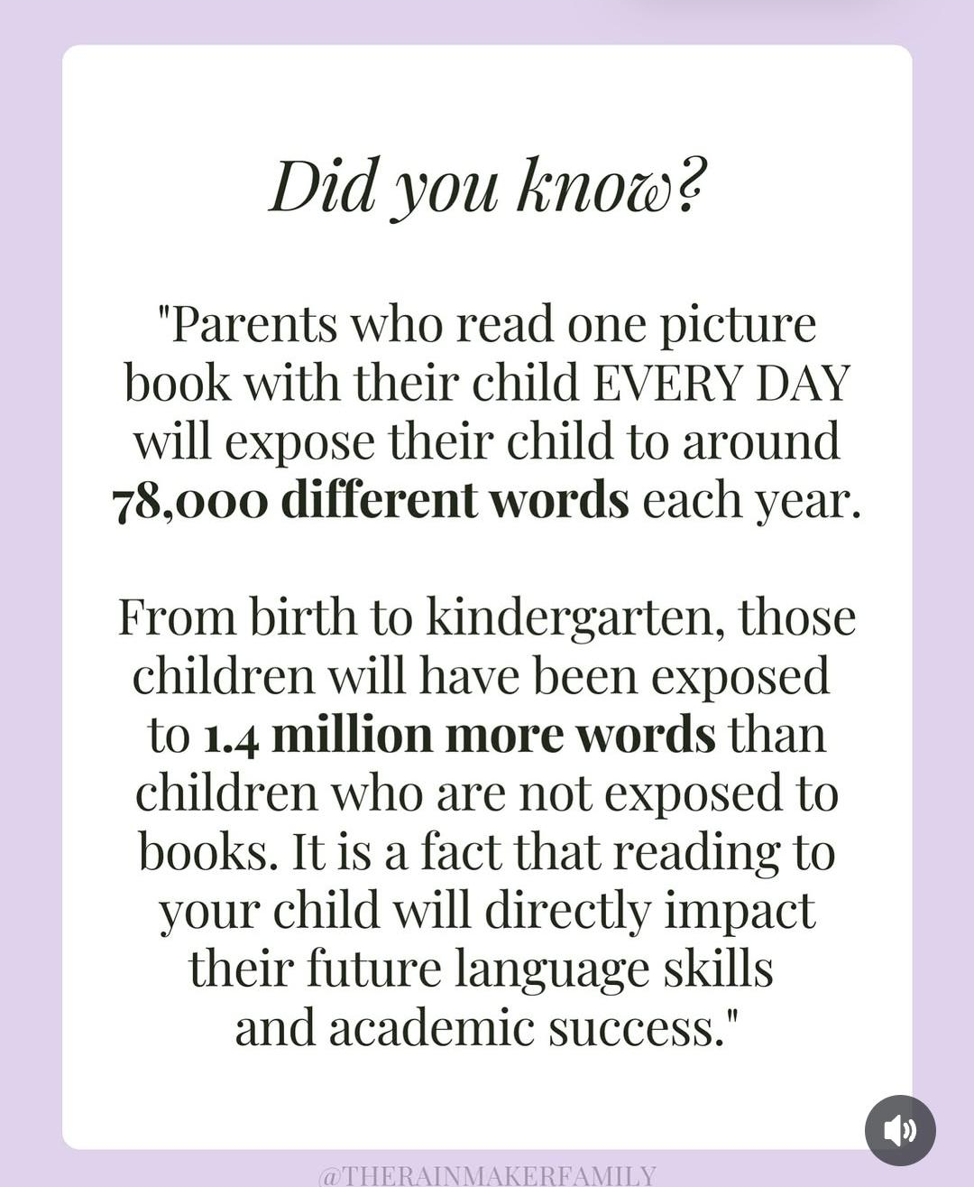

Slide 30

Sláinte do pháiste
Your child’s health and hygiene
Please inform staff of any health and medical needs your child has including any food allergies, asthma etc…that we’re not already aware of.
If your child becomes ill while in school, we will contact the number you have provided on your data collection form. Please make sure this is always up to date and inform us of any changes throughout the year.
In the case of wetting accidents, we encourage pupils to change independently using the change of clothes in their bags/in the cloakroom. In the rare case of a soiling incident, as per our ‘Intimate Care’ policy, pupils will be encouraged to clean themselves independently, made comfortable, and parents will be called.
Please be aware that staff cannot administer medicine. If your child needs medication, feel free to come to the school to give it when needed.
Please inform Máire or Ciarán of anything that may affect your child’s behaviour such as bereavement, sudden shock, separation, etc. All information will be treated as strictly confidential, and will help us to care for and support your child as best we can.

Slide 31
Sláinte do pháiste
Your child’s health and hygiene
If your child is ill, please keep them at home until they have fully recovered to help prevent the spread of infection. NHS guidance on incubation periods for common illnesses is available online via the following link:
https://www.publichealth.hscni.net/sites/default/files/Guidance_on_infection_control_in%20schools_poster.pdf
If you are in any doubt, please also just contact the school office for clarification.
An absence slip should be taken to school upon their return. These are provided at the start of the year.

Slide 32
Polasaithe Scoile
School Policies
All school policies are available to view on the school website www.bunscoilbb.com or from the school office by appointment with the principal.

Slide 33
Mar fhocal scoir...
We are really looking forward to helping your child on their journey in Rang 1. We understand that this is an exciting time for you and your child. However, we also understand that in the future, you may have further questions.
If you have any further questions please don’t hesitate to email the school office on info@bunscoilbb.com or call the school to speak to Máire on 028 437 71356.
Go raibh maith agaibh.

Slide 34
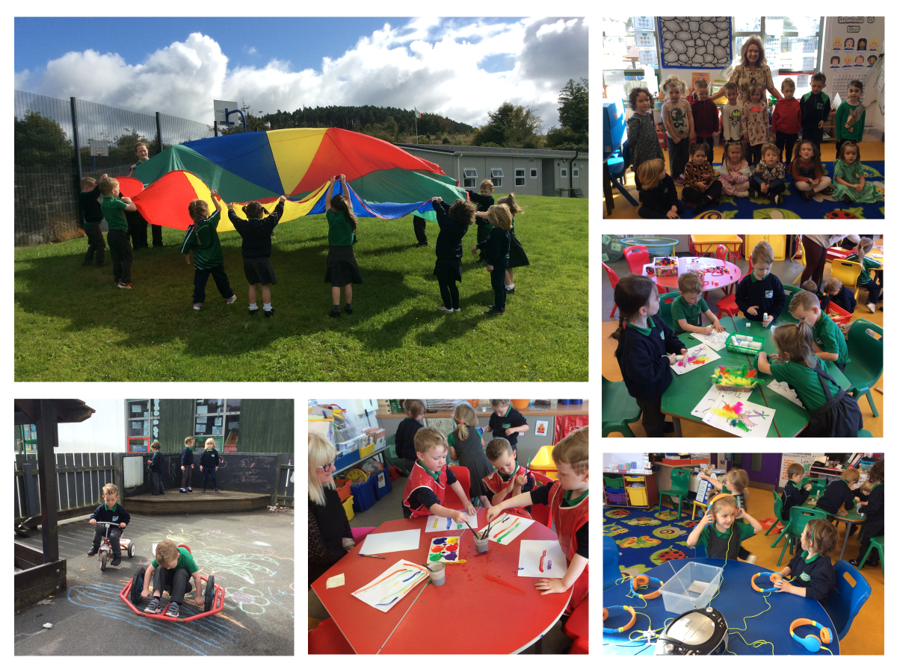

Slide 35


