Slide 1
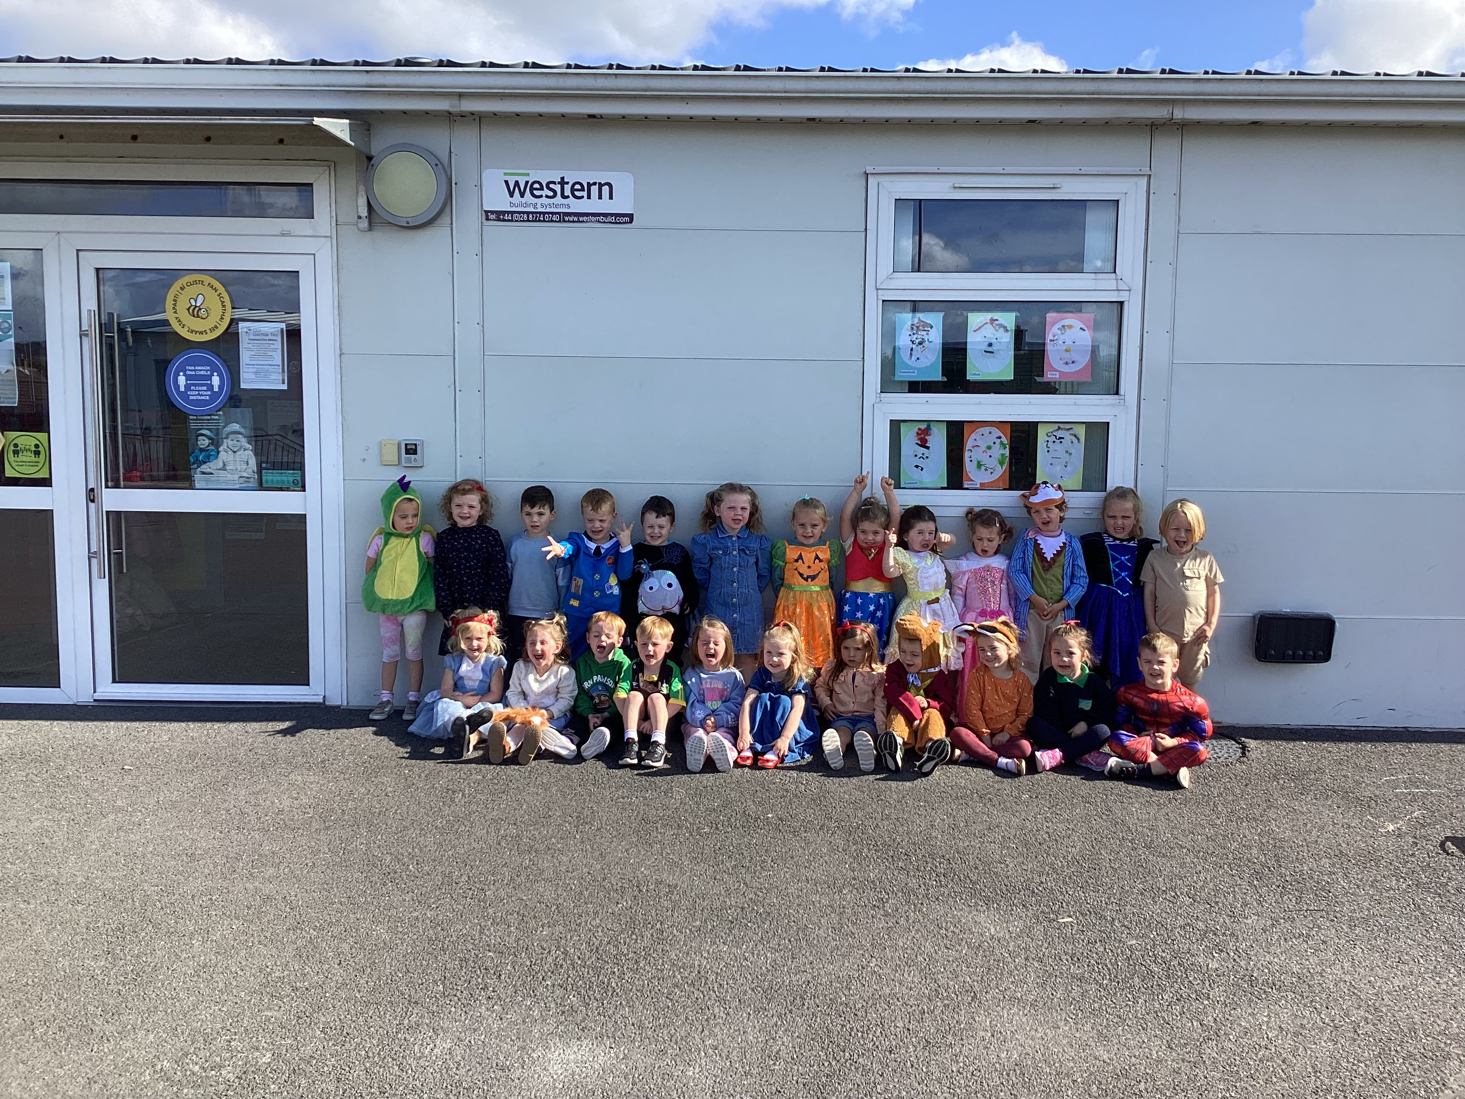
Fáilte go Cruinniú Curaclaim na Naíscoile

Slide 2
Ráiteas Misin
Mission Statement
We at Naíscoil agus Bunscoil Bheanna Boirche are dedicated to creating a caring and secure school community in which every member values the importance of speaking Irish, and in which children, parents and staff feel valued, supported and happy.
We strive to provide an ethos in which openness, honesty and bilingualism permeate through all aspects of our school and the wider community.

Slide 3
Curaclam
Curriculum
Curaclam - Curriculum
The Naíscoil pupils will be following the Northern Ireland Pre-School Curriculum as set out by the Department of Education
This includes Personal, Social and Emotional Development, Language Development, Early Mathematical Experiences, The World Around Us, The Arts (Art, Music and Drama) and Physical Development and Movement

Slide 4
Curaclam (ar lean…) Curriculum (continued…)
At Naíscoil / Nursery level the whole curriculum is delivered through play-based learning. Children learn to problem solve, take turns, share, explain their methods and extend their vocabulary and communication skills through language rich, adult supervised/led play experiences.
They will cover real-life topics such as ‘Animals’, ‘The Body’ and ‘Clothes’, ‘People’, ‘The House’, ‘Travel’, etc. as well as covering seasons, festivals, celebrations, etc..
We give out certificates regularly to encourage good behaviour and listening skills.
We are an inter-denominational school, and we follow ‘Living Learning Together’, a pastoral care programme which encourages personal development and mutual understanding of the world and the wider community.

Slide 5
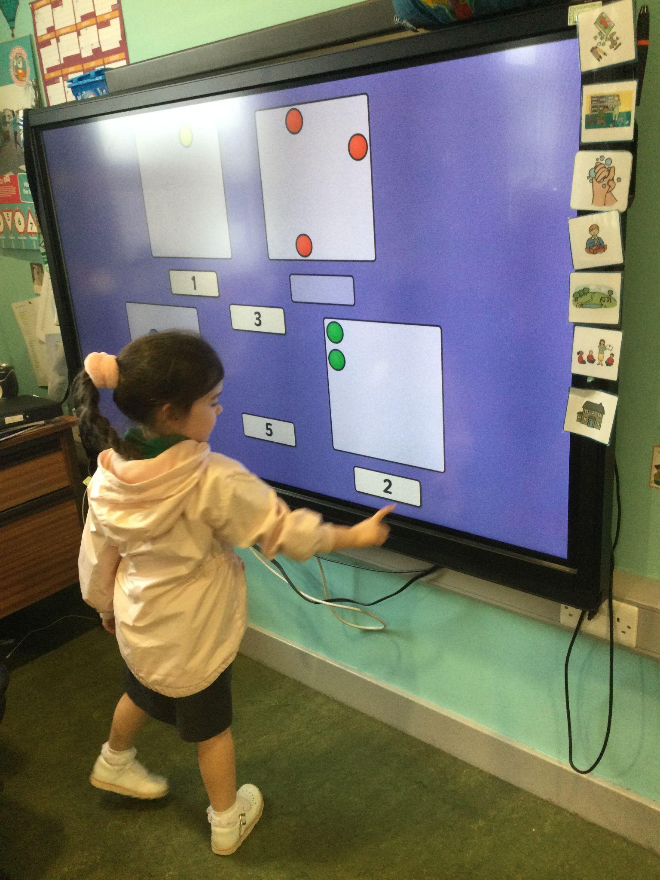
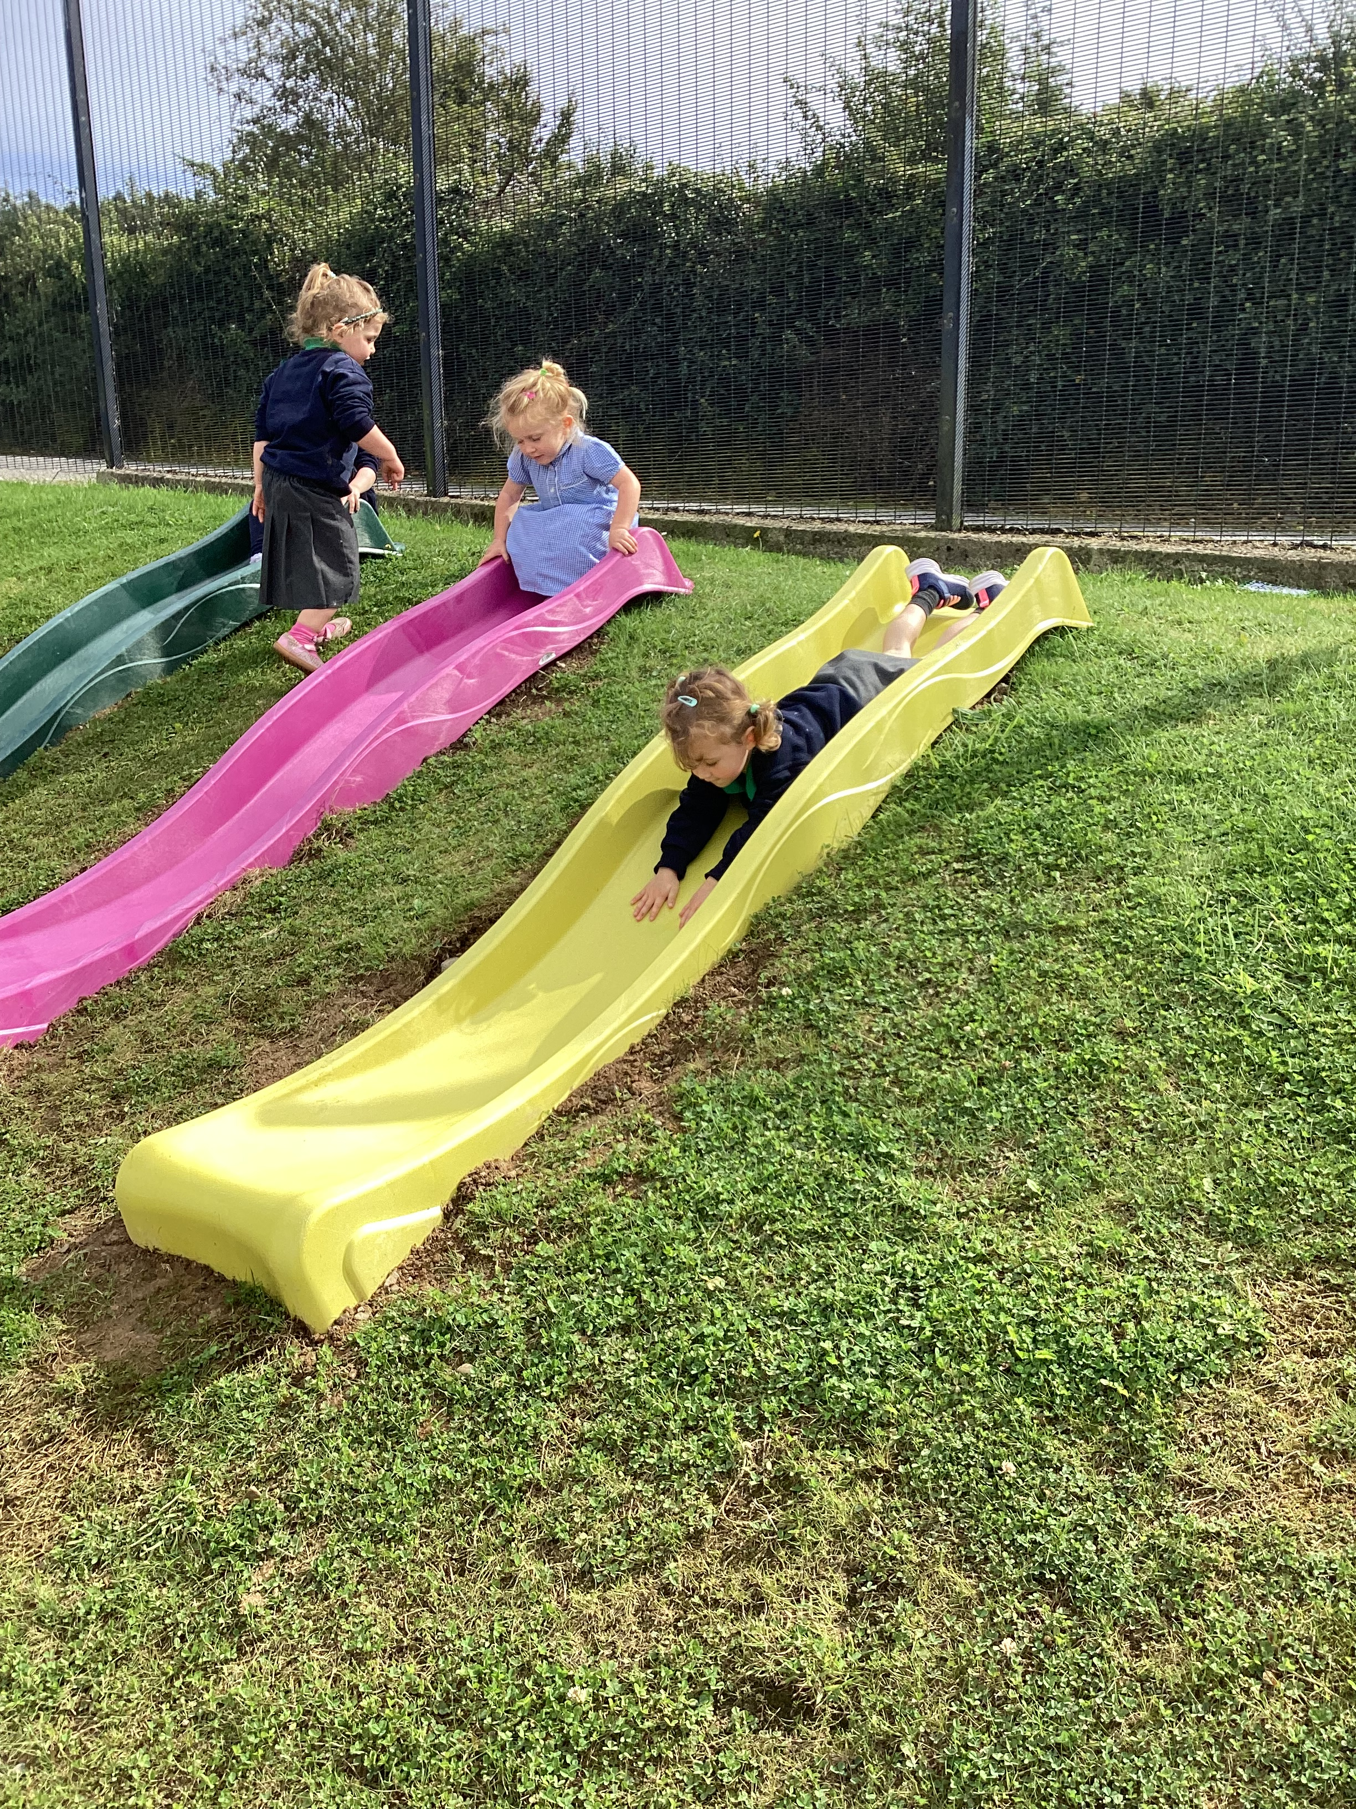
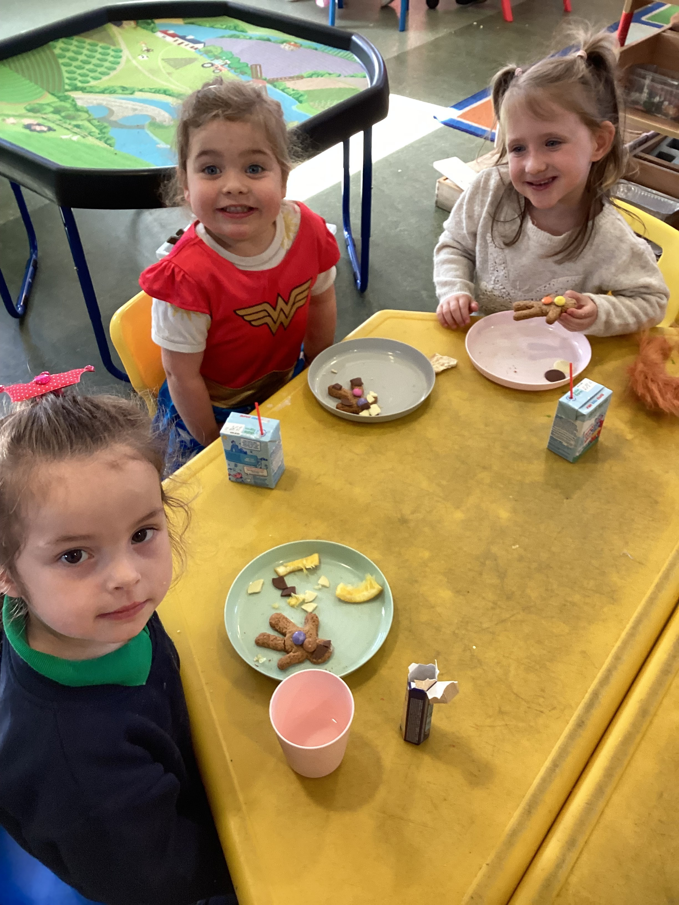
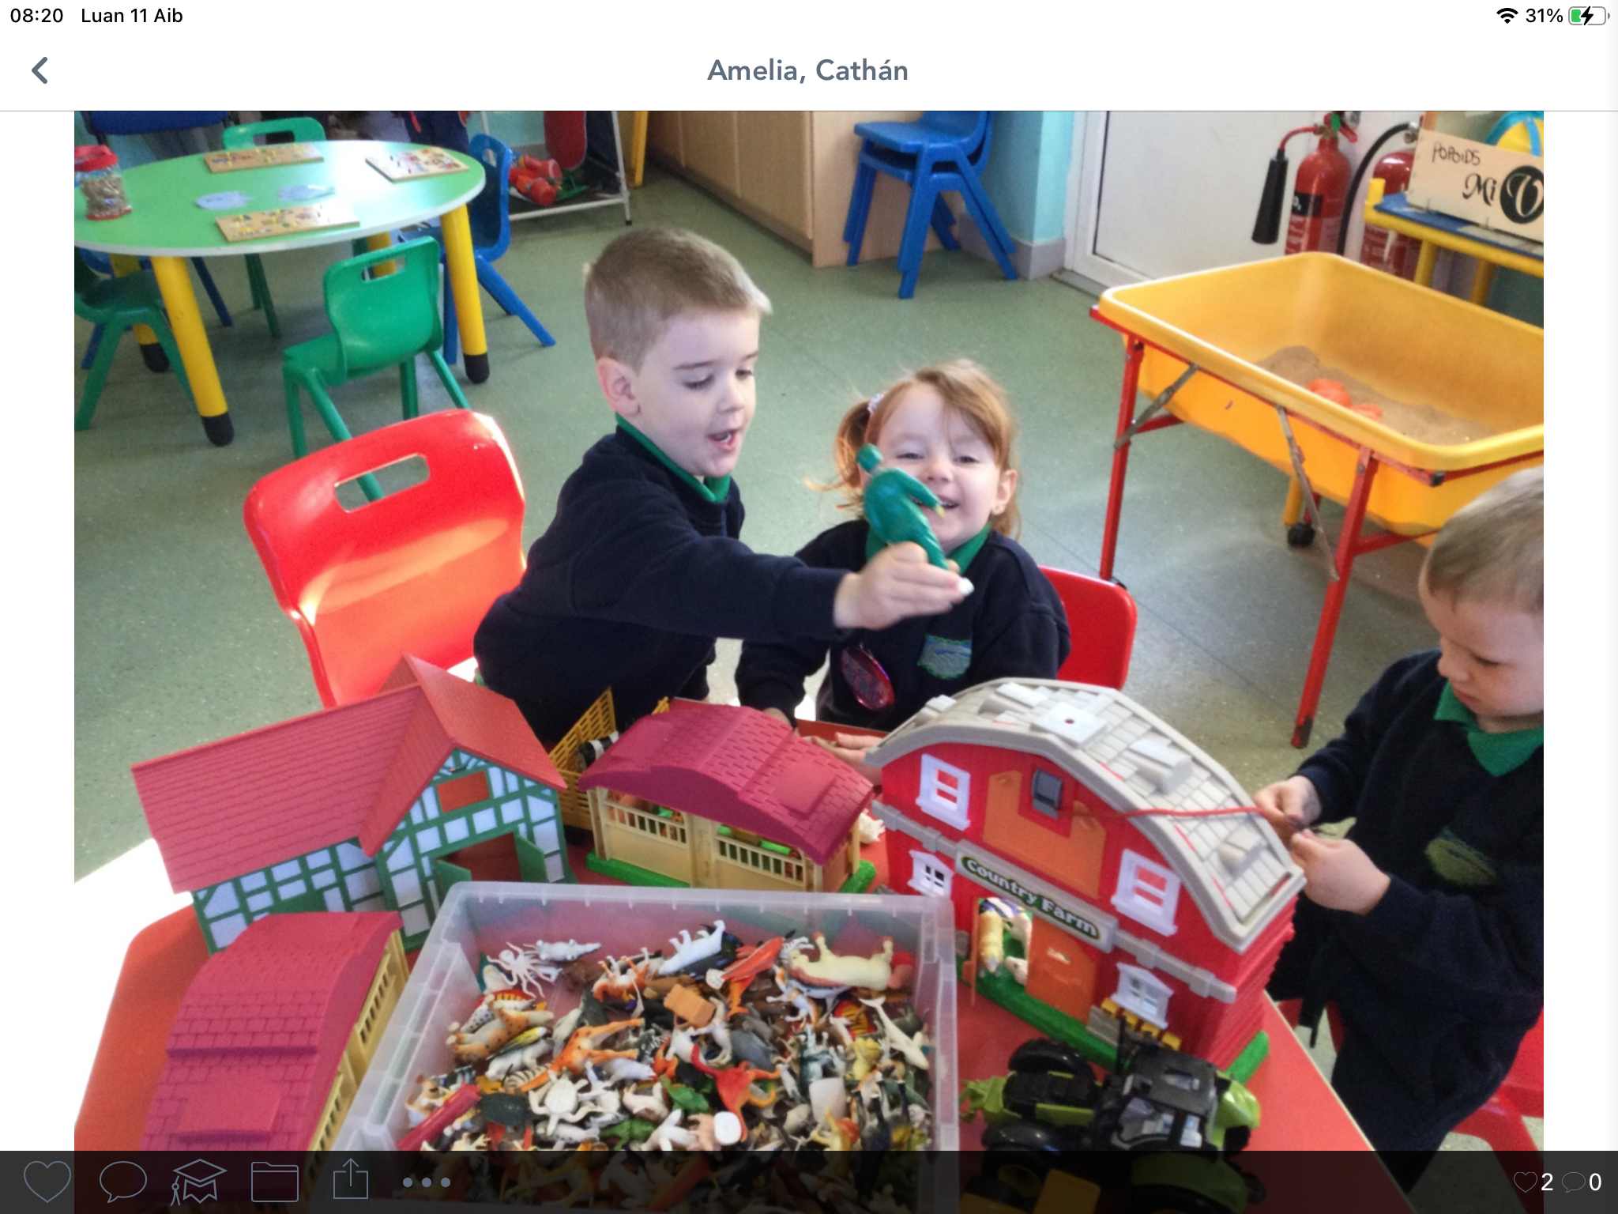
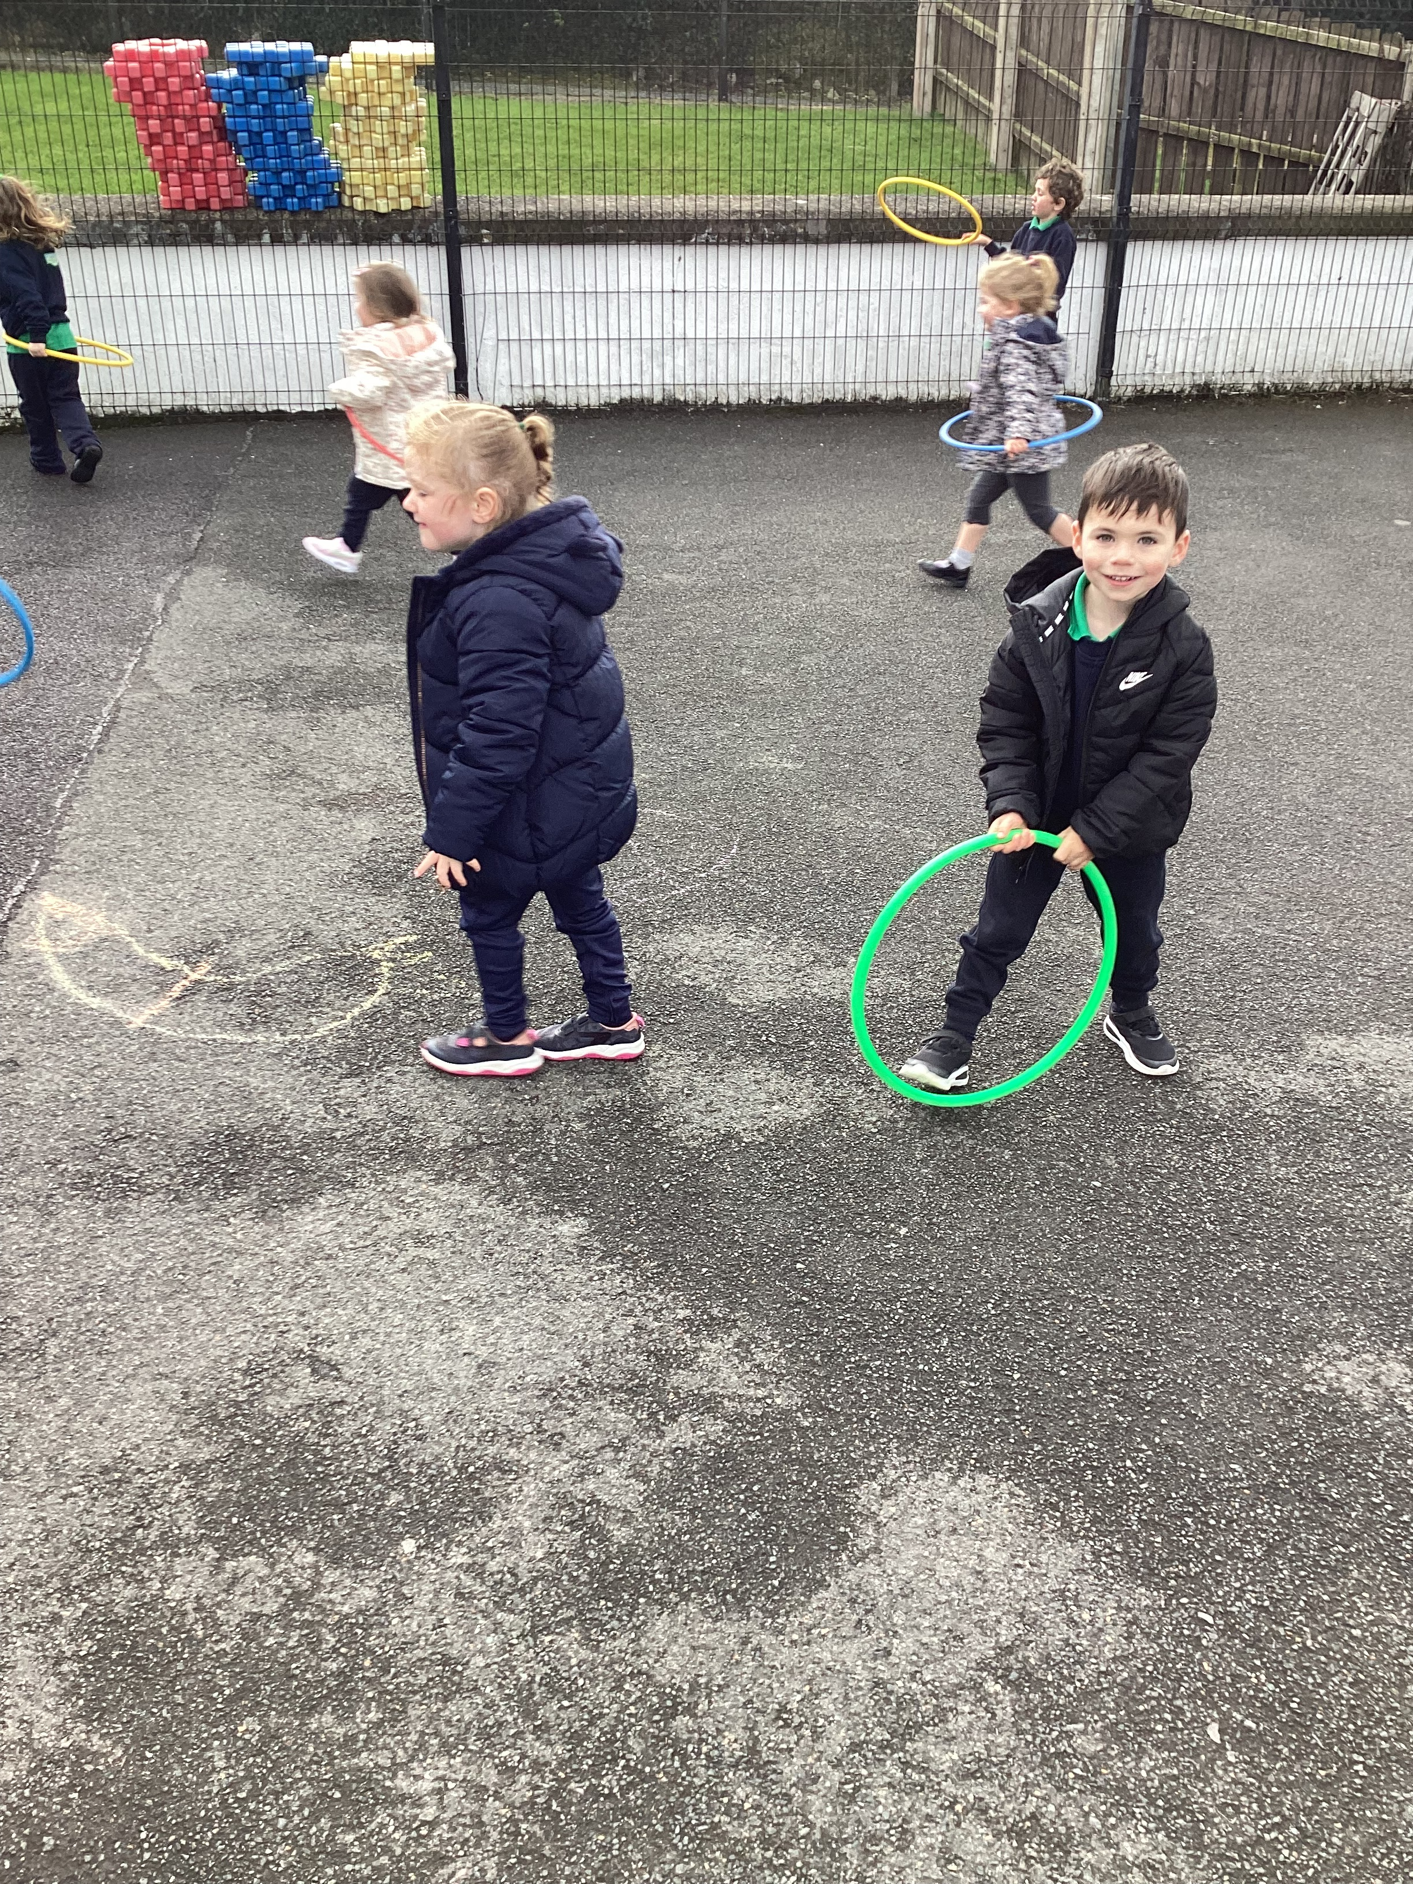
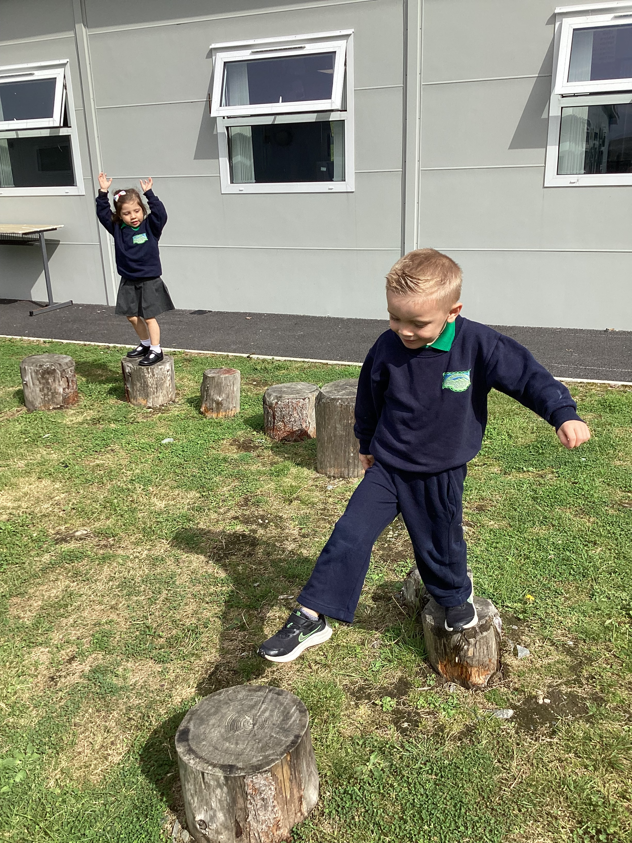

Slide 6
An Lá Scoile The School Day
Naíscoil begins at 9 am.
Breaktime is from 10.45 - 11.05am.
The children in the Naíscoil will eat
a healthy snack each day at a cost
of £3 per week.
Naíscoil finishes at 12.00 noon.
Please ensure you have filled in
‘usual people’ who will collect
your child on our data collection
form, and inform us of any
changes in circumstances or if
someone different will be
collecting your child.
Please remember to inform us
of any new contact numbers
throughout the year if you
change your mobile etc.
9.00am | Doors open for children to come into naíscoil
9.05am-9.30 9.30am-10.35am | Rolla /aimsir /laethanta na seachtaine/ amhráin/ comhrá Roll/weather/days of the week/songs/conversation Indoor play/Free play - children chose freely where to play in a range of areas – water, sand, playdough, construction area, small world, home corner, library, writing table, quiet room (jigsaws, puzzles etc)
10.35am-10.45am | Am glanadh suas/Tidy up time and wash hands before snack.
10.45am-11.05am | Am smailce/Snack Time We provide a healthy snack each day. This includes fruit, bread, cheese, ham, milk and water We have a cookery session or a sos speisialta each Friday.
11.05am-11:40am | Súgradh Taobh Amuigh/Outdoor Play Weather permitting we play outdoors every day.
11.40am-11.55am | Am Ciorcail/Circle Time Stories, games, discussions based on our themes, seasons, children can show their creations from our morning play session, music/singing
12.00pm | Am dul abhaile/Hometime

Slide 7
Éadaí Scoile School Uniform
Our uniform consists of:
Navy sweatshirt embroidered with the school logo and motto (available from John McKenny’s Clothes Shop in Castlewellan, Co. Down);
Track bottoms, skirt or shorts;
Green polo shirt embroidered with the school logo and motto;
Navy school coat (optional);
Training/comfortable shoes (slip on/velcro ideally);
Outdoor play clothes:
Outdoor play is a key tenet of the Nursery curriculum
appropriate trainers / boots / wellies for the weather
Naíscoil pupils are strongly recommended to wear velcro shoes / trainers to enable them to change as independently as possible into wellies / outdoor boots
Please ensure that your child comes to school in a suitable waterproof coat, to allow us to be outdoors as much as possible. Coats with zips are preferable, as we need pupils to be able to put on and take off their own coats independently.
We also ask that you pack a change of underwear, socks and trousers/tracksuit bottoms in your child’s school bag daily (or it can be kept in a plastic bag with their name on it on their coat hanger in the cloakroom) in the case of a toileting accident or a fall in a puddle etc...
Old clothes may be worn on Fridays for our ‘messy play’ at our nature park.

Slide 8
Tuismitheoirí
Parents
Our caring, family ethos at Naíscoil agus Bunscoil Bheanna Boirche means that we strongly value the importance of parental input in their child’s education, and we enjoy a wonderful level of parental participation and involvement in our school community here at the Naíscoil agus Bunscoil.
We strive to involve parents in the life of the school. Parents help with breakfast club, after-school activities and assist on school trips and events. Parents are employed in the school as lunchtime supervisors and classroom assistants. Parents are also involved in school fundraising, and we have a very active and vibrant Parents’ Support Group who regularly organise fundraising events and activities to help subsidise school trips and equipment.
We believe that happy children are more effective learners. Parents are always encouraged to discuss any concerns they may have either with the class teacher or with the principal. Our door is always open, and we pride ourselves here at Naíscoil agus Bunscoil Bheanna Boirche on our open and friendly relationships between teachers and parents.
Whilst having Irish in the home is not a prerequisite to attend Naíscoil agus Bunscoil Bheanna Boirche, parents are strongly encouraged to avail of the many great Irish Language classes that are available in the area in order to be able to support their child’s learning.

Slide 9
Cairde Our Parent Support Group
We have a very active and dedicated Parent Support Group called ‘Cairde’ who regularly arrange activities such as fundraiser events and family fun days.
Their fundraising goes towards subsidising buses for school trips to reduce the cost for parents, purchasing class iPads, class reading books, developing our outdoor play area etc.
They are an integral part of Bunscoil Bheanna Boirche and are always keen for new members to join in and help in whatever small way they can.

Slide 10
Aip Scoile
School App
As we are an award winning Eco School, we aim to use as little paper as possible. Therefore, we send out important messages and information via Seesaw and our Schools NI app. We also send daily photos and videos to keep parents informed of their child’s progress.
Parents are asked to download the school app and select Bunscoil Bheanna Boirche as your default school. Please ensure that notifications are enabled and that you check the app regularly to ensure that you receive all messages.
Our app is available on both Android and Apple devices. Simply visit our school website www.bunscoilbb.com where you will be prompted to download the app for free.
We also ask parents to visit our website regularly to access school holiday lists, latest photos, and to keep up to date with what is happening in our school.

Slide 11
Ag cuidiú le do pháiste Supporting your child
As previously mentioned, whilst having Irish in the home is not a prerequisite to attend Naíscoil agus Bunscoil Bheanna Boirche, parents are strongly encouraged to avail of the many great Irish Language classes that are available in the area in order to be able to support their child’s learning.
We highly recommend parents follow Cairde Naíscoil agus Bhunscoil Bheanna Boirche on Facebook for regular posts and suggestions regarding home-learning and Irish-language events and activities going on.
There are some fantastic websites to assist parents with Irish and supporting their child, such as: www.abair.ie www.tearma.ie www.foclóir.ie
www.bbc.co.uk/northernireland/irish/blas www.irishforparents.ie

Slide 12
Sláinte do pháiste
Your child’s health and hygiene
Please inform staff of any health and medical needs your child has including any food allergies, asthma etc.
If your child becomes ill while in school, we will contact the number you have provided on your data collection form. Please make sure this is always up to date - inform us of any changes throughout the year.
Please be aware that staff cannot administer medicine. If your child needs medication, feel free to come to the school to give it when needed.
Please inform us of anything that may affect your child’s behaviour such as bereavement, sudden shock,
separation, etc. All information will be treated as strictly confidential.

Slide 13
Sláinte do pháiste
Your child’s health and hygiene
If your child is ill, please keep them at home until they have fully recovered to help prevent the spread of infection. NHS guidance on incubation periods for common illnesses is available online via the following link:
https://www.publichealth.hscni.net/sites/default/files/Guidance_on_infection_control_in%20schools_poster.pdf
If you are in any doubt, please also just contact the school office for clarification.

Slide 14
Polasaithe Scoile School Policies
All of our school policies are available to view on the school website www.bunscoilbb.com or from the school office by appointment with the principal.

Slide 15
Mar fhocal scoir...
We understand that this is an exciting time for you and your child as they progress through their pre-school year at Naíscoil. However, we also understand that you may have questions on your child’s development throughout the year.
If you have any questions please do not hesitate to contact us on Seesaw or email Mary directly at mmcmurrough271@c2kni.net. Or call the school on 028 437 71356. You can also email the school office on info@bunscoilbb.com
If you just need clarification on something Ruairí, Louise or Mary will do their best to clarify any questions at pick up/ drop off times.
Go raibh maith agaibh.

