Slide 1
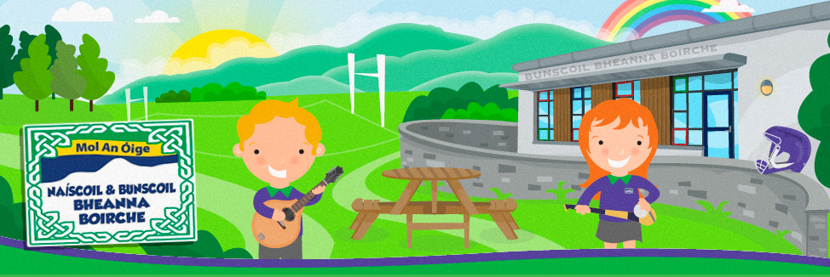
Fáilte go Naíscoil agus
Bunscoil Bheanna Boirche
CRUINNIÚ CURACLAIM
2024

Slide 2
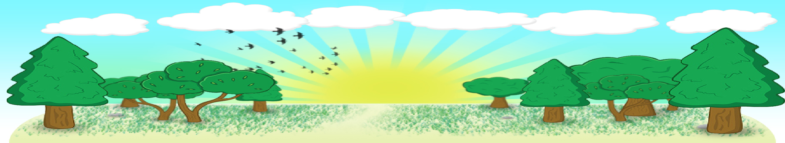
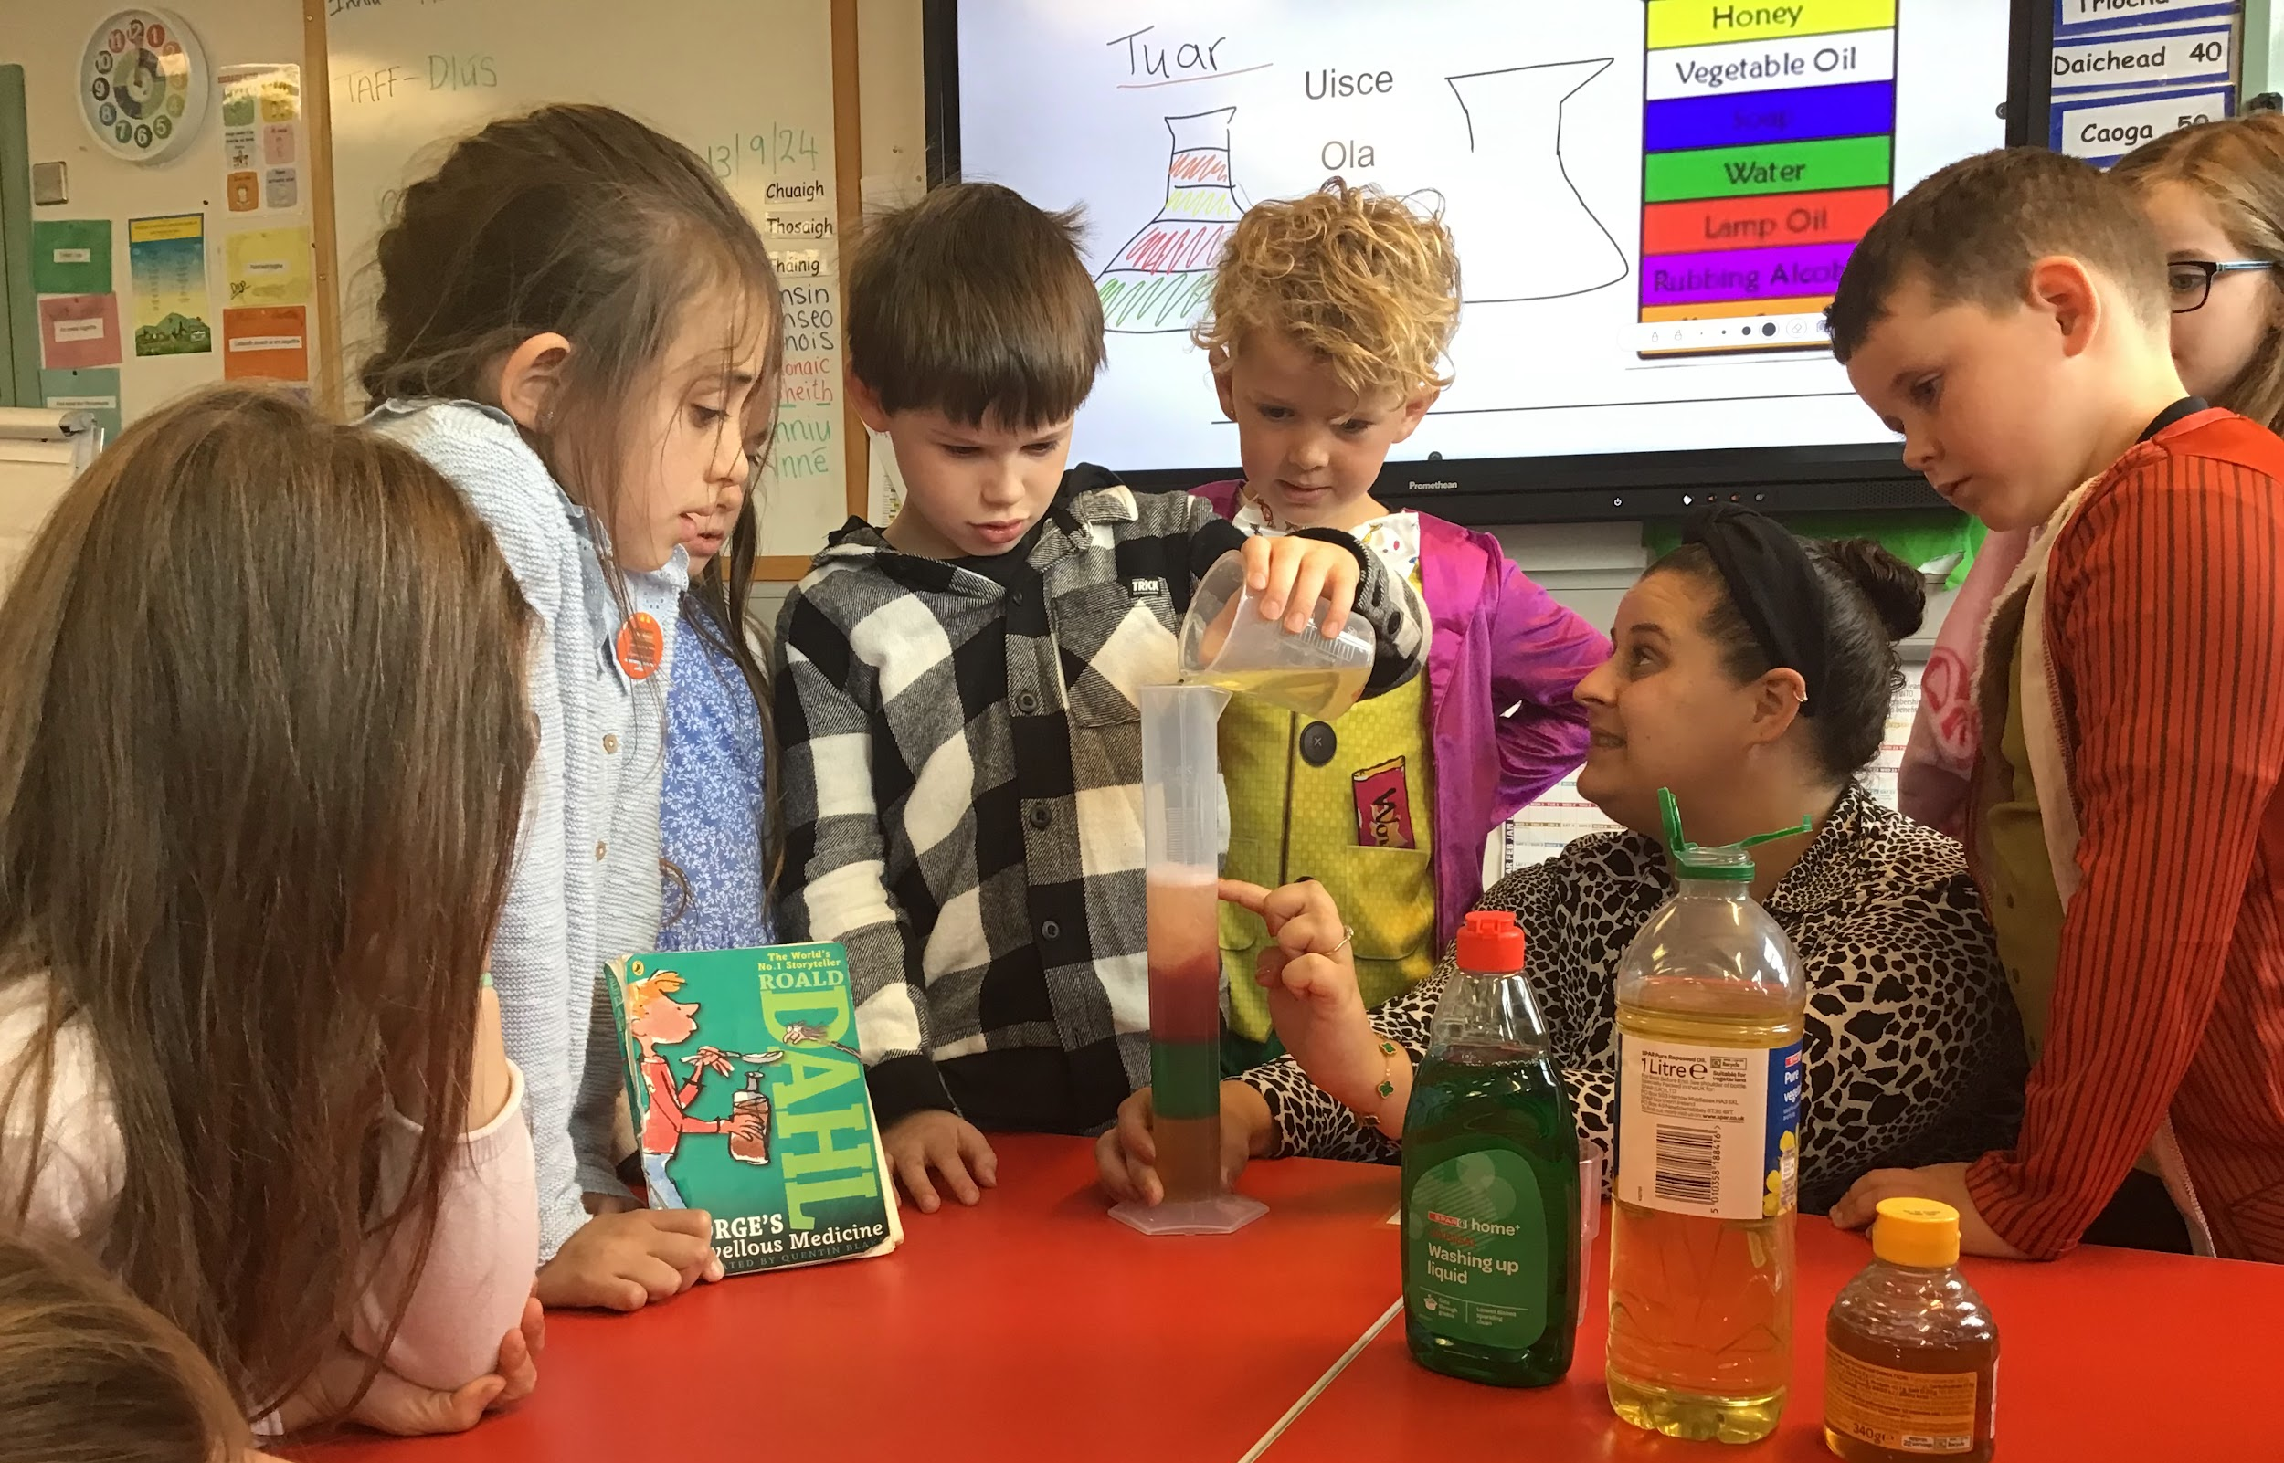
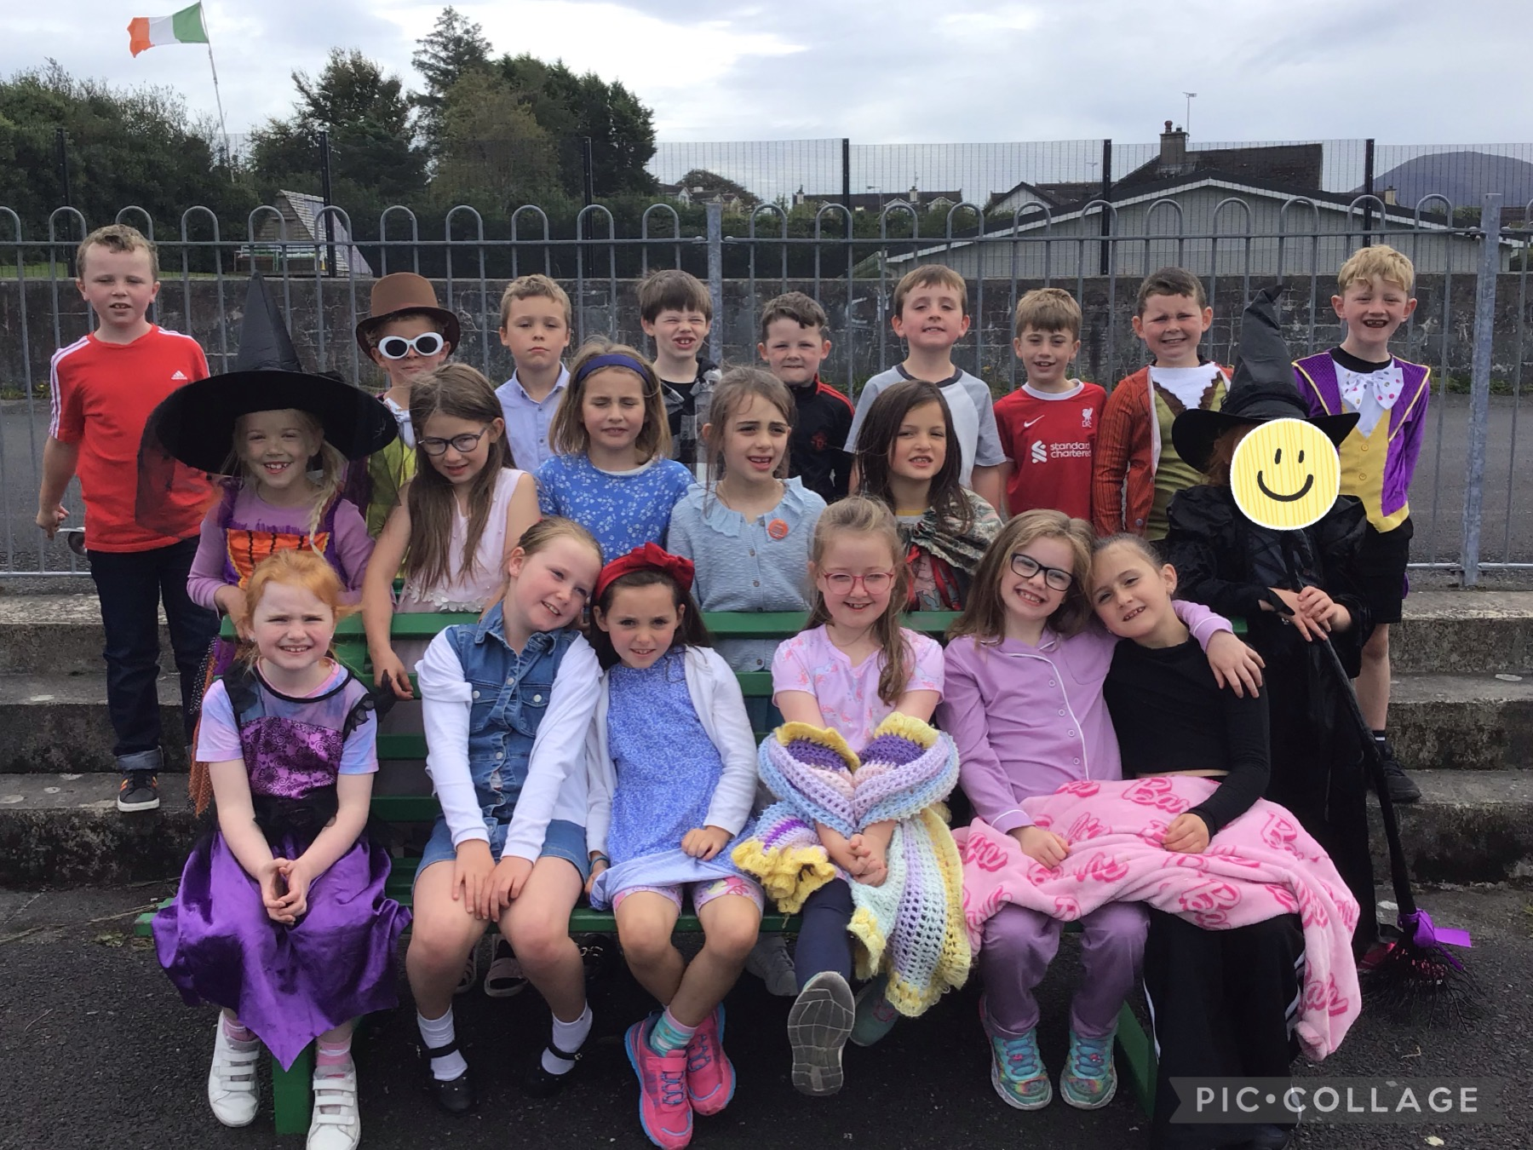
Curaclam - Curriculum
There are three key stages in Primary School:
Foundation Stage (Rang 1 and 2)
Key Stage 1 (Rang 3 and 4)
Key Stage 2 (Rang 5, 6 and 7)
We follow the Northern Ireland Curriculum: Literacy, Numeracy, The World Around Us, The Arts (Art & Design, Music and Drama), P.E., Personal Development and Mutual Understanding (PDMU), Religious Education, ICT.
NSPCC Programme- Keeping safe
Healthy Relationships.
My Body.
Being Safe.
www.nspcc.org.uk

Slide 3
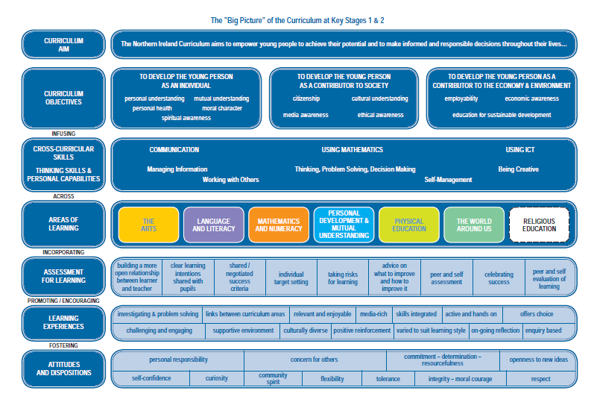

Slide 4
An Lá Scoile The School Day
Class begins at 9.00am. Children are supervised in the clós (playground) from 8.45am.
Parents can avail of our ‘Club Bricfeasta’ which will be available each morning from 8 – 8.45 am and costs £3 daily.
Break time is from 10.30-11.00am.
Lunchtime is from 12.00-1.00pm.
At Bunscoil Bheanna Boirche, we pride ourselves on our healthy eating policy. Our school dinners come from St. Malachy’s Primary School in Castlewellan and are of a high standard. It is recommended that pupils eat fruit, a yoghurt or a small sandwich at break time. Water is always available. Sugary/fizzy drinks are not allowed. Children should have a healthy snack for break time, and we discourage crisps, chocolates and sweets for lunch as these can impact on the children’s behaviour. We do not have any children with a nut allergy at present but we discourage bringing nuts to school. Children are not to share their lunch with friends.
Rang 1 and Rang 2 go home at 2.00pm.
Rang 4 – 7 go home at 3.00pm and at 1.55pm on a Friday to ease traffic congestion.
Rang 3 go home at 2.00pm until Christmas. From January onwards, Rang 3 go home at 3pm
Our after-school club runs from 3 – 4pm daily for R4 pupils and costs £3 daily.

Slide 5
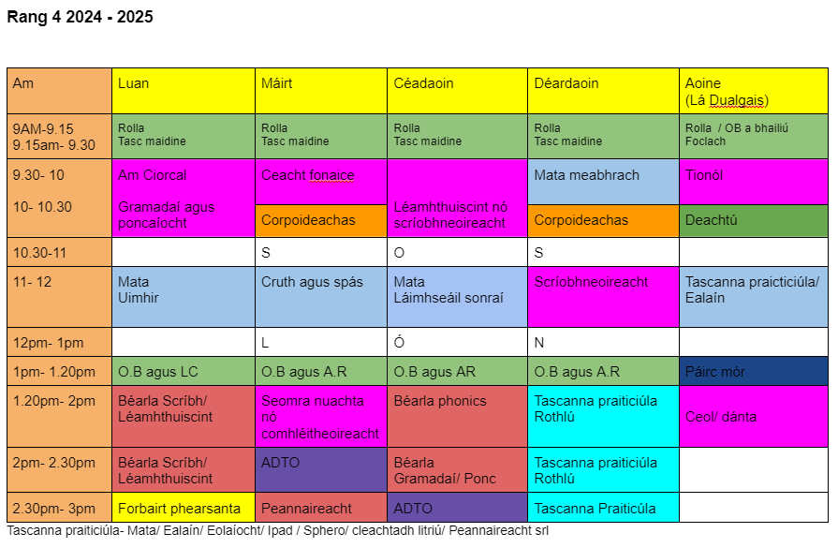
Class Timetable

Slide 6
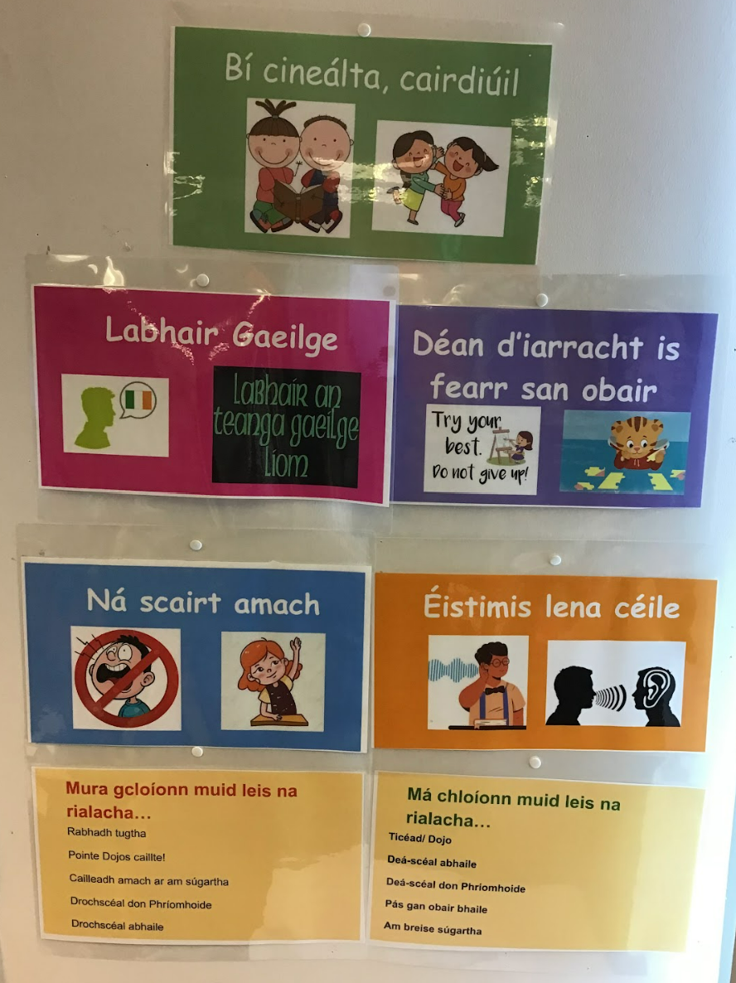
Class rules, Rewards and Sanctions
Class Rules | Class Rewards | Class Sanctions
Speak in Irish Put hands up to speak in class Show respect and kindness to each other and school staff Listen to each other Respect all class and school equipment Always try your hardest and do your best work | Class dojo/reward system Extra play time Note home to say… No Homework Pass Praise/certificates at weekly assembly Special praise from principal Fun afternoon/play park | May result in a loss of dojos Time taken away from play Additional work assigned Note sent home to parents Sent to principal Meeting with parents if behaviours are repeated

Slide 7
Curaclam (ar lean…)
Curriculum (continued…)
A significant proportion of the curriculum in Rang 4 is delivered through topic-based learning. Children learn to problem solve, investigate ideas, create projects, cooperate with others, explain their findings and extend their vocabulary and communication skills through a variety of topics such as ‘The Five Senses’, ‘Habitats’, ’My Local Area’, ‘The Celts’, ‘Seed dispersal’ and ‘Plants’.
We are very well resourced with ICT equipment, with an average of 2 PCs, 1 laptop, an interactive whiteboard and a set of ipads in each classroom.
We are an inter-denominational school, and we follow ‘Living Learning Together’, a pastoral care programme which encourages personal development and mutual understanding of the world and the wider community. We also prepare children for the Catholic sacraments if their parents so wish, following the ‘Beo Go Deo’ Catholic Education Series. We also cater for children who do not wish to participate in R.E.

Slide 8
Litearthacht - Literacy
LITERACY: This will be taught through both English and Irish.
TALKING & LISTENING (Key stage 1)
This is very important. Children must learn to listen when others are talking, as this forms the basis of all other subjects
Encourage your child to listen to you at home, without interrupting and to take turns.
READING (Key stage 1)
Children participate in modelled, shared, paired and guided reading experiences
Home readers are sent home, to be read with parents. These are easier books, to encourage reading. Please make sure all books are returned to school every Friday. Children have access to class library books and we also encourage parents to have their children to join the local library.
Rang 4 will be beginning the Accelerated Reader scheme this year. We have some books in school but more can be accessed through the local library. Your child has unique log in details and can carry out quizzes in school on the books they have read.

Slide 9
Litearthacht - Literacy
PHONICS & SPELLINGS
  Phonics play a very important part in reading and spellings
  Pupils will learn the different sounds and how to combine them to make words
  Pupils focus on a different stage or principle of phonics blending each week
  Phonics comprehension is checked on Fridays through a short dictation test. Dictations will be sent home on Fridays. These dictations are to be signed by a parent or guardian and returned to school on Monday.
WRITING (Key stage 1)
Correct letter formation and cursive writing
Grammar and punctuation
Poetry, drama and songs
Different forms of writing are taught throughout the year eg. recount, instructional, narrative, etc.
Presentation of this work is very important

Slide 10
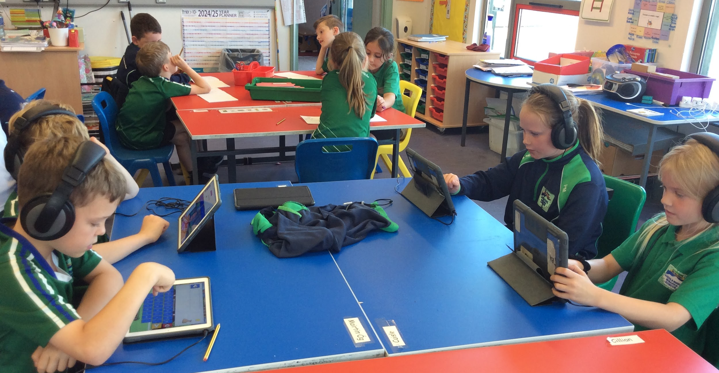
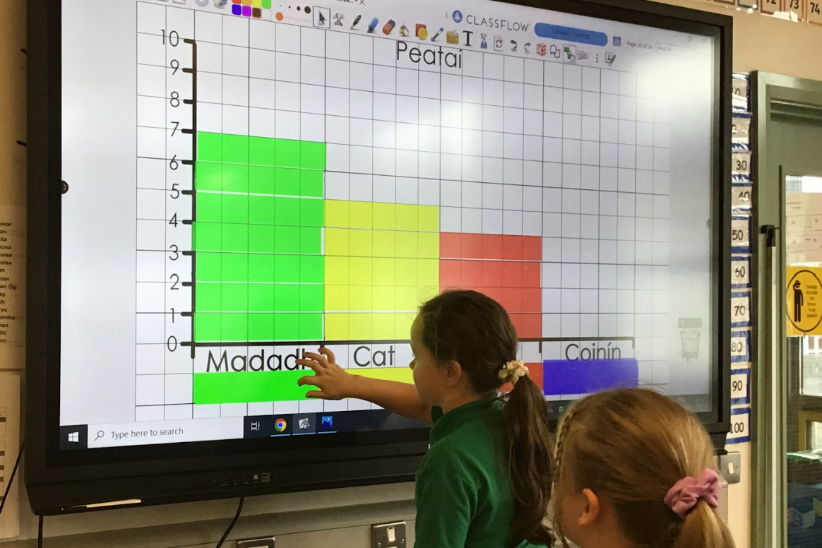
Uimhearthacht / Numeracy
Key stage 1
The month of September is spent on basic revision
Pupils will be introduced to numbers up to 1,000
adding, subtracting, multiplying and dividing
Money – it is helpful to let children handle money at home
Shape and space – 2D and 3D shapes
Measurement – length, weight, capacity, volume and time
Data handling – drawing and interpreting graphs
Mental maths – various games / exercises in class

Slide 11

Measúnú - Assessment
A key question parents often ask is ‘how will my child be assessed?’
Bunscoil Bheanna Boirche assesses pupils in the same ways pupils are assessed in any other primary school in Northern Ireland – Irish or English medium.
In accordance with the NI Curriculum, in Years 1 – 7, teachers must assess your child’s learning.
In Rang 1 & 2, this predominantly takes the form of ongoing individual classroom observations. However, in Rang 1 & 2, pupils are also assessed on a 6 – weekly basis on their key literacy and numeracy skills/targets, albeit in a very informal style, such as structured games and 1:1 activities.
In Rang 3 - 7, pupils undergo standardised tests in the summer term in English, Irish and Maths, which give a more formal indication of progress. These scores are then analysed by the teachers, and used to plan the future teaching and learning of our pupils.
Every year, 1:1 parent-teacher meetings are held to update you on your child’s progress and to suggest areas to help support your child in the home environment.
At the end of each school year, you will receive a written report from your child’s teacher. This will describe your child’s progress in every aspect of the curriculum.

Slide 12
Spóirt
Structured weekly PE lessons are taught, in which teachers follow a movement and athletics scheme which ensures continuity and progression of core skills and competences.
Children also take part in ‘The Daily Mile’ throughout the year.
Rang 6 agus 7 pupils participate in the Cycling Proficiency Programme.
Rang 4 have PE on Tuesday afternoons and Thursday mornings.

Slide 13
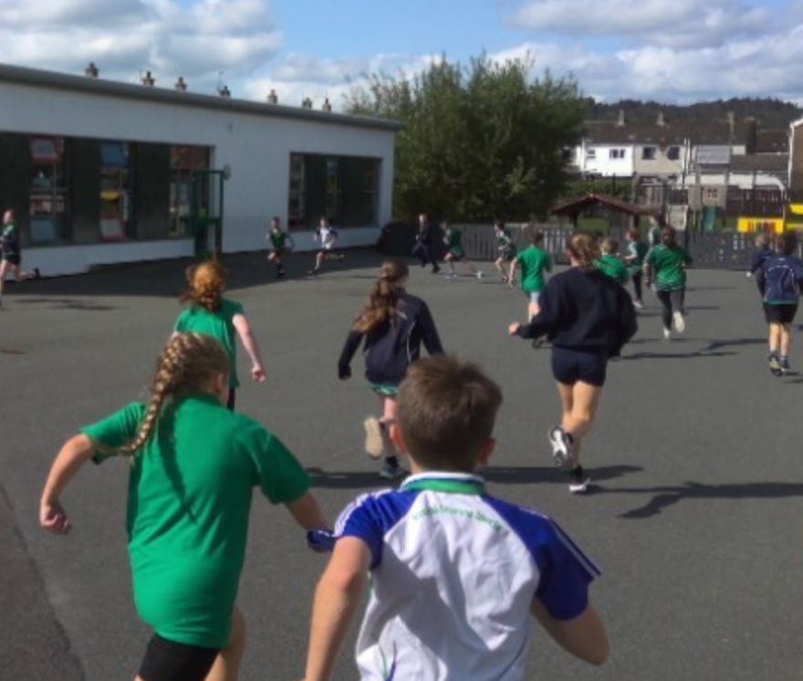
Imeachtaí Seach-churaclaim
Extra-curricular activities
Club Bricfeasta – breakfast club is from 8 – 8.45 am, at a cost of £3 daily
Afterschools Club Mon-Thurs (£3 daily)
R1-3 from 2-3pm daily and R4-R7 from 3-4pm daily
School Council, Eco-School committee
Regular walks and outings
Forest school activities in Bunkers Hill
Inter-school sports and quiz competitions
Summer Scheme - having fun and speaking Irish in July

Slide 14

Éide Scoile /School Uniform
Our uniform consists of:
Navy sweatshirt embroidered with the school logo and motto, grey trousers, skirt or shorts;
Green polo shirt embroidered with the school logo and motto;
Navy school coat (optional);
Black shoes;
Girls may wear navy knee socks, navy tights or white ankle socks;
Girls may wear navy or green gingham dresses in the summer time;
P.E. uniform consists of:
Grey/ navy track bottoms, or grey/navy shorts;
Suitable trainers
Green polo shirt embroidered with the school logo and motto
We have a school jersey which is OPTIONAL
**PLEASE ENSURE ALL ITEMS OF CLOTHING ARE LABELLED CLEARLY!**

Slide 15
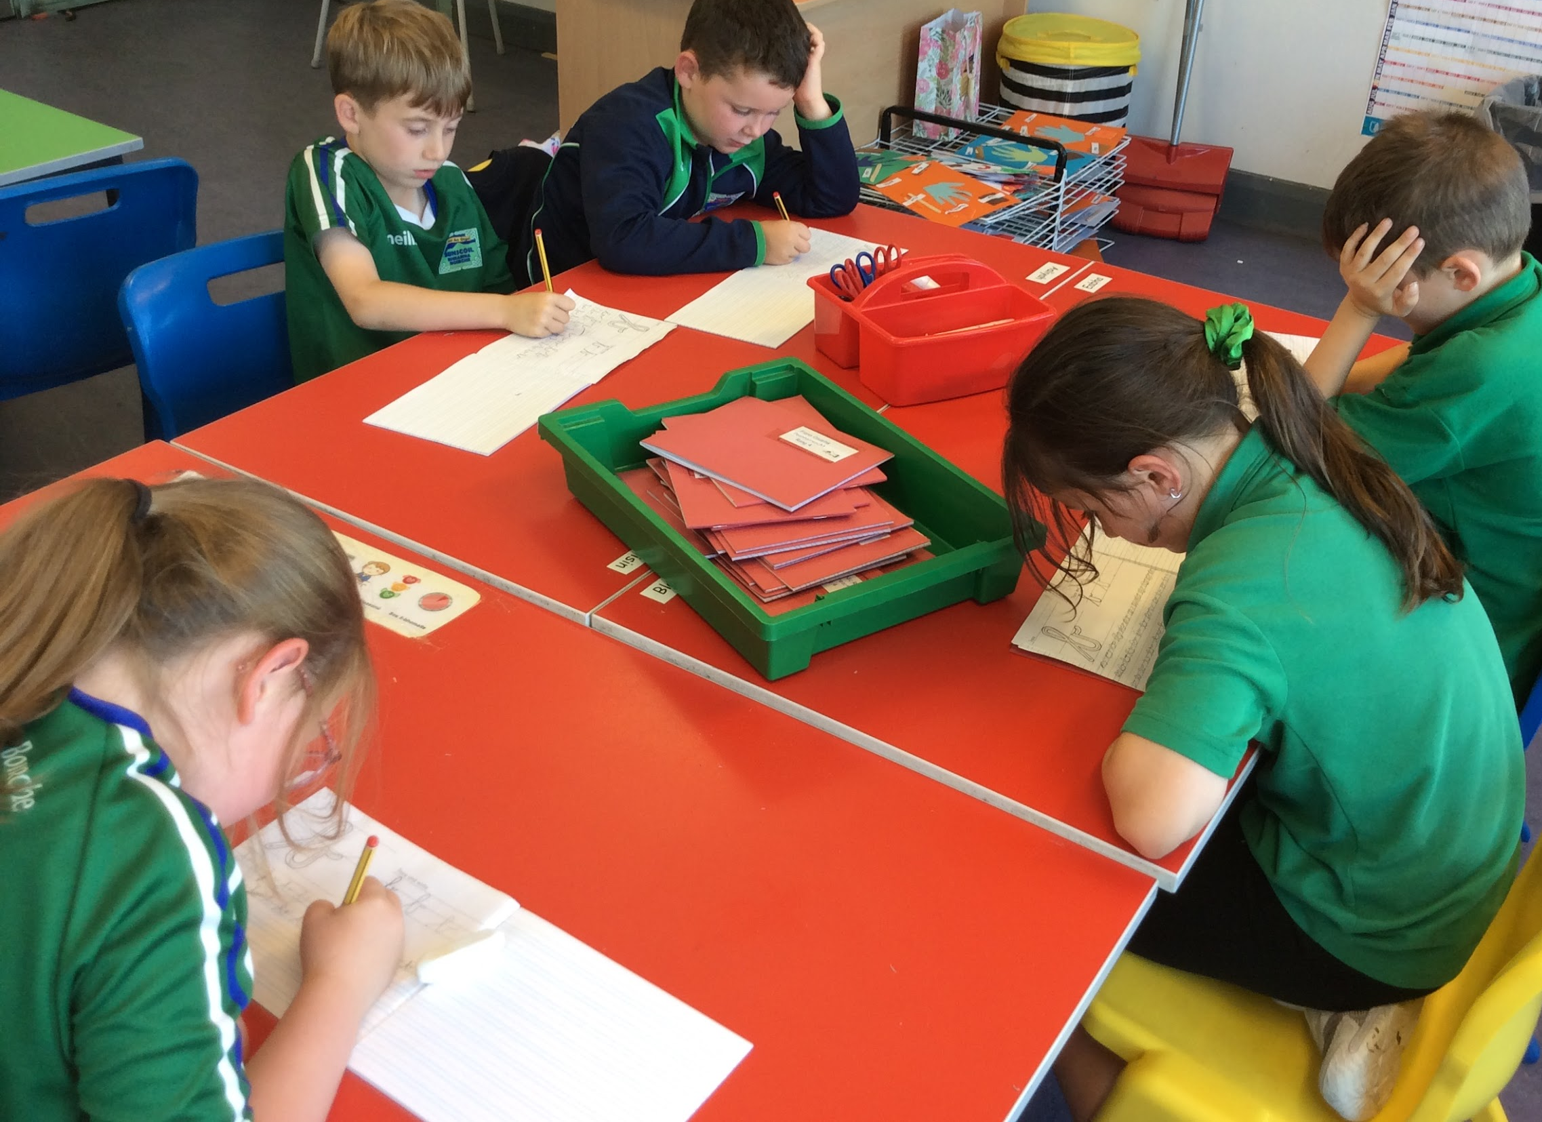
Poncúlacht - Punctuality
Punctuality is extremely important here at Bunscoil Bheanna Boirche. School begins at 9.00am. Register is taken immediately, and anyone who arrives after 9.15am is marked in as late. Anyone who arrives after 9.30am is marked absent for the morning (unless attending an appointment, in which case the teacher should be informed). If attendance falls below 85% the Education Welfare Officer from the Education Authority will investigate absences.

Slide 16
Tuismitheoirí - Parents
Our caring, family ethos at Bunscoil Bheanna Boirche means that we strongly value the importance of parental input in their child’s education, and we enjoy a wonderful level of parental participation and involvement in our school community here at Bunscoil Bheanna Boirche.
We believe that happy children are more effective learners. Parents are always encouraged to discuss any concerns they may have either with the class teacher or with the principal. Our door is always open, and we pride ourselves here at Bunscoil Bheanna Boirche on our open and friendly relationships between teachers and parents.
Every class now have a page of their own on the Bunscoil Bheanna Boirche website. The class teacher will regularly post pictures of what’s going on in the class, so you can stay up to date.
In addition, Cairde BBB has a private Facebook Group where you will find regular photos and updates of what’s been happening at school. Make sure to join!

Slide 17
Parental Role
You are the first educators. For your child to attain all-round development parental support is vital. Here are a few pointers;
- Punctuality in the morning and afternoons.
- Ensure PE gear is worn on appropriate days (Tuesdays & Thursdays) Encourage independence (be responsible for own books, homework)
- Take an interest in their work: ask them about their homework, reading books/novels or about what topics they are studying in school.
- Homework is important - check and sign the Homework diary/ sheet / Reading Record / dictation book to ensure the pupils see its value.
- Encourage a healthy diet and lifestyle. (The school has a healthy break policy in line with the SOS programme – only fruit, vegetables, milk or water is permitted.)
- Instil a sense of respect for others and their property.
- Make sure that pupils remember to bring dinner money or lunch to school, as appropriate in envelopes. Please ensure your child knows what they are having for dinner, especially on days where there is an option. Dinner menu is on the school website. (Dinner costs £2.60 per day)

Slide 18

Aip Scoile
School App
As we are an award winning Eco School, we aim to use as little paper as possible. Therefore, we send out important messages and information via our Schools NI app.
Please ensure that notifications are enabled and that you check the app regularly. We also ask parents to visit our website to keep up to date with what is happening in our school.
Our app is available on both Android and Apple devices. Simply visit our school website where you will be prompted to download the app for free. www.bunscoilbb.com

Slide 19
Cairde
Our Parent Support Group
We have a very active and dedicated Parent Support Group called ‘Cairde’ who regularly arrange activities such as fundraiser events and fun days.
Their fundraising goes towards subsidising buses for school trips to reduce the cost for parents, purchasing class iPads, class reading books, developing our outdoor play area etc.
They are an integral part of Bunscoil Bheanna Boirche and are always keen for new members to join in and help in whatever small way they can. Keep up to date on the Facebook Group or speak to one of the parent members if you think you could spare a few hours a month or have any great ideas to share.

Slide 20

Polasaithe Scoile
School Policies
All families receive a summary of our Child Protection Policy on beginning Naíscoil and Rang 1.
All of our school policies are available to view on the school website www.bunscoilbb.com or from the school office by appointment with the principal.

Slide 21
Ag cuidiú le do pháiste
Supporting your child
A great way to help your child is to encourage them to develop their own independence through taking responsibility for looking after their coats, jumpers, etc. (please label these), remembering to take home their homework folder and to bring it back to school.
As previously mentioned, whilst having Irish in the home is not a prerequisite to attend Bunscoil Bheanna Boirche, parents are strongly encouraged to avail of the many great Irish Language classes that are available in the area in order to be able to support their child’s learning.
All homeworks are sent home on a Monday. We do not mind if for example, Monday’s homework isn’t complete on Monday night, as long as all tasks are completed and returned to school by Friday. Spellings and Homework page will be posted on our Google Classroom page every Monday along with a recording of múinteoir Sinéad reading out the words in both Irish and English. Encourage your child to listen to these recordings as they practise.
Remember, homework is a REVISION of work/topics covered in class, so pupils will be able to tell YOU what they are meant to do, and will take great joy in doing so!

Slide 22
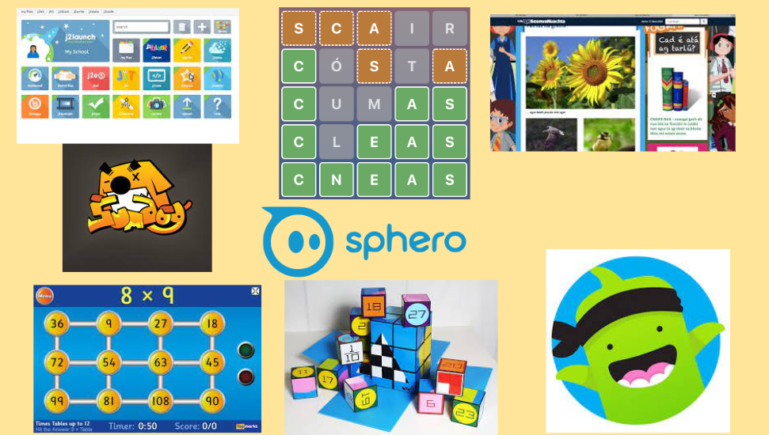
Ag cuidiú le do pháiste
Supporting your child
There are some fantastic websites to assist parents with Irish and support their child, such as: www.abair.ie www.tearma.ie www.foclóir.ie
https://foghlaim.tg4.ie/ www.irishforparents.ie
We also recommend using the following apps if you have a tablet device at home:
Cód na Gaeilge, Sumdog, Cúla 4, Fuaim Ú, iMovie, Beebot,
Scratch Jr, Book Creator, Green Screen

Slide 23

Sláinte do pháiste
Your child’s health and hygiene
Please inform staff of any health and medical needs your child has including any food allergies, asthma etc
If your child becomes ill while in school, we will contact the number you have provided on your data collection form. Please make sure this is always up to date - inform us of any changes throughout the year.
Please be aware that staff cannot administer medicine. If your child needs medication, feel free to come to the school to give it when needed.
Please inform Sinéad or Ciarán of anything that may affect your child’s behaviour such as bereavement, sudden shock, separation, etc. All information will be treated as strictly confidential.

